Slide 1
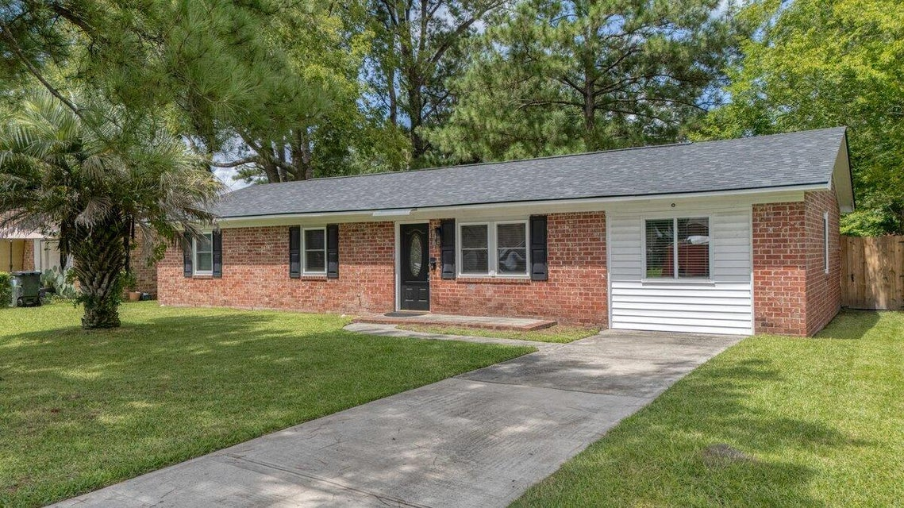
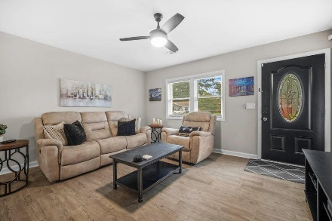
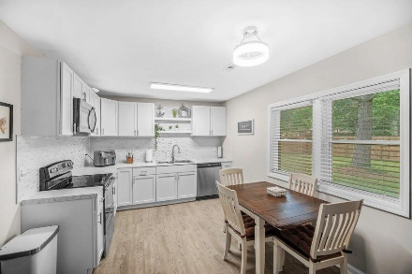
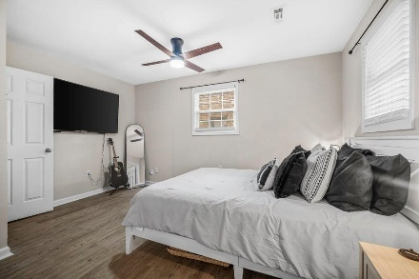
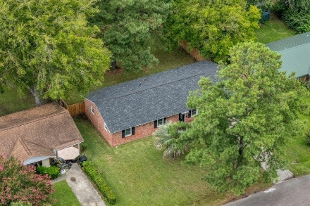

212 Gardenia Street Robynwyn | Summerville, SC 29483 | MLS# 25022467 | $299,990
Darrell Creek Elevated Home With Elevator & Salt Pool
Fully Remodeled Ranch in the Heart of Summerville
Just Listed Under $300,000!!!
Co-hosting with Lisa Wood from Crown Home Mortgage
Offering $2500
Lender Credit
Completely turnkey and priced to sell, upgrades include:
Full Remodel 3 years ago: new flooring, windows, paint, kitchen including new refrigerator, 2 bathrooms Roof & Water Heater replaced 3 years ago
6 ft privacy fence 1 year ago. New HVAC 6 months ago!!!
Step into this turn-key beauty at 212 Gardenia St in the heart of Summerville, SC! This fully remodeled brick ranch is the definition of move-in ready—every detail inside and out has been upgraded. The HVAC was just replaced this year, along with a custom privacy fence. In 2022, the roof, water heater, plumbing, electrical, flooring, windows, paint, kitchen, and both bathrooms were all updated, ensuring peace of mind for years to come. The owner's meticulous care is evident the moment you enter the bright, open living room, which flows seamlessly into the large eat-in kitchen. Featuring new shelving, cabinets, tiled backsplash, and a refrigerator (only 2.5 years old, and conveys), the kitchen is designed to impress. The HUGE bonus room is the showstopper, perfect as a home gym, man cave, dining area, or second living room. Down the hall, you'll find two well-appointed guest bedrooms with a beautifully renovated shared bath. The spacious primary suite is a true retreat, complete with a large walk-in closet and spa-like en suite bath, featuring an updated vanity with white cabinetry, separate toilet area, and a luxurious 5-foot tiled shower.
The nearly quarter-acre lot is perfectly manicured and fully fenced with a 6-foot privacy fence, ideal for pets, kids, or simply grilling and relaxing in your own private oasis.
All of this comes with an unbeatable location: just 5 minutes from Historic Downtown Summerville and the thriving Nexton community, just close your eyes and pick where you want to eat and shop! Plus this home is zoned for the highly sought-after DD2 School District. There's nothing this home doesn't offer, pack your bags and move right in! Schedule your private showing today, because 212 Gardenia Street won't last long!
House Tour
Elissa Campbell
843-853-1433 | elissa.campbell@agentownedrealty.com
AgentOwned Realty Preferred Group | 824 Johnnie Dodds Blvd | Mt Pleasant, SC 29464

