Slide 1
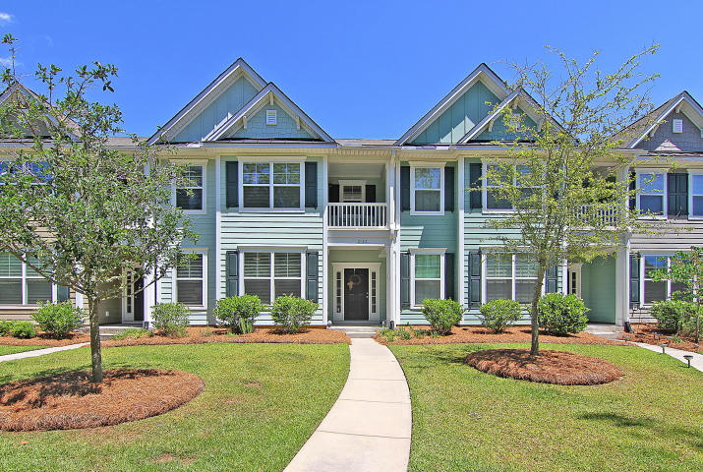

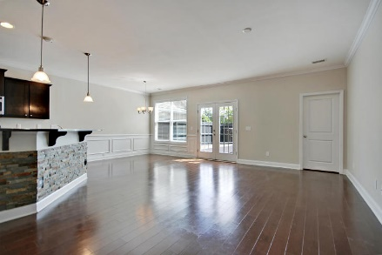
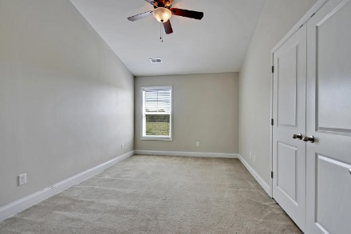
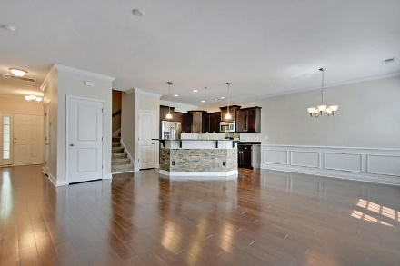
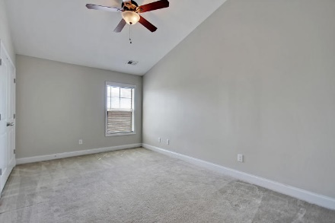
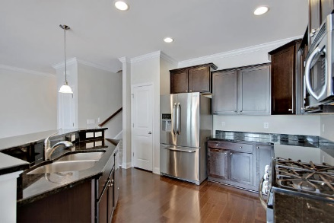
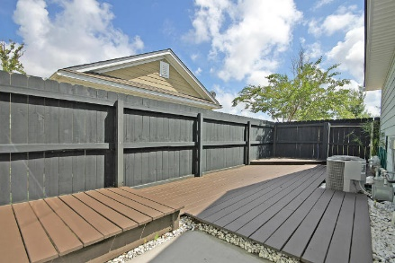
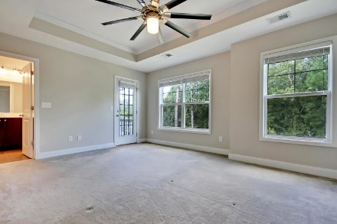
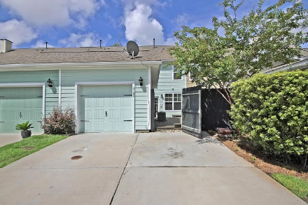
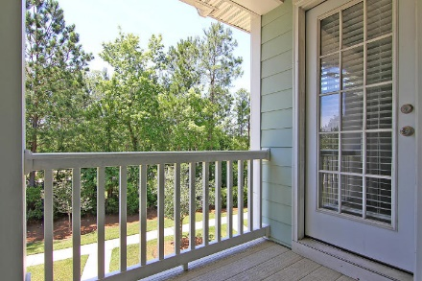
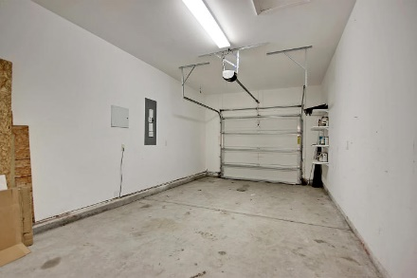

Parkshore Marshfront
Park West Paradise
2132 Promenade Ct ~ Mt Pleasant ~ MLS# 17023047 ~ $316,000
PRICED BELOW MARKET!
Park West paradise presents an amazing townhouse that’s spacious and has a great outdoor oasis. Completely repainted and easy to show! The heart of this home is the living room, dining area and granite kitchen with gorgeous hardwood floors, a breakfast bar, SS appliances and a gas range. Wainscoting in the dining area and a beautiful slate siding on the breakfast bar are just a few of the elegant touches in this home.
The first level boasts a giant office with French doors which could serve as any other flex space you may need. The owner’s retreat upstairs features a tray ceiling, multiple closets, an en-suite full bath with dual vanity and access to a private balcony. The 2nd and 3rd bedrooms are generously sized!
Enjoy the outdoors on the multi-level deck and hangout area which is perfect for outdoor entertaining!
Call or email for details: (864) 934-5447 or Missy@MattOneillTeam.com

