Slide 1
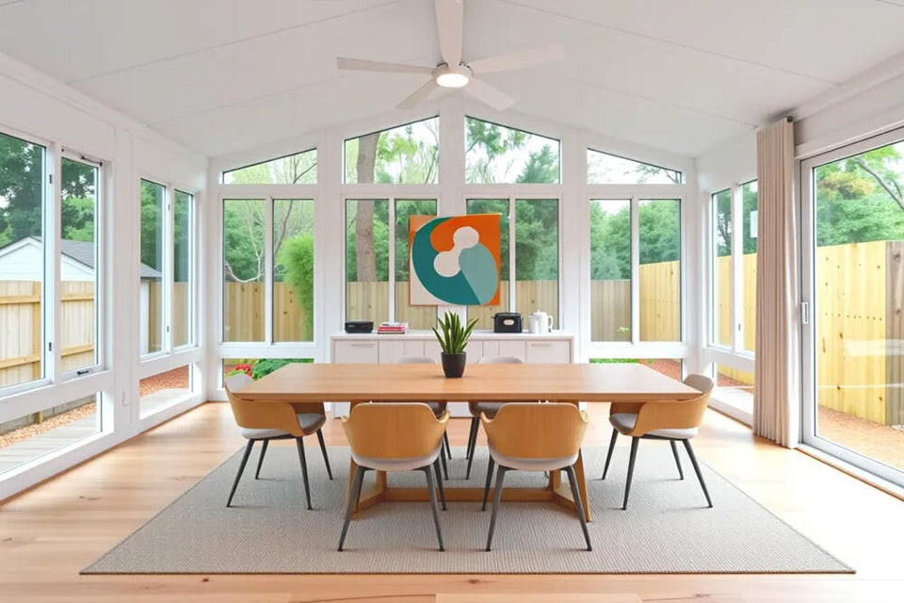
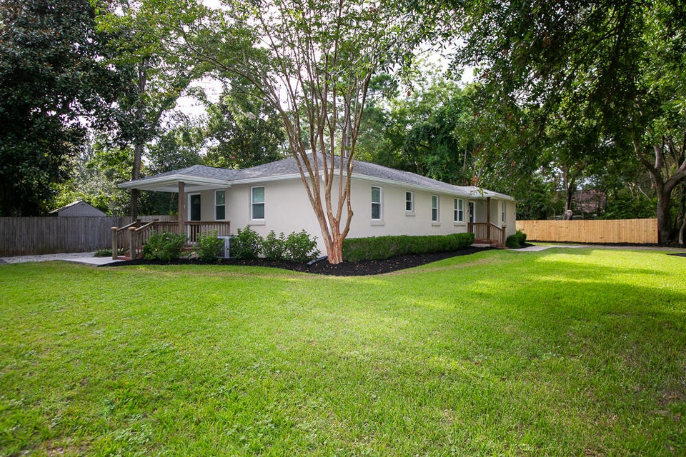
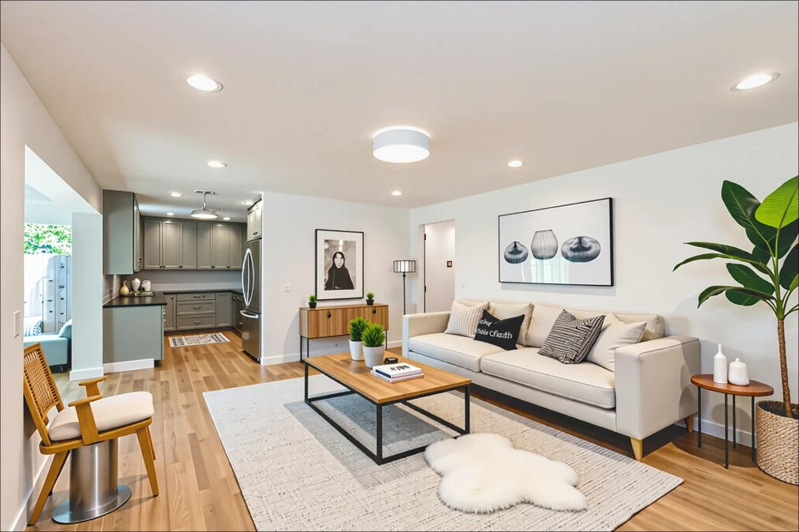
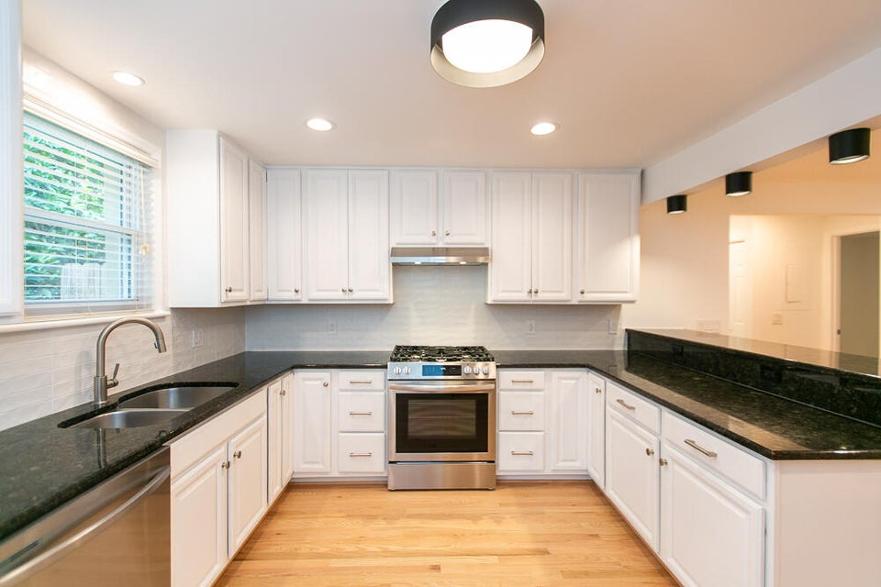
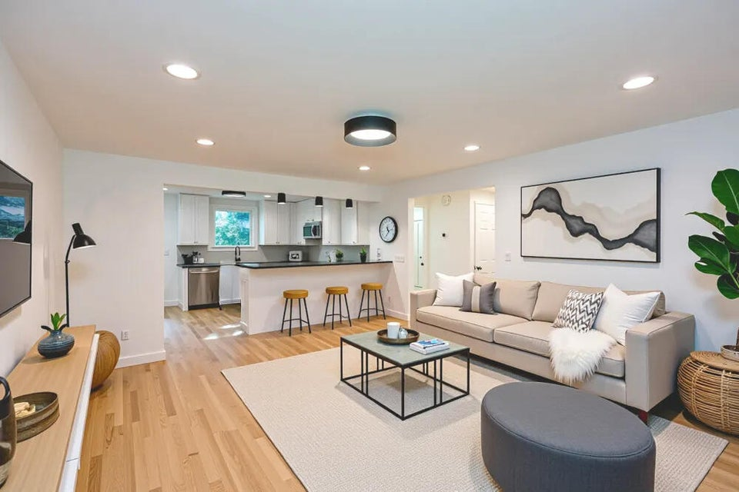

Renovated Duplex - Riverland Terrace
2136 Parkway Drive A&B
Riverland Terrace | Charleston, SC 29412
MLS# 25022102 | $1,270,000
On a corner lot deep within the highly sought after Riverland Terrace neighborhood, this freshly renovated duplex includes two units, each with two bedrooms/ two bathrooms. A newly formed horizontal property regime has been created to offer each unit individually as ''condos'' (see MLS #'s: 25022088 & 25022089). Prior to filing the regime, the entire parcel (both units) may be purchased, fee simple. Prior to updates, each unit leased, long-term, unfurnished for $3,000/mo. ($6,000/mo. in total). This property is subject to unincorporated Charleston county jurisdiction, which has implications for permissible short term rental use. Property is currently vacant with updated kitchens, baths, lighting, appliances and finishes; offering turn-key occupancy, income or both. Come and see!
Marion Jackson
Broker-in-Charge/Owner
Mobile - (843) 442-4404
mj@charlestonpropertybrokers.com
Charleston Property Brokers, LLC | 2182 Edisto Avenue | Charleston, SC 29412

