Slide 1
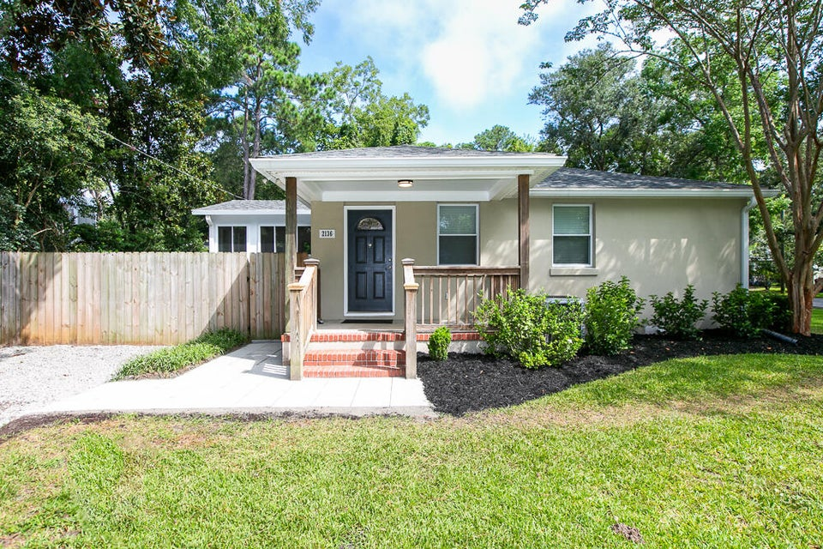
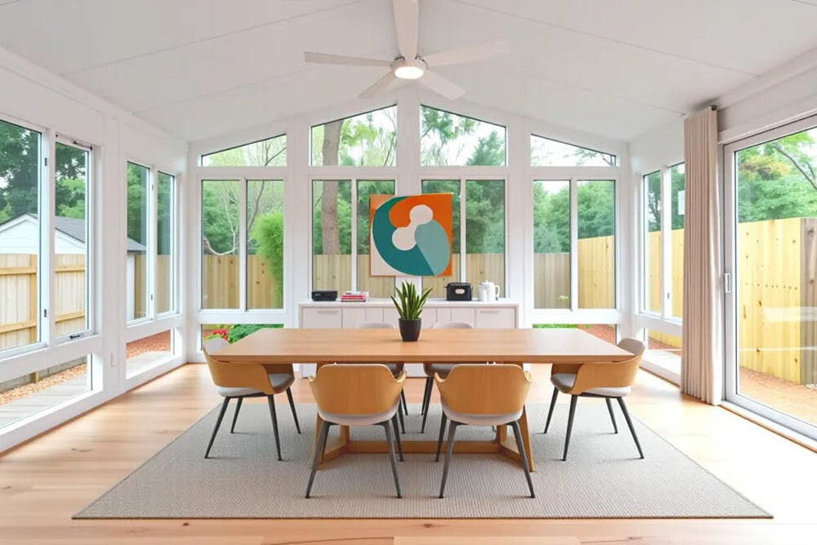
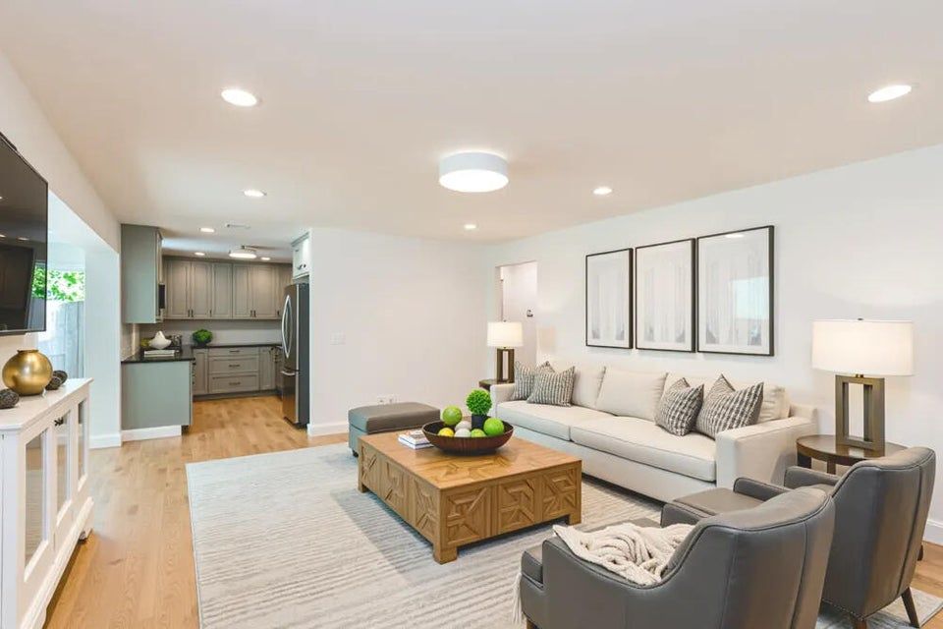
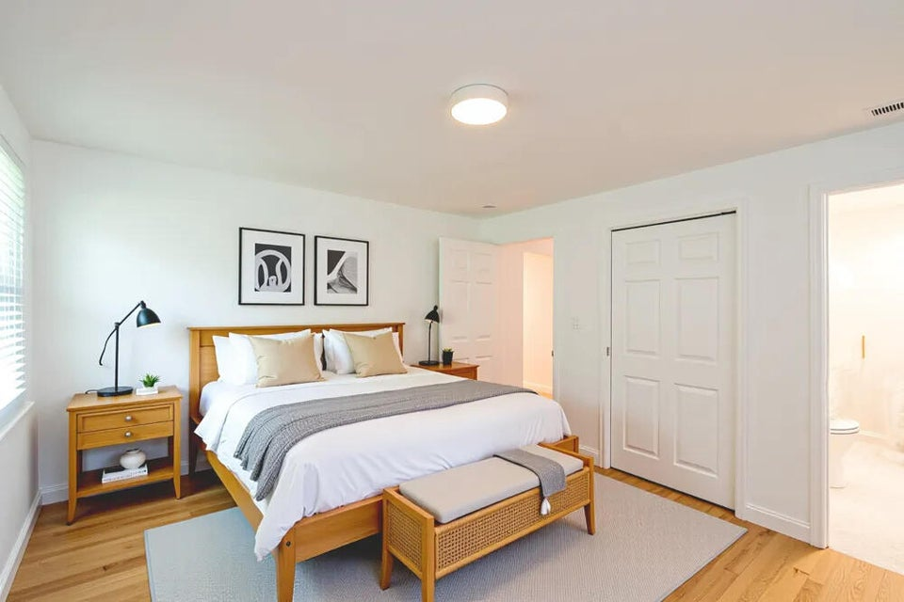
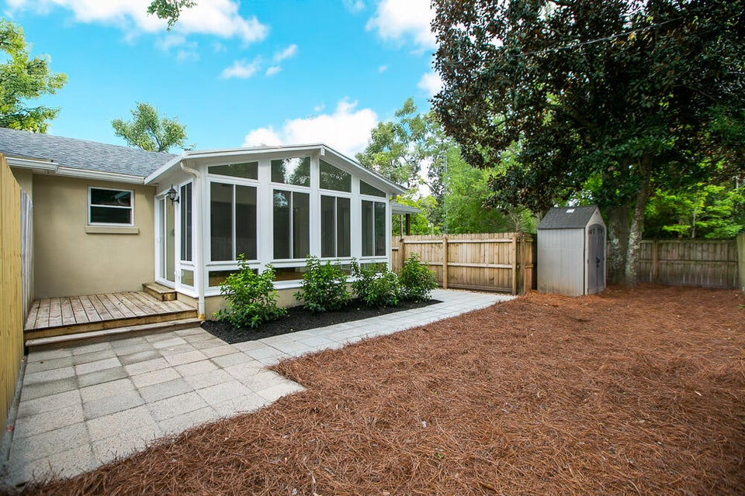

Renovated 2/2 in Riverland Terrace
2136 Parkway Drive
Riverland Terrace | Charleston, SC 29412 | MLS# 25022089 | $635,000
This beautifully renovated 2-bedroom, 2-bath condominium is part of an intimate, newly established two-unit property. Situated on a quiet corner lot in the coveted Riverland Terrace neighborhood, each unit enjoys its own street-facing entrance for added privacy. This Parkway Dr.-facing unit features a charming front porch, a rear deck, and a sunroom that overlooks your own private, fenced backyard. Inside, you'll find an updated kitchen with granite countertops, new appliances, and updated fixtures, as well as renovated bathrooms, hardwood floors throughout, and updated lighting, all exuding a Southern cottage aesthetic. A stacked washer/dryer, outdoor storage shed, and thoughtful finishes complete the home. Just minutes from downtown Charleston and Folly Beach, Riverland Terrace is known for its tree-lined streets, beautiful parks, local bars and restaurants, public boat ramp, and the historic Terrace Theater.
Schedule a visit today and see if this is your perfect Lowcountry cottage retreat.
Marion Jackson
Broker-in-Charge/Owner
Mobile - (843) 442-4404
mj@charlestonpropertybrokers.com
Charleston Property Brokers, LLC | 2182 Edisto Avenue | Charleston, SC 29412

