Slide 1
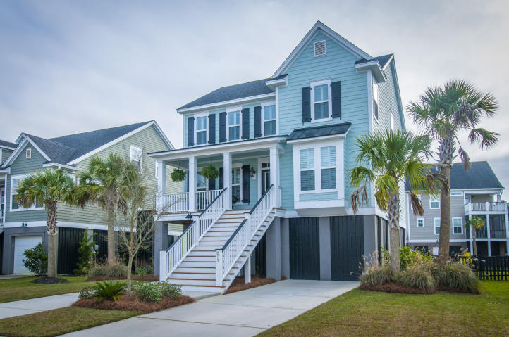
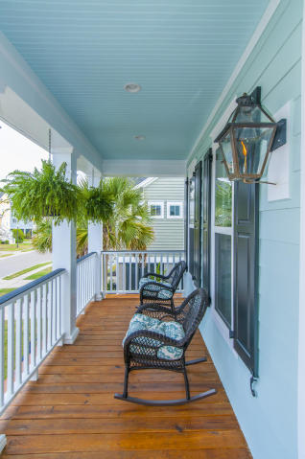
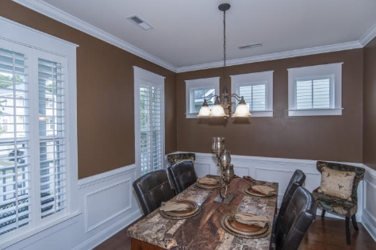
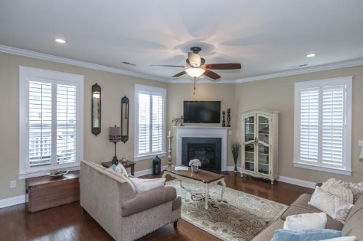
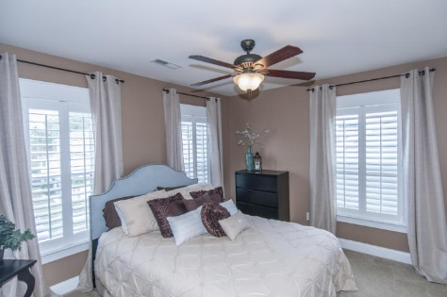
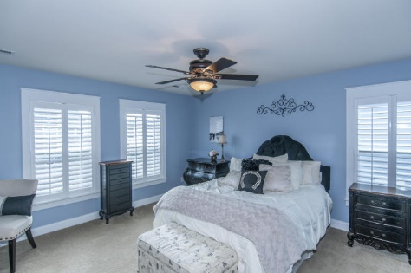
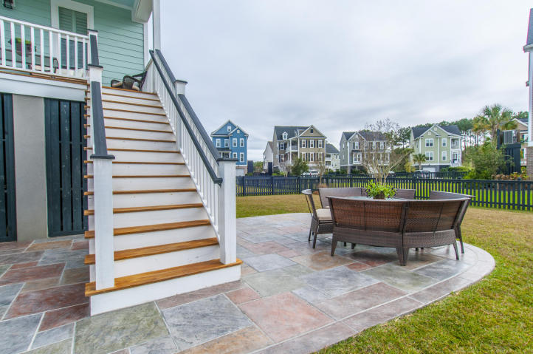
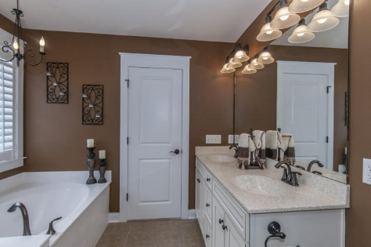
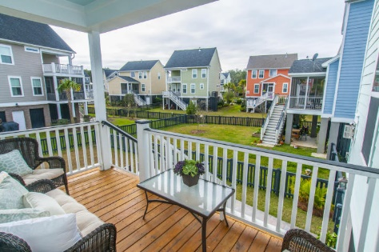


213 Clouter Creek Dr· Shellring at St Thomas Island
Beautiful elevated home in move in ready condition
JUST REDUCED!!
You will be welcomed with a relaxing front porch with gas lantern. Wonderful open floor plan with hardwood floors and many upgrades. The gourmet kitchen features granite counter tops, stainless appliances, gas range, plus eat-in dining. All opening to a spacious family room with fireplace and plantation shutters. Formal dinning for those special occasions plus an office study. Relax on the back porch or the designer patio with a large fenced in yard. The oversized master suite and bath feature dual vanities, tub, shower and large walk-in closet. There are two addition good size bedroom. Shellring amenities include a neighborhood pool and play area. Conveniently located to shopping, dining, beaches and Boeing.
Asking $418,500
MLS# 16000737
1,946 SqFt
3 Bed/2½ Baths
Shows like a model home
Don Dawson
843-514-0452
ddawson@carolinaone.com
Carolina One Real Estate • 2713 Highway 17 North • Mount Pleasant, SC 29466
www.TeamDawsonSC.com

