Slide 1
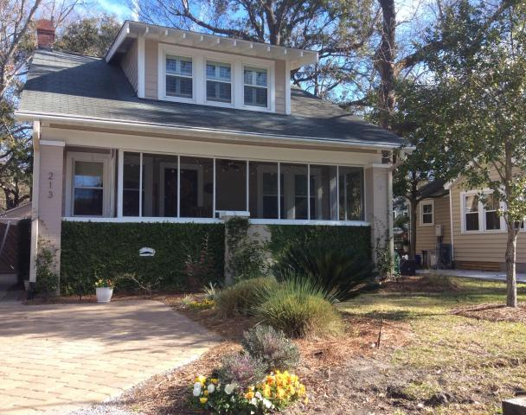
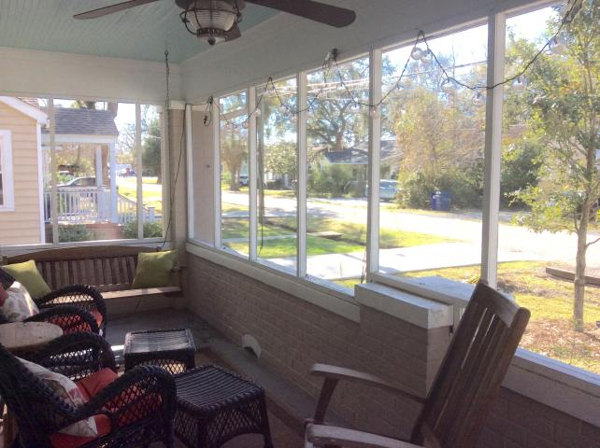
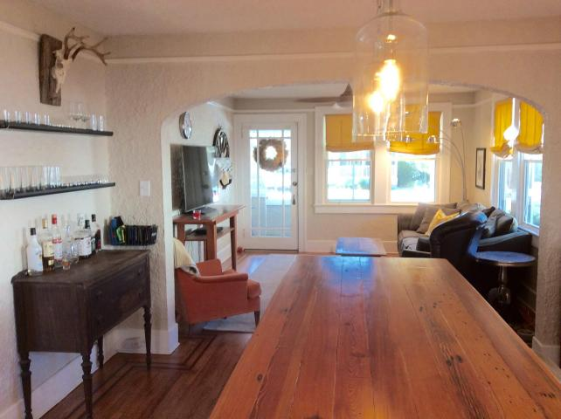
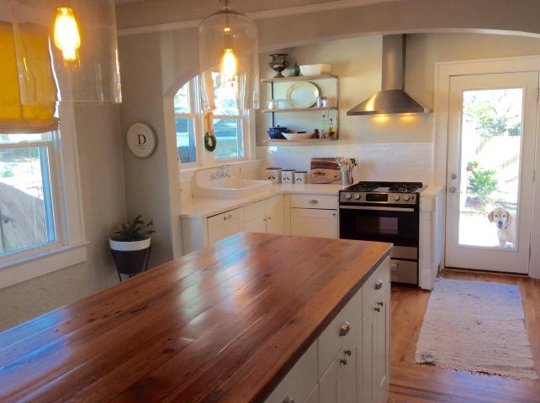
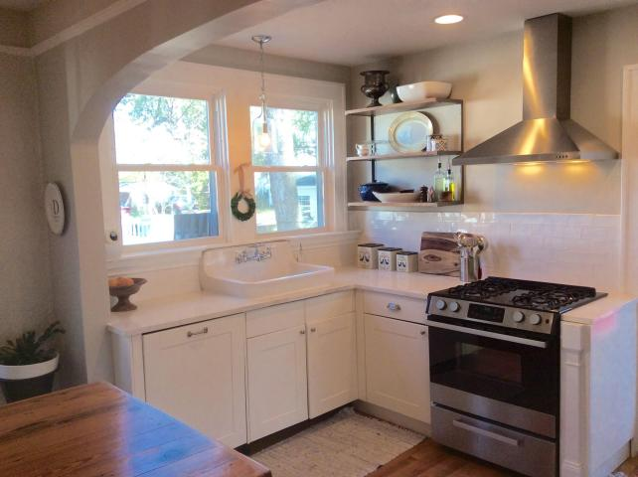
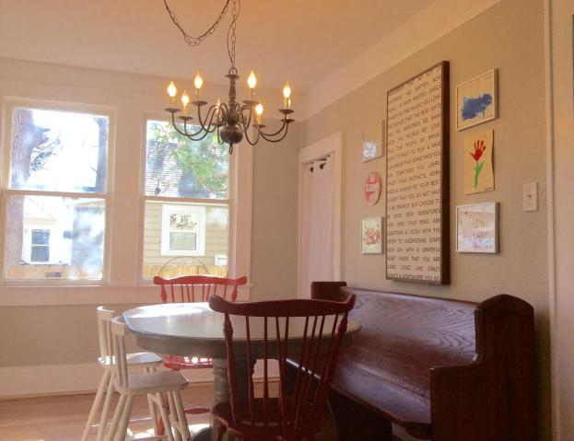
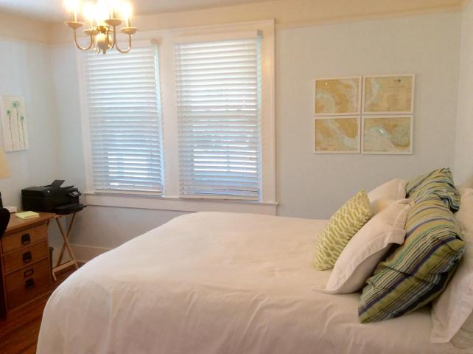
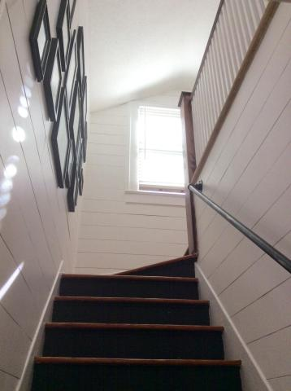
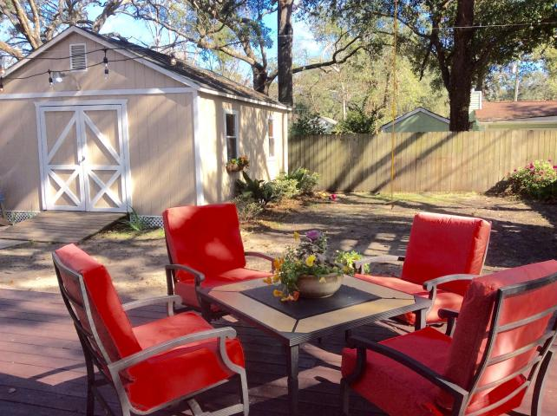
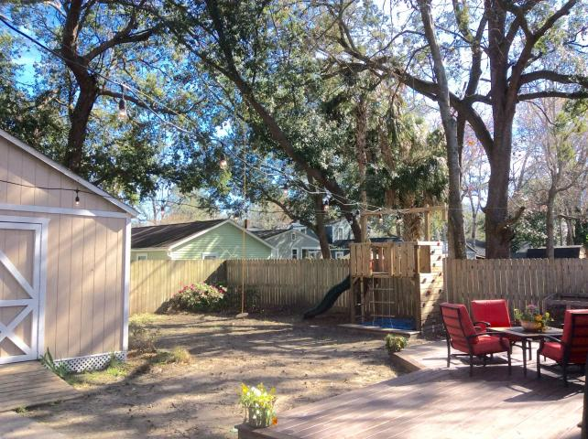
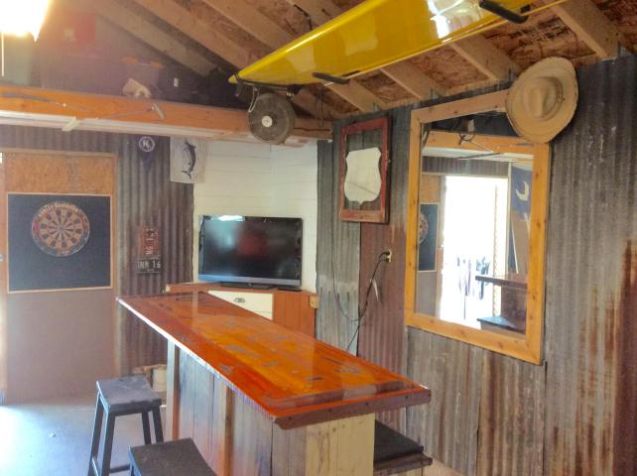


Avondale Charmer!
213 Hickory Street
Ashley Forest ~ Charleston ~ MLS# 17004012 ~ $465,000
Fantastic craftsman bungalow only two short blocks from all the restaurants and shops Avondale has to offer! The sweet curb appeal of this home will capture your heart right from the start! Beautifully landscaped, the yard boasts a new irrigation system and lush zoysia sod. This sunny home boasts hardwood floors throughout the entire house. The open downstairs floor plan is great for entertaining. The kitchen was recently updated to include new soft close cabinets, cambria countertops and a custom built island topped with stunning 100yr old reclaimed heart pine with even more storage and seating. A bedroom and full bath complete the main floor. Chic shiplap siding covers the stairwell and hallways. Upstairs are two additional bedrooms, another bathroom and a flex room off the master which would make a great home office or den or could easily be converted into a very nice master bath. With ample outdoor living spaces off the front (full front screed porch) and back of the house (oversized back deck) and a huge shed/man cave there is plenty of room to spread out. Man cave boasts a built in bar and electricity for your tv and frig. Custom built work benches offer great storage and space for those who like to tinker. HVAC new 2013, roof and electrical 2009. New windows in last 5 years. Easy to see!
Keller Williams Realty
Charleston West Ashley
1180 Sam Rittenberg Ste 105
Charleston, SC 29407
Amy Zonarich
Realtor
(843) 534-3523
amy@amyzonarich.com
www.liveandlovecharleston.com

