Slide 1
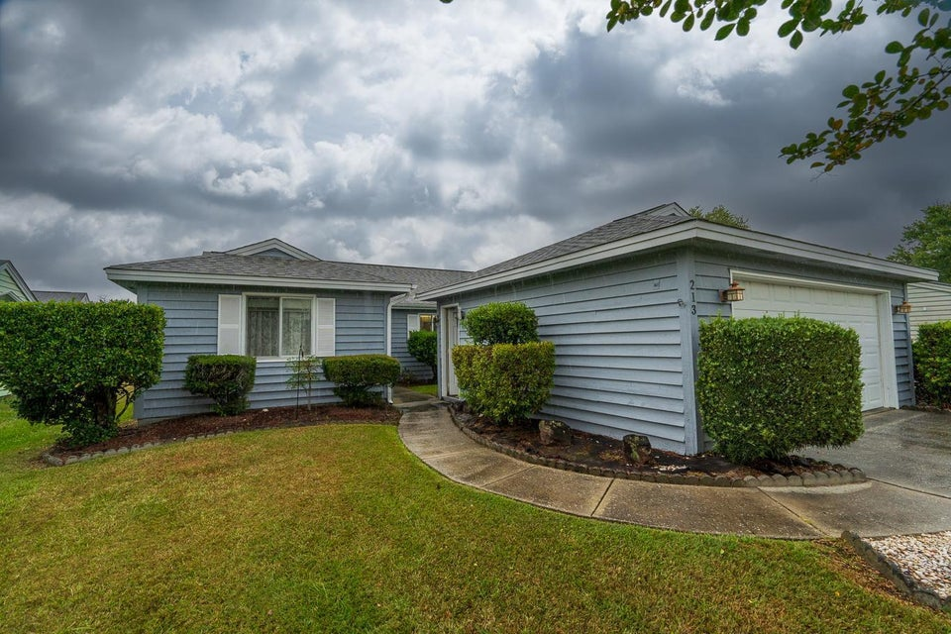

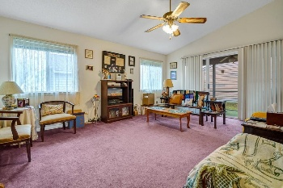
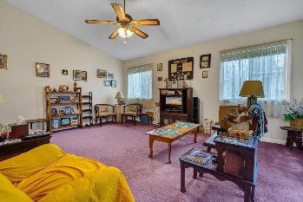
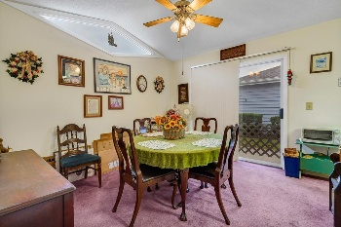
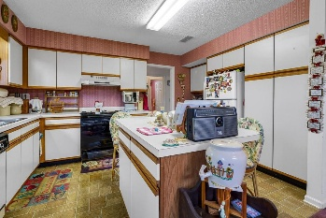
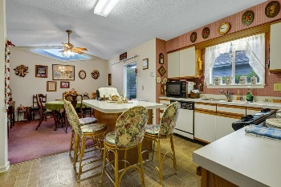

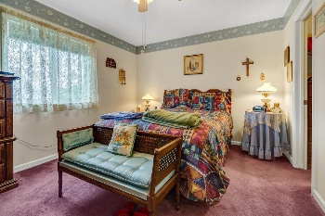
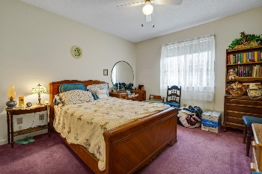
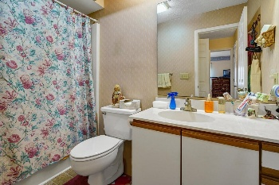
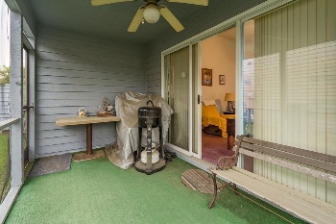
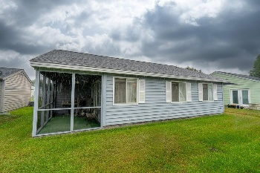
Joe Stalvey
843-460-2850
josephstalvey@gmail.com
Motivated Seller
Make An Offer
213 Birkdale Lane
Myrtle Beach, SC 29588 | MLS# 24018545 | $259,900
Welcome to this lovely 2-bedroom, 2-bath home, the best of "Walk-In" type homes (no steps). Nestled in the subdivision of Green Springs Patio Homes in Island Green, this nearly 1200 square foot home offers a world of potential for those looking for a retirement retreat or a first-time homebuyer. With its newer roof and HVAC system, and a new water heater to be installed, these main concerns are complete. The home is accompanied by a detached two car garage. Close enough for all that Myrtle Beach has to offer, yet far enough away that when you're home you can relax and be HOME. Make your appointment now to see this great home. All information deemed to be correct. Please verify all information that is deemed important to Buyer. Home being sold "As-Is"
The Charleston Real Estate Café | 672 Marina Dr Suite 110 | Charleston, SC 29492

