Slide 1
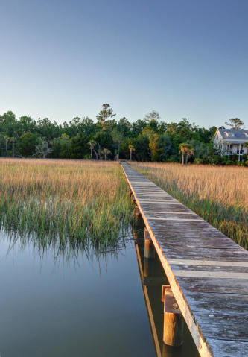
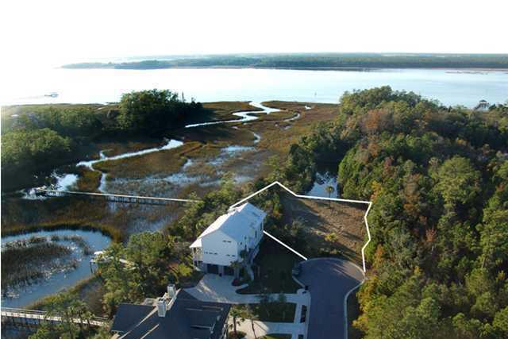
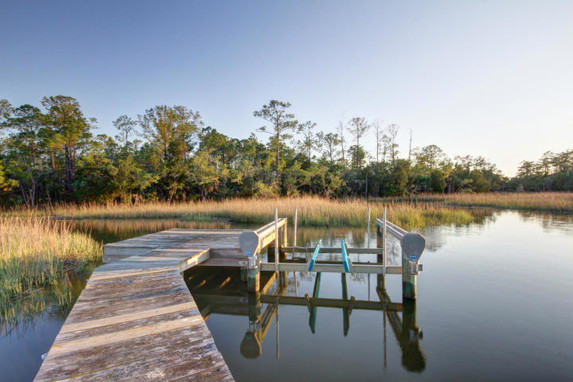
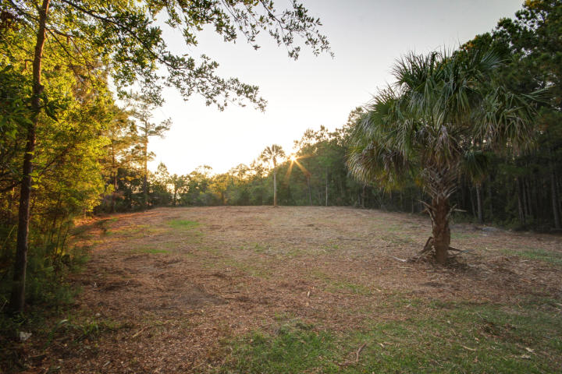
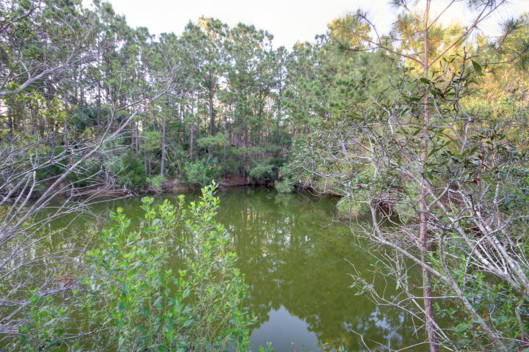
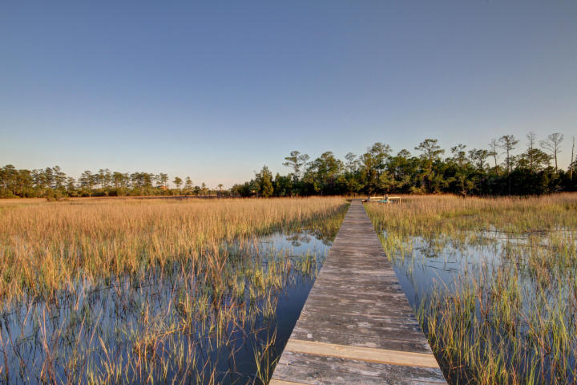
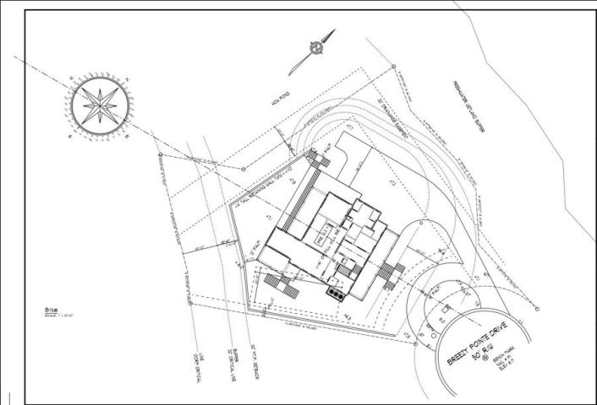
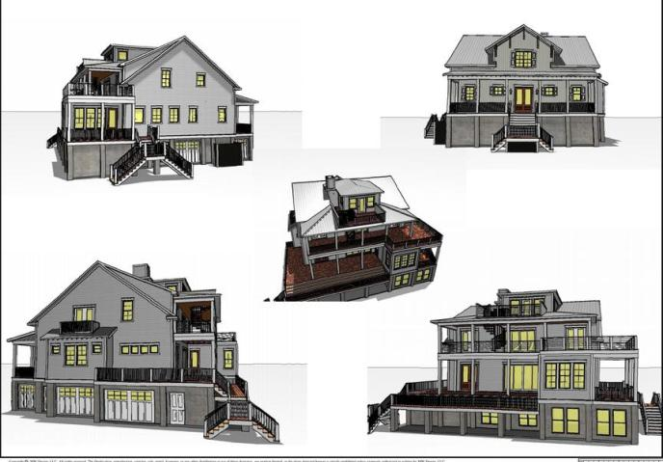

This Beautiful Home Is Move In Ready!
2140 Breezy Point Drive
The Pointe @ Rivertowne Country Club
Build Your Dream Home in Rivertowne on this Fantastic and Secluded RIVER FRONT lot with DOCK and boat lift in place. Your only neighbor is in the front left of the cul-de-sac. The dock leads to a large tidal creek quickly running into the Wando River. Sellers have done the homework for you with house plans ready to build up to a 5000 SF elevated home with views of the Marsh and River.
This lot is private on a two property cul-de-sac in Rivertowne Country Club. Sunset views of the river and marsh are yours every evening on this beautiful, west-facing lot. The lot is surrounded by tidal creeks, endless marshes, and wetlands. At the rear of the lot is a large private pond. To your right is a large tract of protected wetlands; and on the left are tidal creeks. Your river view (off the back of the lot) includes glimpses of the Ravenel Bridge, Daniel Island, downtown and more.
Riverfront Lot $475K
MLS# 19014186
Geri Lipps Carolina One Real Estate
843.810.8398 glipps@carolinaone.com

