Slide 1
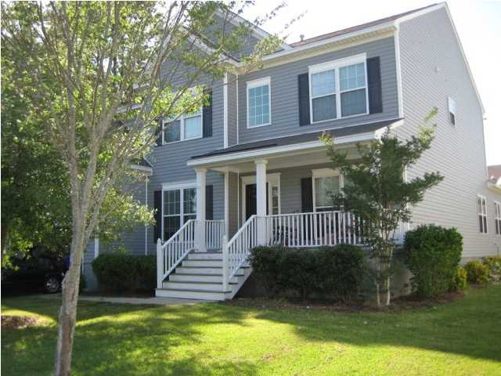
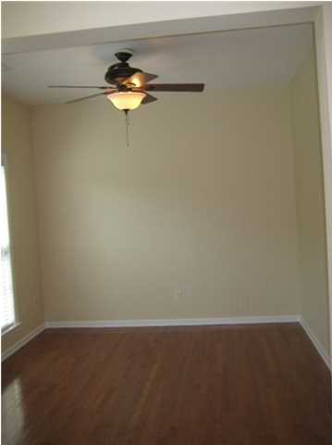
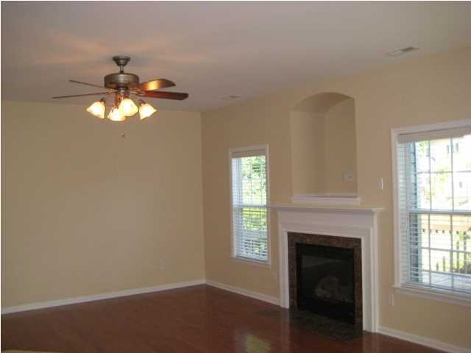
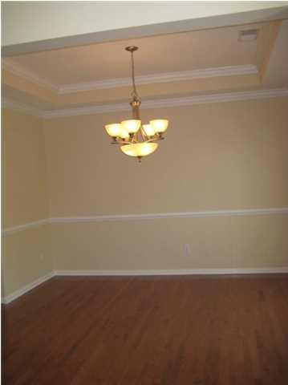
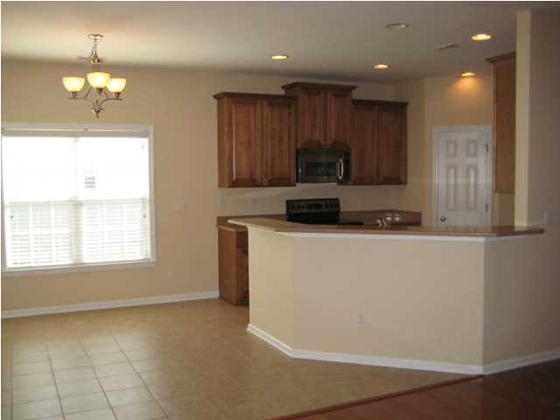
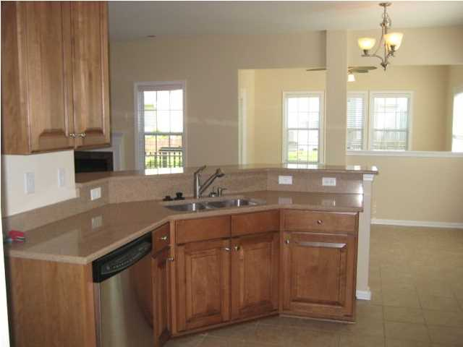
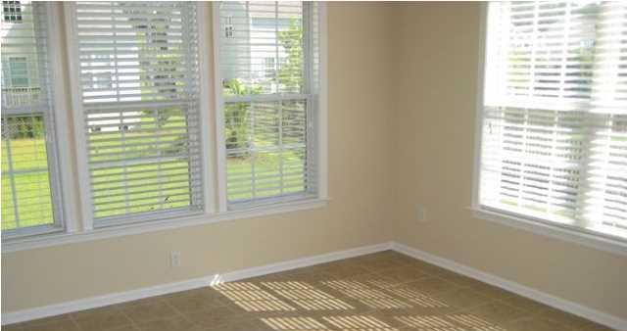
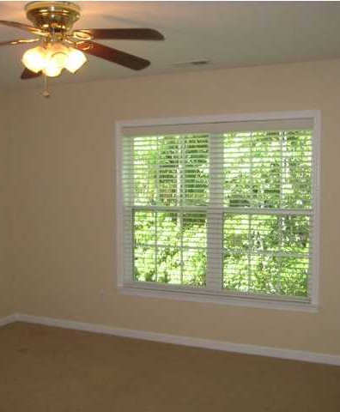
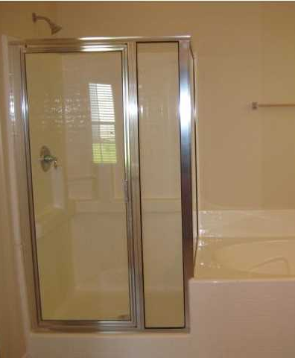

2141 Summerwood Dr Planters Pointe Mt Pleasant MLS# 1415393 $439,000 6 Bedrooms | 3½ Baths 3,286 sf
Entire interior was just painted!! Rare 6 Bedroom home in Planters Pointe!! This home has an inviting foyer, formal dining room and living room, open kitchen to living space with a breakfast area and sunroom! Master bedroom is on the first floor as is the laundry. Upstairs there is another large bedroom with a full bath, 3 more bedrooms and a larger 6th bedroom that could be used as a 2nd living area, media room, play room and much more. This home has plenty of space! Hardwoods downstairs, stainless steel appliances and a 2 car garage. There is also a wetland next to this lot that can not be built on.
Large 6 bedroom in Planters Pointe!
Kendra Boozer
843.834.5089
kendrafboozer@gmail.com

