Slide 1
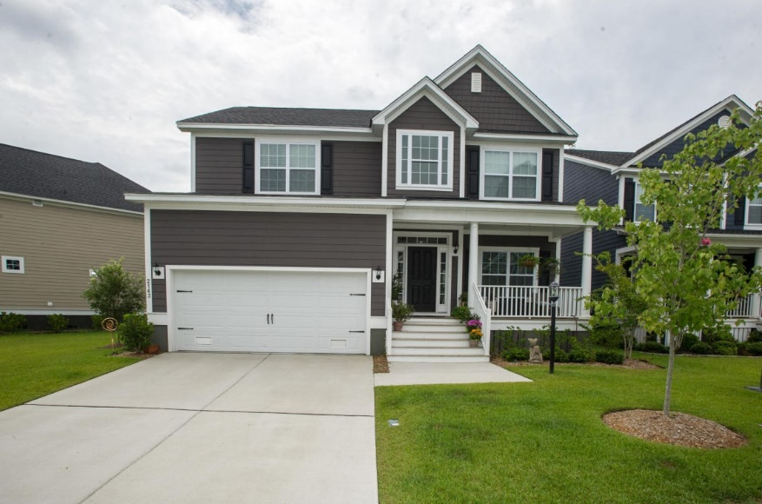
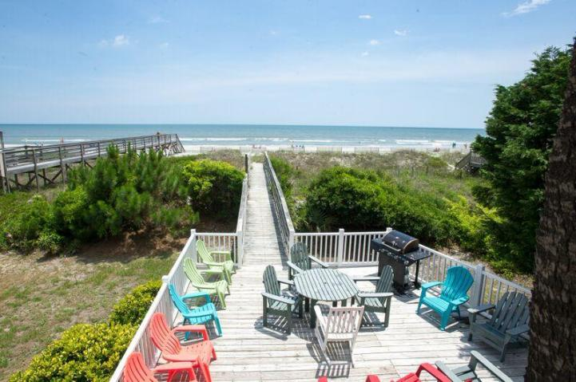
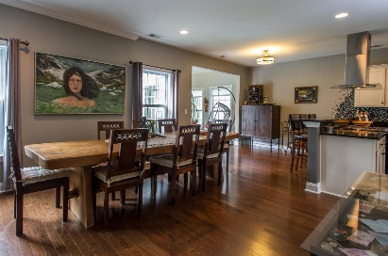
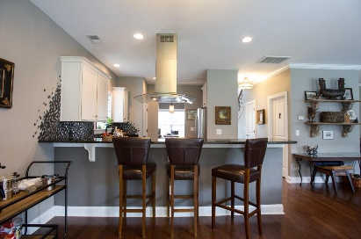
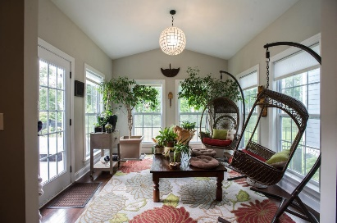
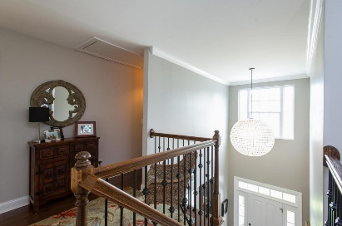
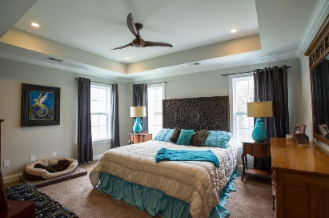
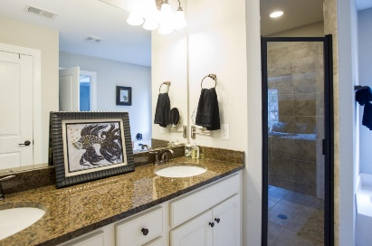
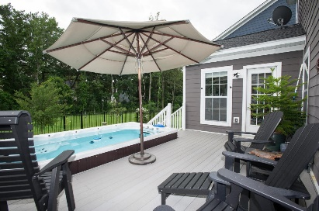
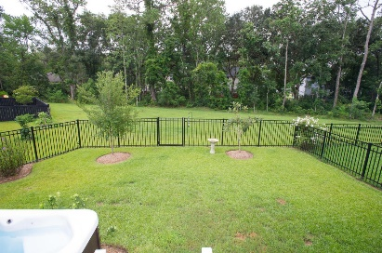


Amazing Custom James Island Home
2143 Pentland Drive
Riverland Park
Charleston, SC 29412
MLS# 16019574 ~ $459,900
3 Bed | 2½ Bath
***Stunning home/multiple upgrades. Oversized bedrooms and Amazing flow of space and high attention to details. Home has a pool/hot tub combination (est. $23,000 upgrade install). Beautiful backyard overlooking wooded lot. Hardwood floors downtown, chef style kitchen with high end appliances/counters/cabinets. Well built home less than two years old. ***Pool: 16' long with 3 levels of jets. 2 kinds of covers, seating on one end. Will comfortably hold 10 or more people. Deck is solid composite decking with stainless hardware. Metal fence. Must see the detail. Easy drive to MUSC/Boeing/Downtown and Folly Beach. Less than one mile to Stono River (boat launch and storage) and very close proximity to golf and tennis. St Johns Yacht Club a mile away So many great things in this home must see!
Bryan Thompson
Office - (843) 769-5100
Mobile - (843) 452-1686
bryan.thompson@agentownedrealty.com
www.bryanthompsonrealestate.com
AgentOwned Charleston Group | 902 Savannah Hwy | Charleston, SC 29407-7802

