Slide 1
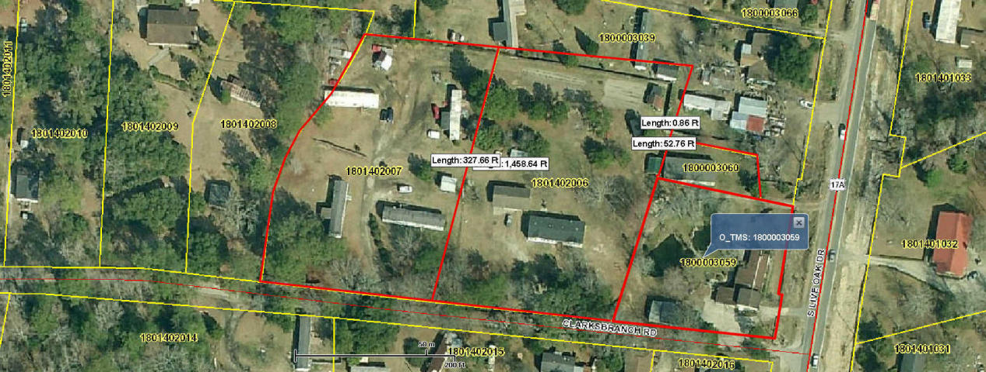
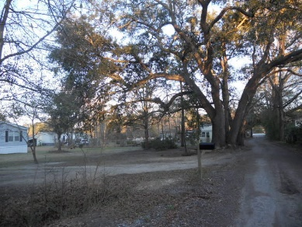
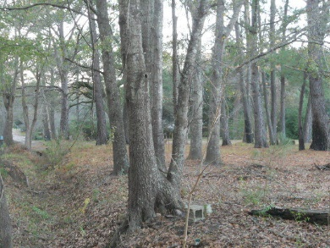
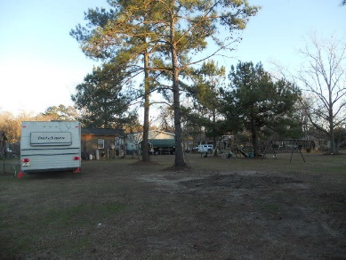


2143 S Live Oak Drive Moncks Corner, SC 29461 MLS# 17005332 $721,500
Four Properties Being Sold As One
2.67 Acres!
This property is being sold with 3 other properties. The tax map numbers are 180-00-03-060, 180-14-02-006,180-14-02-007. Water and sewer is available on 17A. 3 of the 4 tax map numbers have water hook up but tax map # 180-14-02-007 is well and septic.
Great location on 17A approximately 4 miles from where the new hospital will be built and 1 mile from the new Dollar Store. Great space for new construction or a commercial business. Buyer needs to verify all information they deem necessary to purchase of property to include zoning. Seven manufactured homes are currently on the land. Seller lives on the land and rents the remaining manufactured homes. With acceptable offer they will leave the manufactured homes or remove them if needed.
Connie White, Broker
843-532-3356
conniesyouragent@gmail.com
Charleston Homes · 597 Old Mt. Holly Road · Suite 301 · Goose Creek, SC 29445

