Slide 1
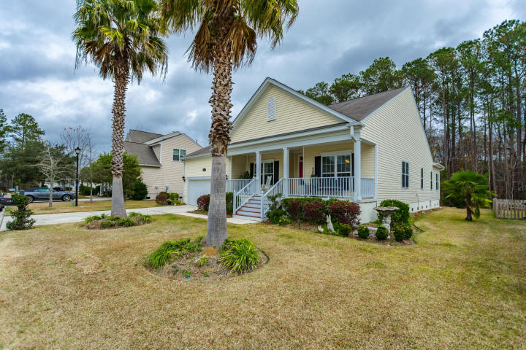
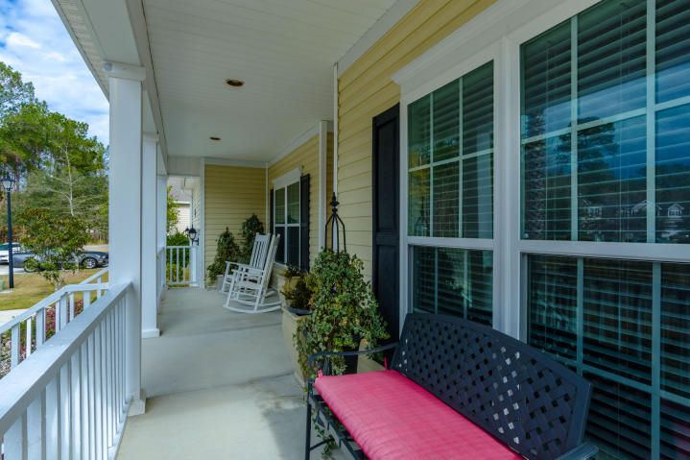
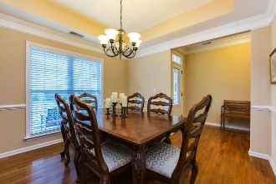
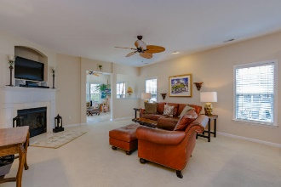
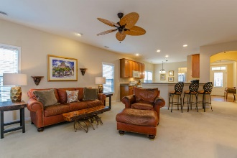
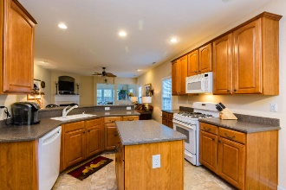
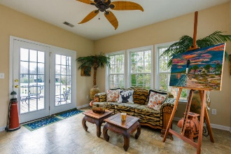

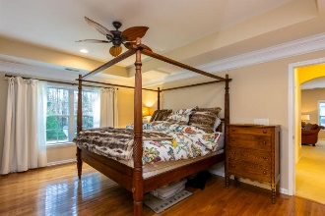
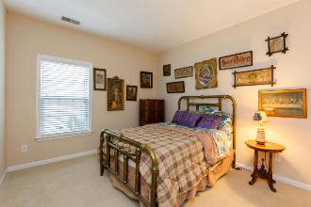
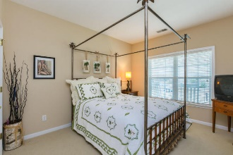
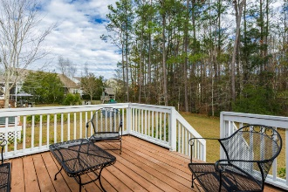
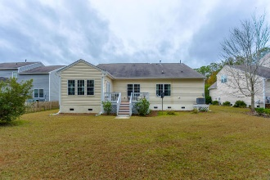

2144 Summerwood Drive Planters Pointe ~ Mt Pleasant, SC 29466 ~ MLS# 17000009 ~ $365,000
Below Fair Market Value In Mt Pleasant ~ Motivated Seller
This lovely 3 bedroom/2 bath single story ranch home is located in the heart of Mt. Pleasant. The inviting front porch welcomes you into the home and creates another ample size outdoor living space.
Upon entering the home one is greeted by an open floor plan that makes for wonderful family living. The gracious master bedroom and en-suite is tucked away from the other two bedrooms. The well lite office room can also be used as a 4th bedroom or an extra den. The sun-room faces out on to the beautiful backyard surrounded by a foliage oasis.
The family can have many a great barb-e-que gatherings on the back deck. Many upgrades in the home. This home is a must see!
Carolyn Dubrofsky
843-324-9645 M
cdubrofsky@comcast.net
The MarshallWalker.com Group
582 Rutledge Ave Charleston, SC 29403

