Slide 1

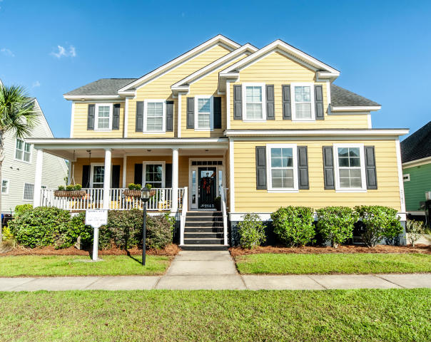



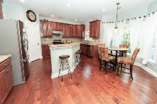
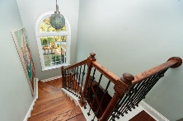
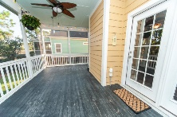
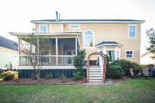
2145 Sandy Point Lane
Rivertowne On The Wando · Mount Pleasant · MLS# 19006002 · $527,900
New Price!!
Beautiful MOVE IN READY low country home embraces all that is southern living, it also backs on to the wetlands so privacy & peace is assured! Enter the property via the full front porch, with swing. Move indoors & notice the spacious, open living feel, stunning hardwood floors, crown molding & relaxing coastal color palette. The airy kitchen has a casual dining area overlooking the large yard & marsh views. On cool days stay cozy by the fireplace in the large family room or retreat upstairs to the tranquil master bedroom w/ garden tub & large shower. This Earth Craft home is environmentally friendly & up to 30% more energy efficient. RTOTW has swimming pools, tennis courts, playgrounds & community docks for all to enjoy.
Michelle Brooks · (843) 819-0450 · michelle@mycharlestonhomes.sc
Brand Name Real Estate | 4 Carriage Lane Suite 106 | Charleston, SC 29407

