Slide 1
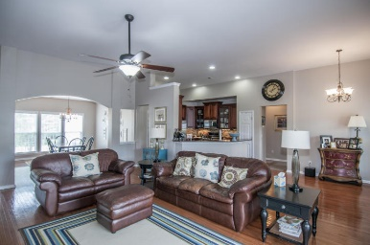
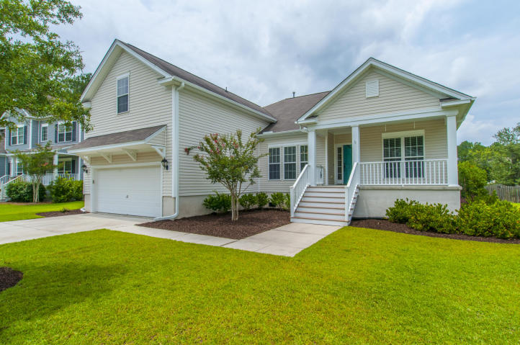
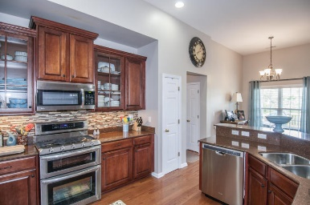
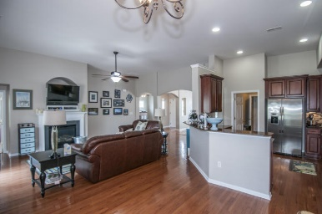
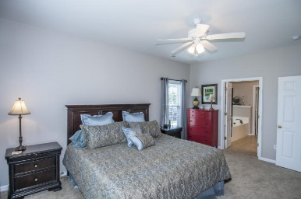
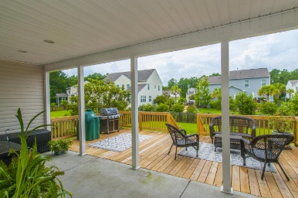
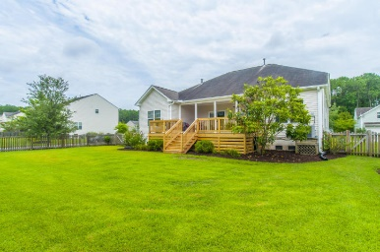


2145 Summerwood Drive Planters Pointe ~ Mount Pleasant MLS# 16017546 ~ $425,000
FANTASTIC OPEN FLOOR PLAN!!
This 4br 3ba Mt. Pleasant home also has wonderful upgrades and great location! 5-10 min to shopping, dining and movie theatre....15-20 min to the beaches....20-30 min to historic downtown Charleston and all those unbelievably fabulous restaurants!!
As you enter the foyer, you will see the charming archways leading to the living room/office to your right and the large dining room to your left. Continue straight back to the family room with gas log fireplace
Large breakfast area and kitchen, all with hardwood floors.
The kitchen has really nice easy care silestone counter tops, 42'' cherry finish cabinets with pull-outs, stainless steel appliances including natural gas cooktop, double ovens, new microwave and new dishwasher! Wow!!
Lots of storage in the pantry closet as well as in the laundry area and garage.
The master bedroom is down and the master bath is very pretty with ceramic tile, double vanity sinks, separate tub and shower and an amazingly huge walk-in closet! Wow again!!
There are 2 more nice sized bedrooms down and a full bath. And the 4th bedroom is upstairs with a full bath and has it's own heating and air control.
Entertaining will be so easy with this floor plan that flows to the outside 12' x 24' deck with natural gas line to your grill....(Priceless!!!) Another wow!!
Backyard is fenced
All new decking
New gutters
Entire interior of the home has new paint
New carpet in all bedrooms
Ceiling fans in family room, office and all bedrooms
Tile in all bathrooms.
Planters Pointe is a great neighborhood with walking trails, clubhouse, beautiful swimming pool and tennis courts!
Welcome home!!!!!
Bob Crawford
ABR, EPRO, SRES, REALTOR
Mobile - (843) 860-8008
bcrawford@carolinaone.com
www.CharlestonGolfProperties.com
Carolina One Real Estate
2713 Highway 17 North
Mt. Pleasant, SC 29466

