Slide 1
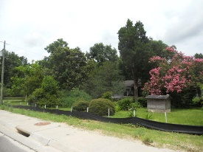
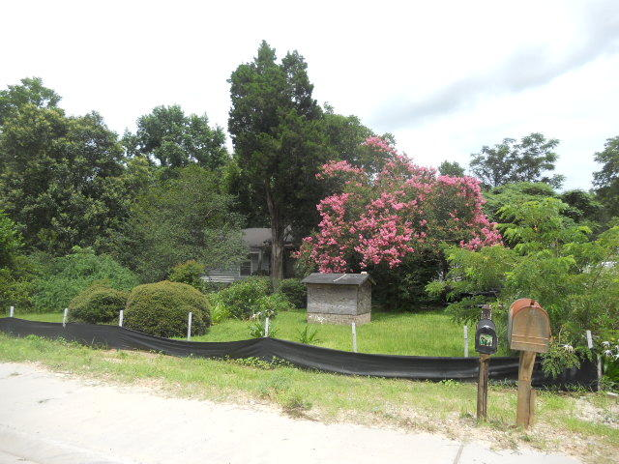
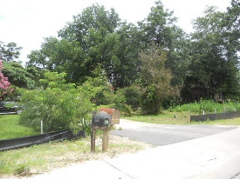
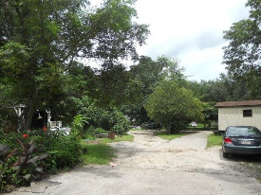
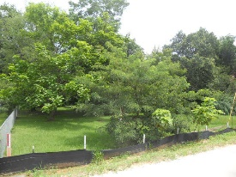
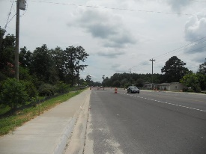
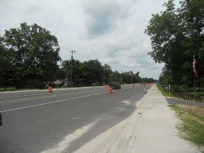


6.6 Acres!! Great Spot For A New Business!
2146 S Live Oak Dr
Moncks Corner, SC 29461
MLS# 17005333
$700,000
Open House Canceled!
Under Contract In 3 Days!
Prime Location on Hwy 17A approximately 4 miles from where the new hospital will be built and 1 mile from the new Dollar Store. Great spot for a new business or a developer to build new homes!
6.6 acres offers room for a building and parking. Manufactured homes are located on the property but the family are willing to remove unless buyer is interested in keeping them on the lot. Property has electricity, water and septic tank.
Connie White, Broker
C: 843-532-3356
conniesyouragent@gmail.com
Charleston Homes
597 Old Mt. Holly Road
Suite 301
Goose Creek, SC 29445

