Slide 1
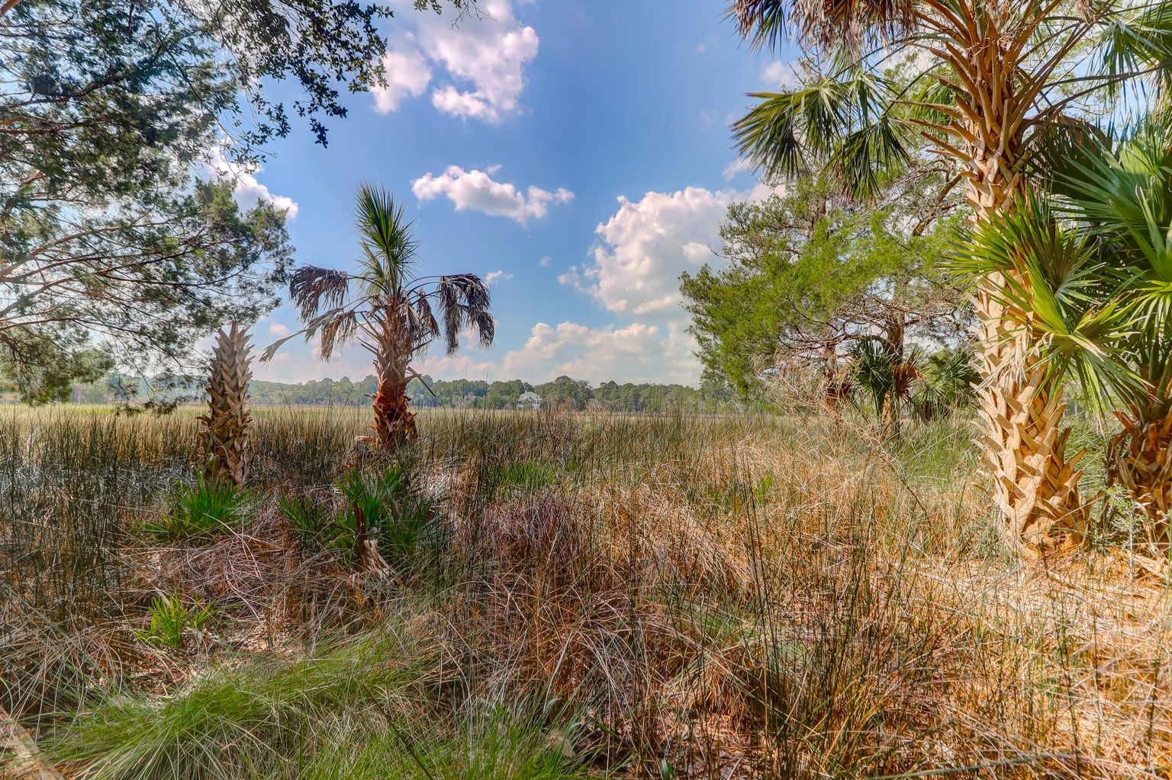
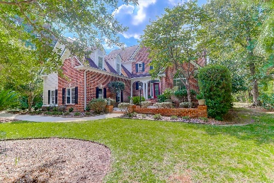
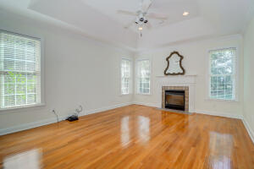
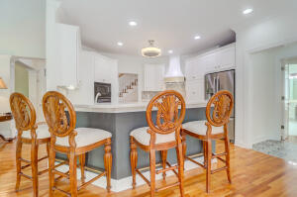
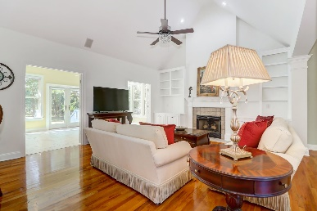


2147 Shell Ring Circle
Dunes West | Mount Pleasant, SC 29466 | MLS# 21028112 | $1,090,000
Tidal Creek and Marsh Views
Gorgeous Home and Landscape
PRICED TO SELL!
Exceptional updated estate home in this incredible private gated and highly desirable community of Dunes West! This renovated move in condition stately home has many wonderful features and benefits. 4 Bedrooms, 3.5 Baths and the Owner's suite is conveniently located on the first floor. Gourmet kitchen complete with wrap around counter, striking custom hood over the stove top, top of the line appliances with lots of cabinetry. Convenient for dining and entertaining, lots of space for those holiday events and parties. The great room features a fireplace with gas logs. Exquisite lighting throughout this home creates a wonderful ambiance. The great room opens up to a large bright sunroom with beautiful views of the marsh and tidal creek. Master bedroom is downstairs with a tray ceiling, fireplace with gas logs. 2-car garage with extra storage and a very spacious finished room over the garage with an adjoining bath. This home features central vacuum, hardwood floors throughout, Jacuzzi tub in Master bathroom, large custom walk-in closet, and many other fine details. This home is situated on a pristine professionally landscaped lot with beautiful trees and ornamental foliage. Tidal water behind this home with lots of marsh grass and vegetation. The backyard has a tidal creek. If a dock is a serious consideration a Buyer should contact OCRM for an application. The incredible views of nature, wildlife, and the abundance of vegetation is quite the serene setting for afternoon naps and bird watching. Enjoy the best of life in this grand home! Dunes West is a wonderful community that offers Resort style amenities, 3 lovely pools with a waterslide, tennis courts, workout facility, and Golf Club with restaurant, boat ramp, boat and camper storage. Enjoy jogging trails, being close to award winning schools, great shopping, beaches, and only minutes away from downtown Charleston, Roper Hospital and much more. Must see!!
A $3,000 Lender Credit is available and will be applied towards the buyer's closing costs and pre-paids if the buyer chooses to use the seller's preferred lender. This credit is in addition to any negotiated seller concessions.
Darlene Smith
Office - (843) 886-8110
Mobile - (843) 696-7824
darlenesmith@carolinaone.com
DarleneSmithTeam.com
Carolina One Real Estate
1503 Palm Blvd Ste
Isle of Palms, SC 29451

