Slide 1
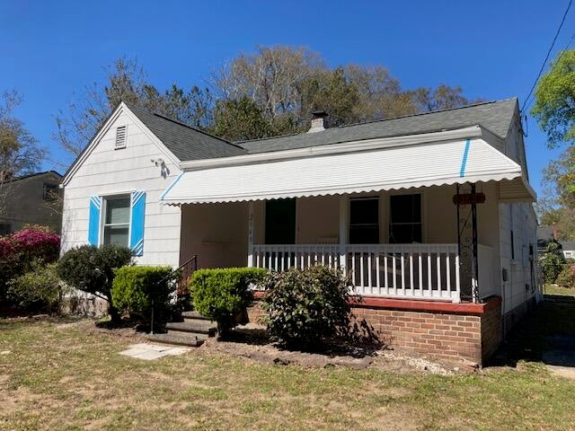
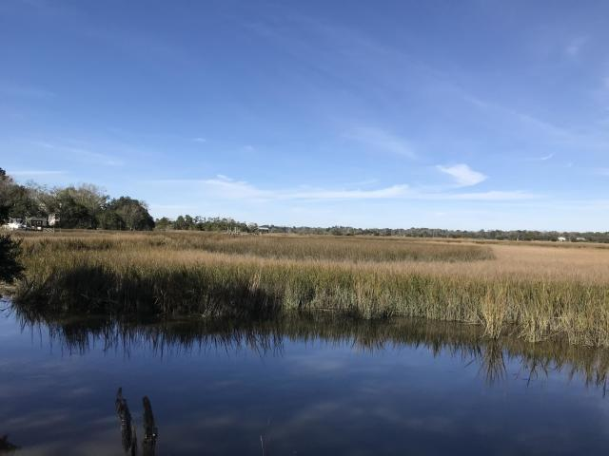
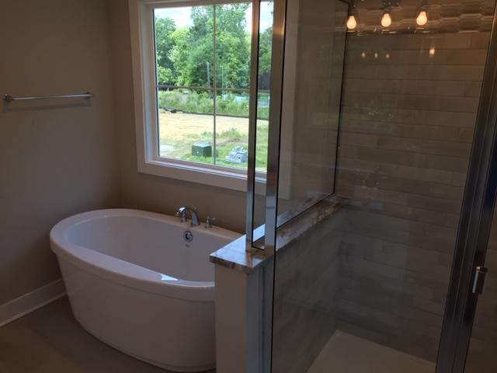
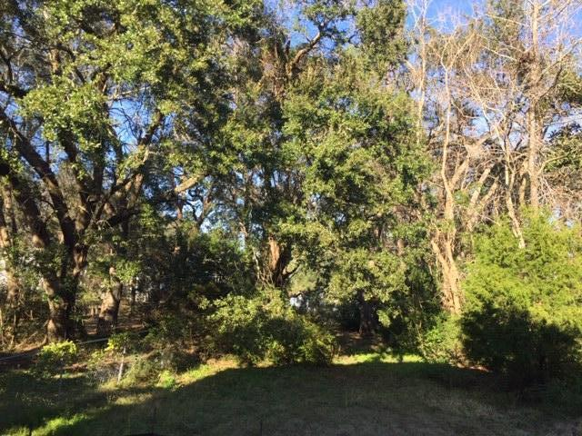
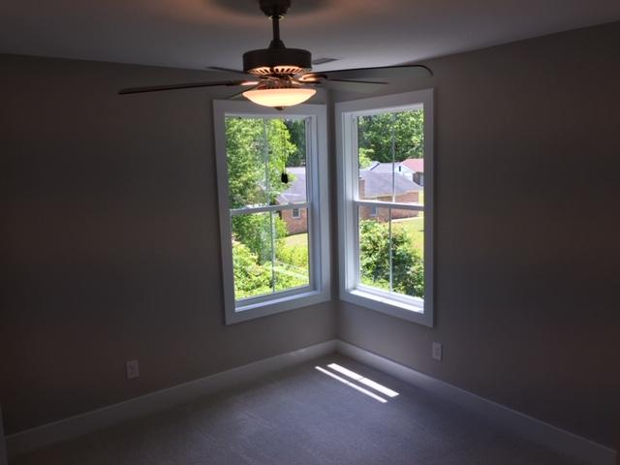
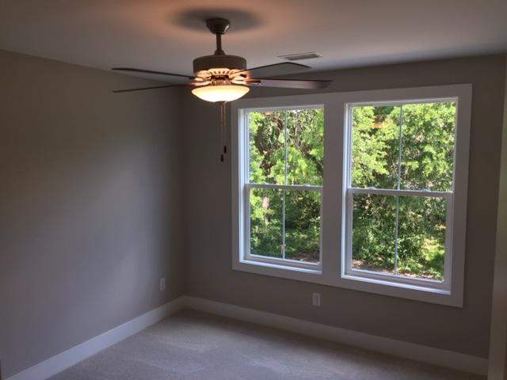
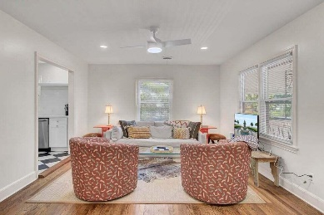
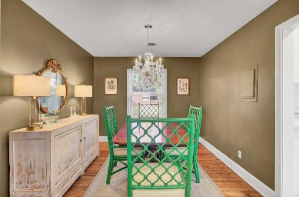
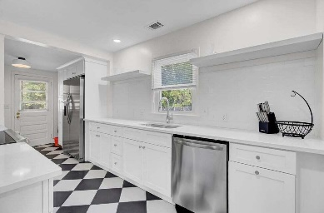
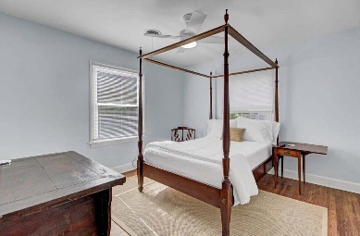
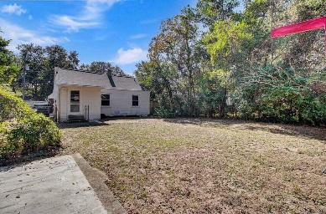




Just listed: Renovated Riverland Terrace Cottage GO AND SHOW!
2148 Welch Avenue
Riverland Terrace
Charleston, SC 29412
MLS# 23005848
$549,000
2 Bedrooms :: 1 Bath :: 971 sf
This Riverland Terrace cottage just had a tasteful renovation and has all the charm! New kitchen (with a hood vent that vents to the exterior of the home), new bathroom, new lighting fixtures, new tankless water heater, elegant door hardware, & smart thermostat. New flooring was added and the original hardwoods have been restored. Kissed with a fresh coat of paint, this home is ready for a new buyer who is looking for a home with great charm in an incredible location in the desirable Riverland Terrace Subdivision. Classic exterior notes give the home a restored antique feel. Roof is approximately 2018 and HVAC is approximately 2019. Enjoy ample shopping, dining and nightlife as the home is very close to the Terrace Theater Plaza, Charleston Pour House and much shopping and dining!
Riverland Terrace is a neighborhood with unparalleled location and enticement. The subdivision boasts Plymouth Park, baseball fields, Plymouth Boat Ramp (on the Wappoo Cut), and the Medway Community Garden. Very close proximity to the City of Charleston Municipal Golf Course ("The Muni")! Houses on Welch are being revitalized one at a time!
Eric Draper
(843) 442-7118
eric.draper@gmail.com
Jon Moore
(843) 732-3365
jon@charlestonrealestategroup.com
www.charlestonrealestategroup.com
Charleston Real Estate Group | 443 Folly Road | Charleston, SC 29412

