Slide 1
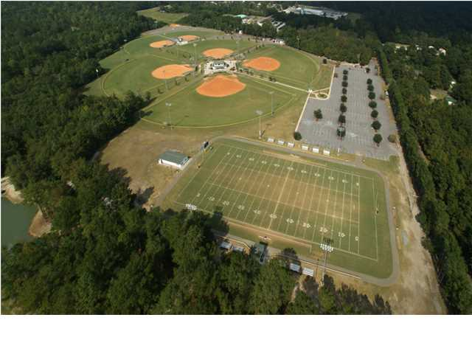
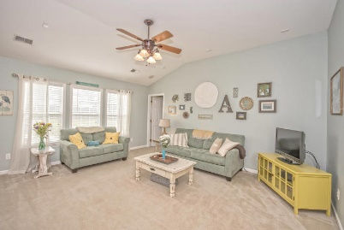
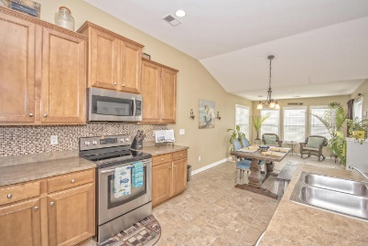
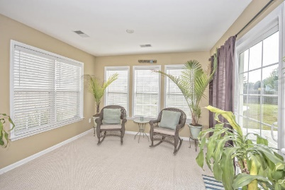
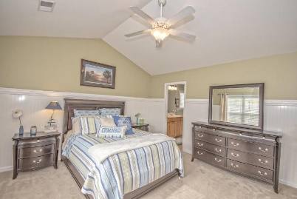
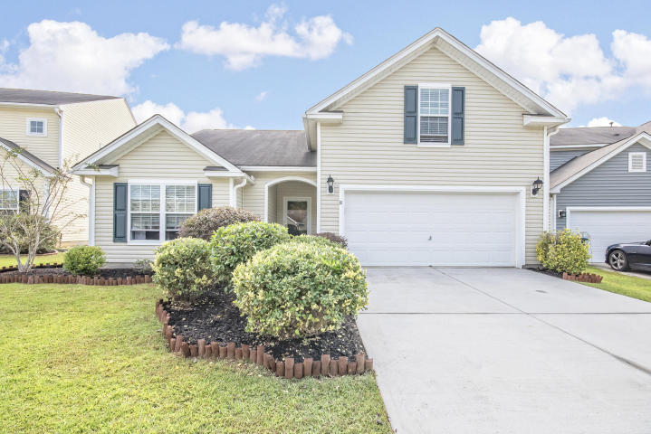
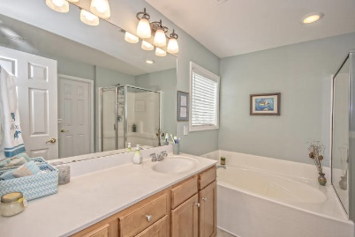
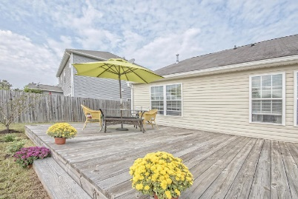
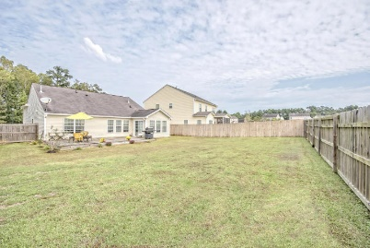


214 Goldfinch Lane
Arbor Walk | Summerville, SC 29485 | MLS# 15026283 | $199,000
Just Listed!
All Offers Welcome!!
You will LOVE this Charming Open Concept styled home with pretty colors and in Excellent condition. This is the popular Alston A Plan built by Ryland Homes. Offering Master Bedroom down with huge Walk-In Closet, large Great Room/Dining area with 10'ceilings plus an additional sun room overlooking the spacious fenced-in back yard and huge deck (16'x 27'). The Gourmet Kitchen boasts staggered 42'' Maple Cabinets w/Pull-Outs, S/S Appliances, Recessed lighting ,Center Island w/Breakfast Bar, Tile Backsplash and large Pantry. GR wired for surround sound. 4th bedroom is upstairs and can be used as a flex space. Attic space has flooring for additional storage. Sidewalk Community with Direct Access to Sawmill Branch Creek Trails. Close to Highly Regarded DD2 Schools, Shopping, Restaurants and I26.
View a virtual tour at www.214goldfinch.com
Beth Mandell
M 843-900-1296 | O 843-871-2121
bmandell@century21properties.com
www.bestcarolinahomedeals.com
Century 21 Properties Plus of Summerville | 118 W Richardson Ave | Summerville, SC 29483

