Slide 1
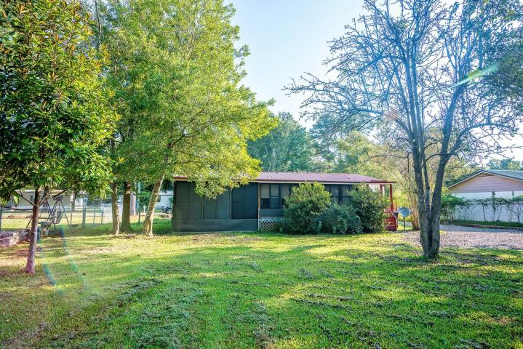
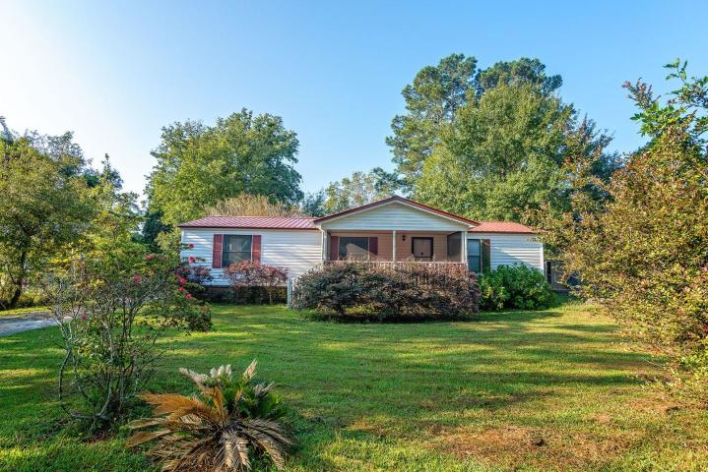
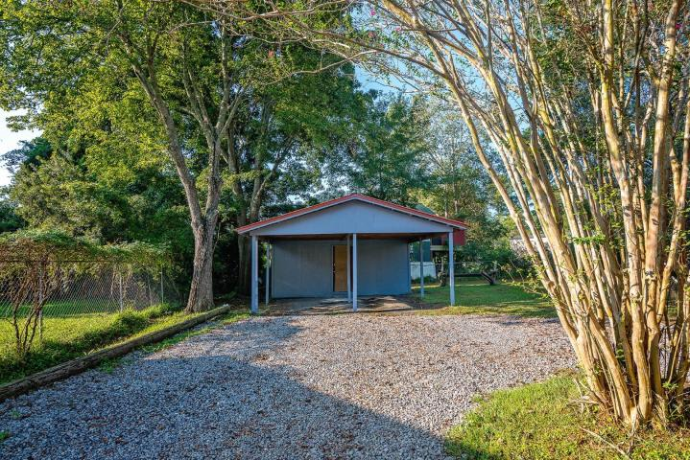
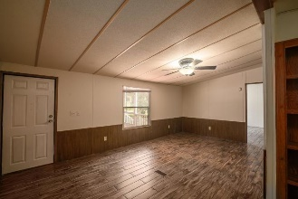
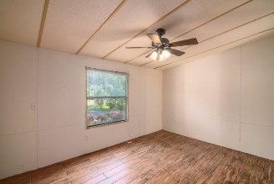
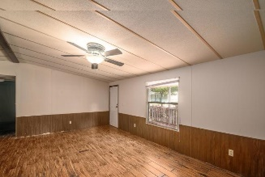
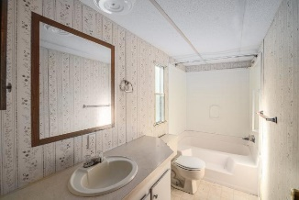
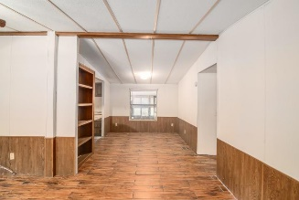
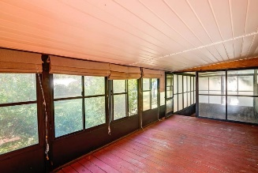
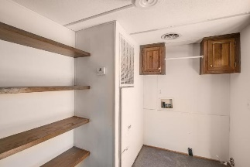
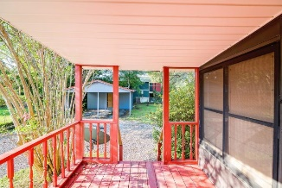


2153 Poinsettia Avenue Summerville, SC 29486 ~ MLS# 18026316 ~ $128,000
Just Listed!
3 bed 2 bath for $128,000 in Elm Village
This lovely 3 bedroom 2 bath home is situated on a meticulously landscaped .28 lot. The screened in front porch welcomes you home and is a great place to sit and enjoy a cup of coffee. As you enter, you'll be greeted by a floor plan, with a great flow for entertaining and everyday living. Kitchen is spacious with lots of cabinets and counter space. The spacious master bedroom is separate from the other bedrooms, it has a large walk in closet and en-suite bathroom. There is a separate dining area, large laundry room w/built in shelves and cabinets, a spacious guest bath and two large bedrooms. Easy to clean wood like tile flooring is throughout living areas and master bedroom. Vinyl in kitchen and bathrooms, with new carpet to be installed in the other bedrooms.
Off the back entrance is a huge sunroom with a walk down to a separate area perfect to put a hot tub. Park your cars under the 2 car detached carport and store your lawn mower and more in the attached shed. The roof was replaced about 2 years ago and HVAC within the last 3 years.
This home has much to offer, come and see it today!
Asking $1,200,000
MLS# 17023051
3,692 SqFt
4 Bed/3½ Baths
Short Drive to Historic Downtown Charleston & Beaches
Jacqui Swain (843) 295-9484 jacquiswainc21@gmail.com www.JacquiSwain.c21.com
Century 21 Expert Advisors
100 Seven Oaks Lane
Summerville, SC 29485

