Slide 1
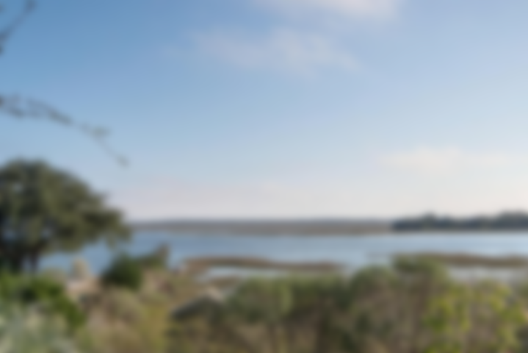
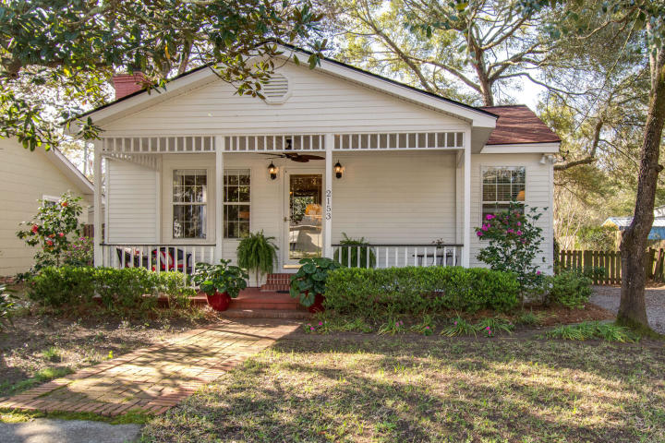
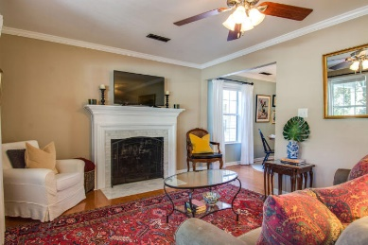
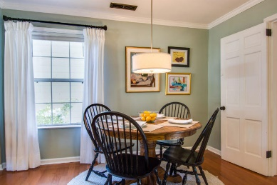
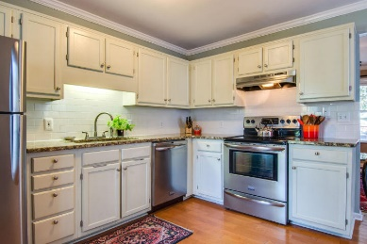
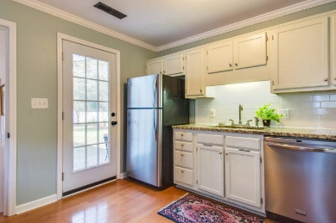
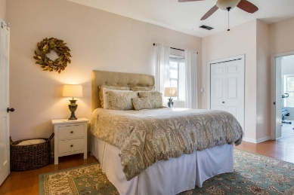
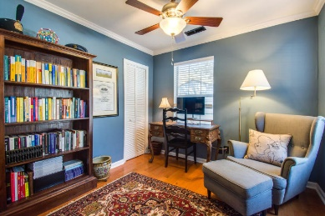
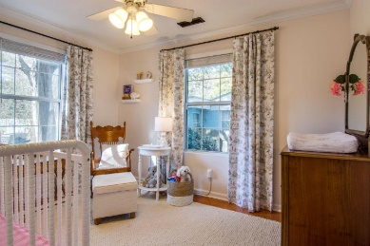
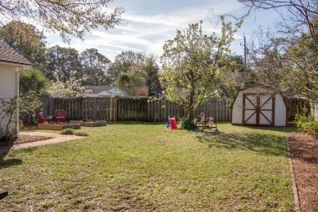


RECENTLY ON TOUR WITH HGTV Price Reduced, Seller Motivated!
2153 Welch Avenue
Riverland Terrace
Charleston, SC 29412
MLS# 19008506
$392,000
Charming Cottage, Turn Key READY, in highly coveted Riverland Terrace neighborhood. A Walkable community with beautiful views and access to a Boat Landing. This 3 bedroom 2 bath home has an updated, Large Owner suite, apart from the additional bedrooms. Hardwood Flooring, Tankless Water Heater. Updated Kitchen, Bonus room, Currently used as gym & laundry. Fireplace in Living room, Large back yard, fenced in opens to the street and there is room to store a Boat! Just minutes from downtown and Folly Beach. Golf nearby, Plymouth Playground & Pocket Park are all nearby in addition to a community garden at Medway Park. This is a great neighborhood for all. WALK to nearby Terrace Theater, restaurants & shops New Roof, 2015,Timberline Ultra HD architectural shingles. New HVAC & duct work 2017
Jan Miller Cell (843) 345-9719 | Jan.Miller@nvrealtygroup.com
NV Realty Group | 91 Broad St, Ste A | Charleston, SC 29401
janmiller.nvrealtygroup.com

