Slide 1
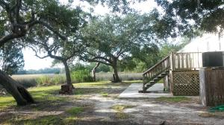
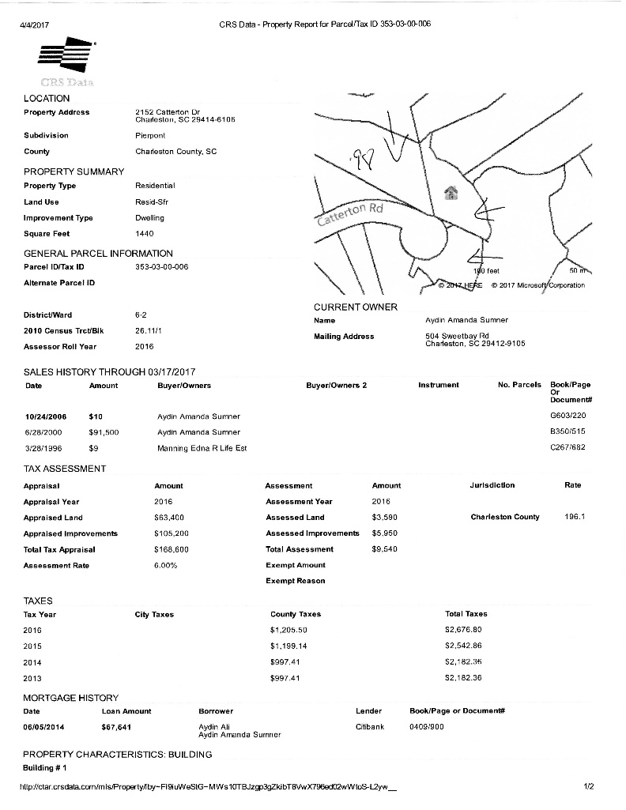

Catterton Drive ~ Dogwood Gardens
Charleston, SC 29414
Investors/Developers
$25K Price Reduction!
2 SF homes and 1 Mobile home Rental in the heart of West Ashley with Beautiful Marsh Views
Selling as a package - The 3 lots total over 1.5 Acres on the end of a cul=de=sac
Current Rental income on 3 properties is 3650 month.
Potential development site - for townhomes or apartments, add a dock
Please do not disturb the tenants.
Offering at $749,000
Gerri Sandford
(843) 817-8762
gsandford29455@gmail.com
Anchor Line Realty LLC
1619 Samuel Rd
Charleston, SC 29412

