Slide 1
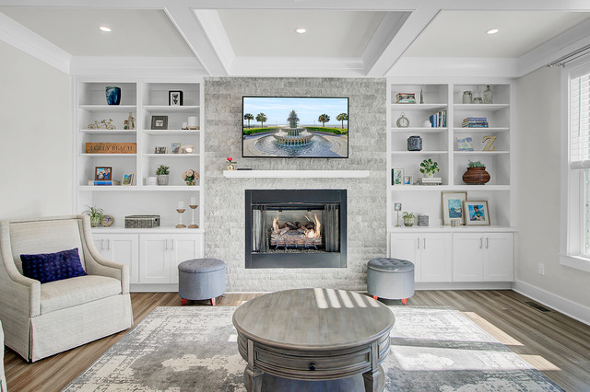
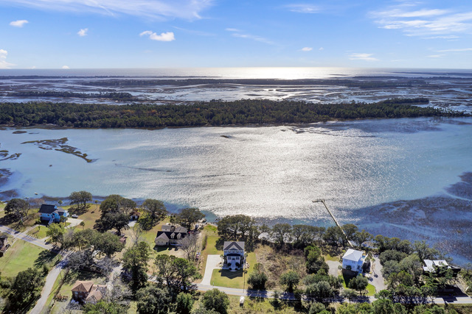
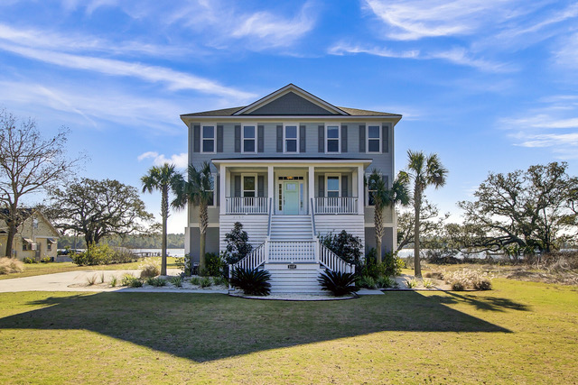
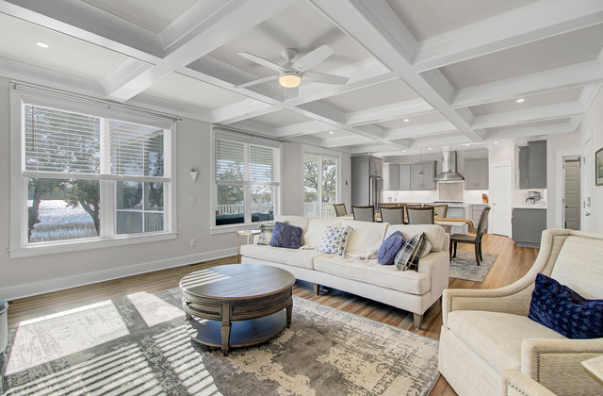
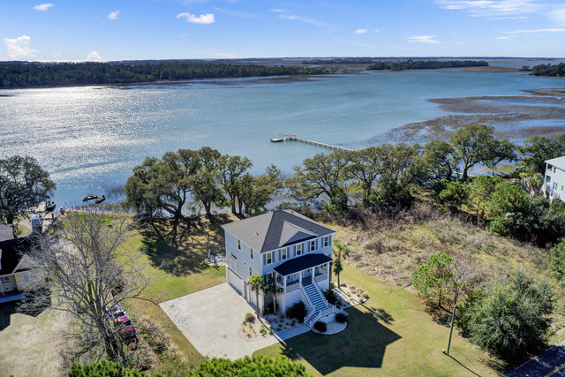
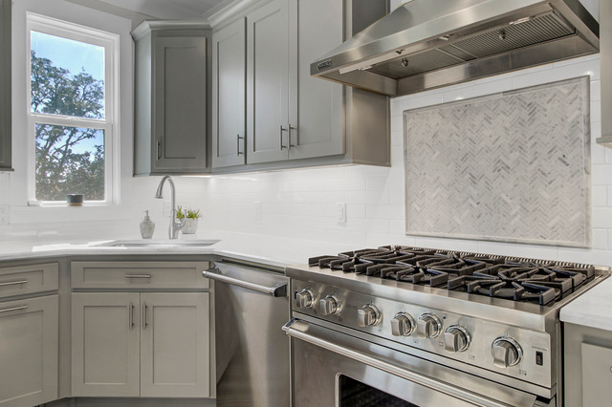



DREAM HOME with VIEWS GALORE
2157 Sol Legare Road
Charleston, SC 29412
MLS# 24002561
$1,585,000
Video Tour
HOT new listing with AMAZING VIEWS!
Dock permit in hand on this stunning 4 bedroom 4.5 bath home WITH ELEVATOR. This beauty is on James Island bordering Folly Beach- 5 minutes to put your toes in the sand!
Build a dock or easily launch your boat down the street at the Sol Legare boat ramp and fishing pier!
Move in ready, this home which was built in 2019 will feel brand new. Schedule your tour while you can!
Take a video tour of the property!
Ellen O'Neil
Broker/Owner, ABR, e-PRO, CNE
Charleston Realtor of Distinction
(843) 300-8530
www.EllenONeilProperties.com

