Slide 1
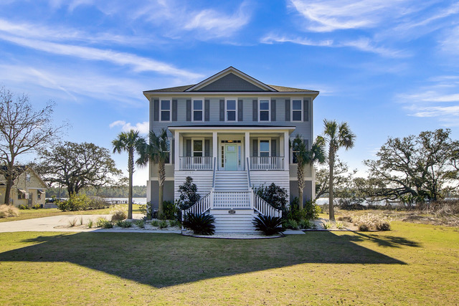
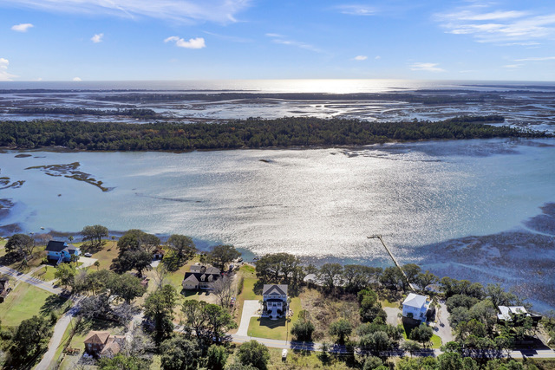
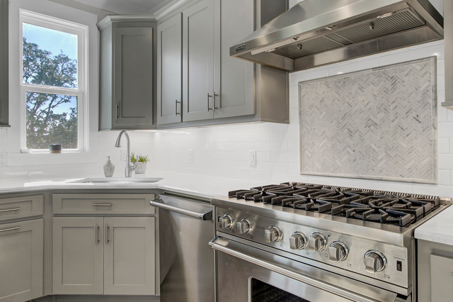

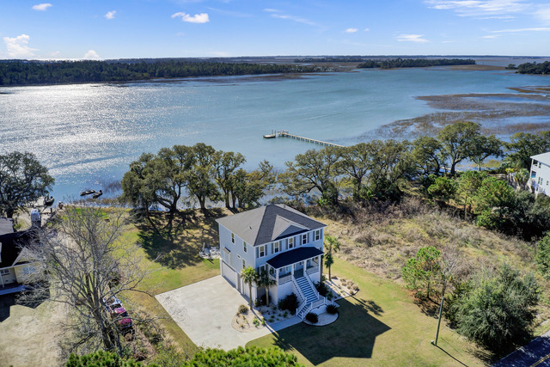
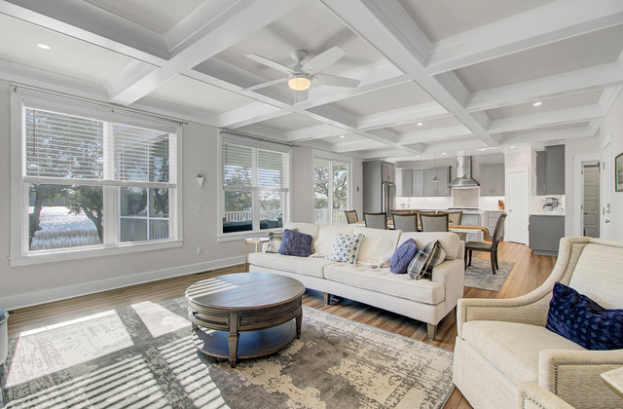



New Listing- Waterfront with Dock Permit
2157 Sol Legare Road
Charleston, SC 29412
MLS# 23011944
$1,650,000
Stunning elevated waterfront home with DOCK PERMIT! This gorgeous home borders Folly Beach- 5 minutes to put your toes in the sand! Custom home offers 4 bedrooms each with their own full bath. Fine craftsmanship and attention to detail throughout. Home was built in 2019 yet feels like new construction! There is an elevator servicing all levels. Views are AMAZING and home design capitalizes on them! See the water from your kitchen, dining area, family room, master suite, and guest suite. Watch the dolphins swim by from your back porch while you wait for your own dock to be built. Boaters don’t despair, the Sol Legare boat launch and fishing pier are at the end of your road! For any buyer looking to own a little slice of heaven with views galore, minutes from the beach, and close to Historic Downtown Charleston, THIS IS THE ONE FOR YOU!! Showings to begin on Saturday June 3. Open Houses Saturday June 3 (10-2) and Sunday June 4 (12-4). Call me for additional details.
Take a look at the property video and more by clicking the link below!
Property Website
Ellen O'Neil
Broker/Owner, ABR, e-PRO, CNE
Charleston Realtor of Distinction
(843) 300-8530
www.EllenONeilProperties.com

