Slide 1
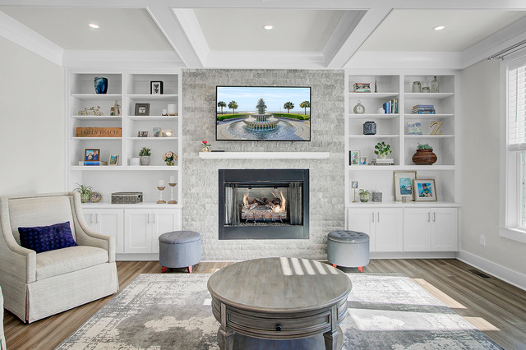
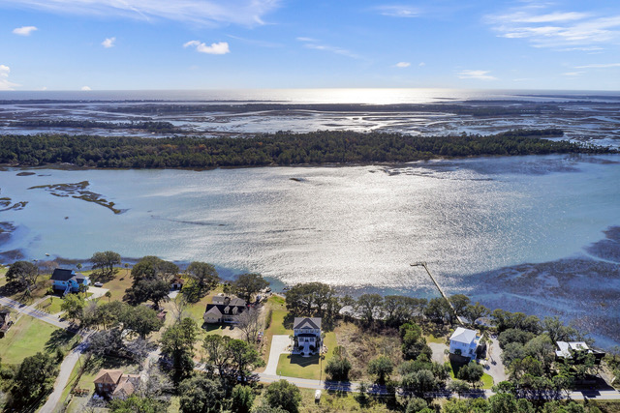
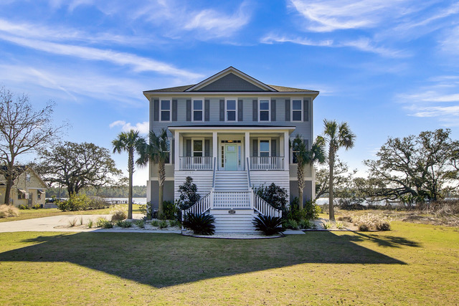
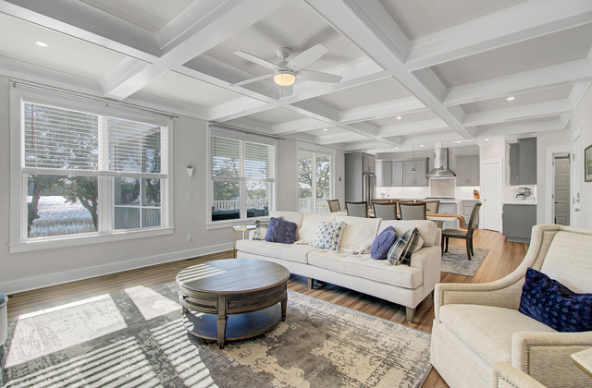
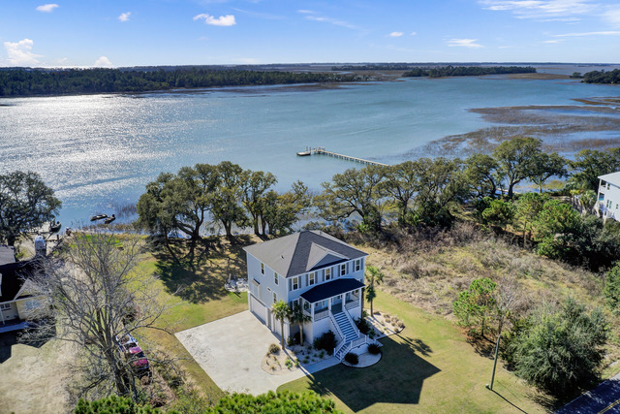
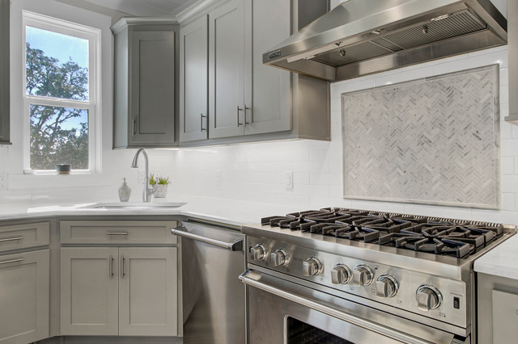
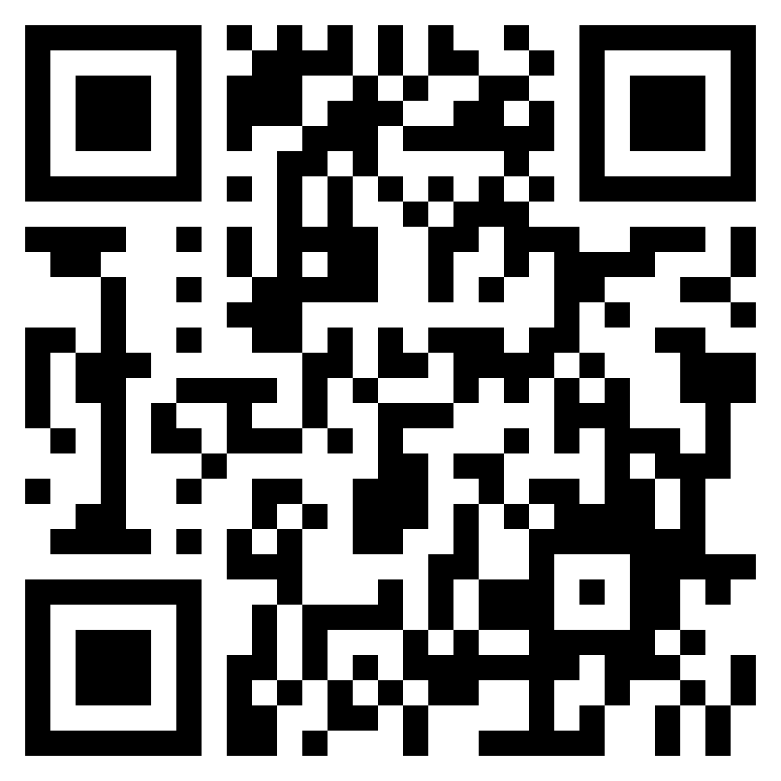


Price Reduced and AGENT BONUS!
2157 Sol Legare Road
Charleston, SC 29412
MLS# 23011944
$1,625,000
Video Tour
This is a win-win! Bring your clients to this DREAM HOME with VIEWS GALORE ~ Agents will receive a $5,000 BONUS for ratifying a contract in August.
This is a 4 bedroom, 4.5 Bath elevated custom home with elevator. Home is located 5 min from Folly Beach and the finishes are stunning.
Check out the property video. These views never get old! Dock permit is in hand (and transfers to new owners). There is a boat launch (Stono River) at the end of this road along with a beautiful fishing pier. No restrictive covenants. This is what dreams are made of!
Schedule your showing ASAP and contact me with any questions you have.
Take a video tour of the property!
Ellen O'Neil
Broker/Owner, ABR, e-PRO, CNE
Charleston Realtor of Distinction
(843) 300-8530
www.EllenONeilProperties.com

