Slide 1
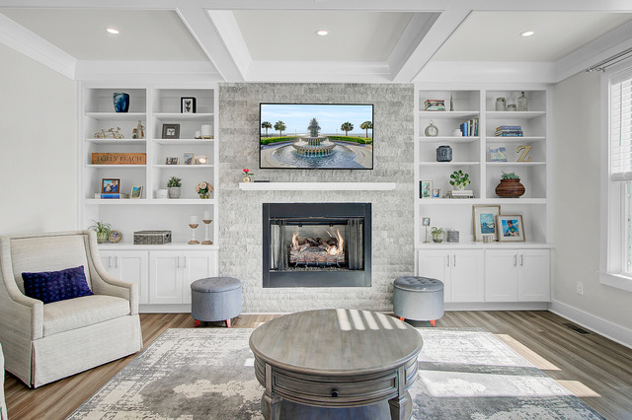
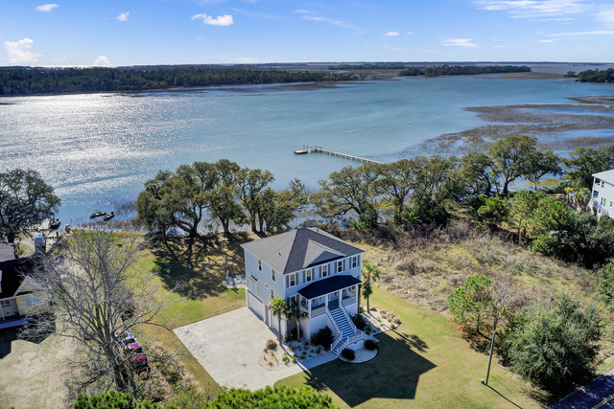
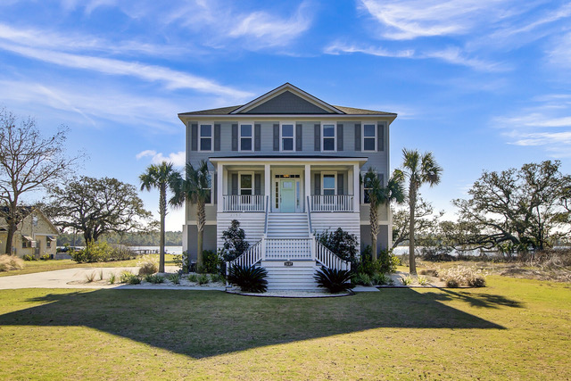
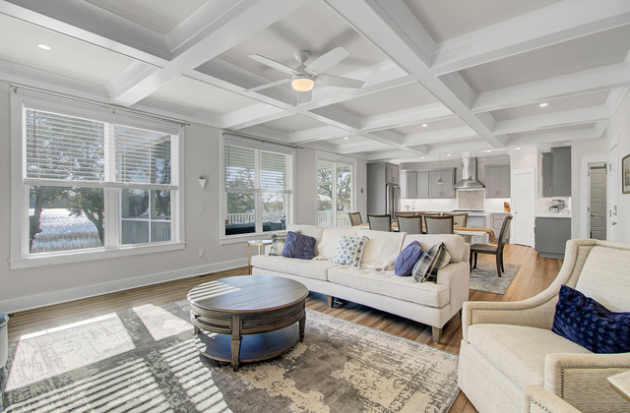
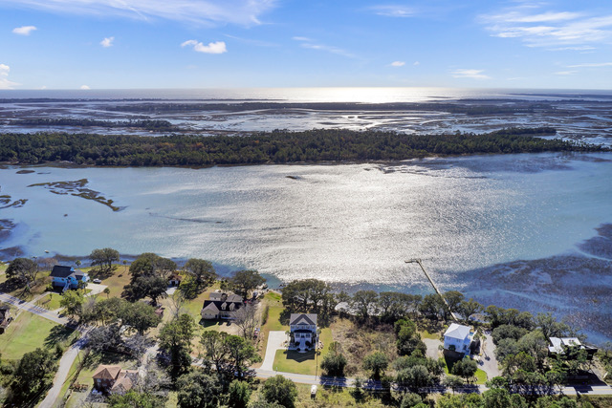
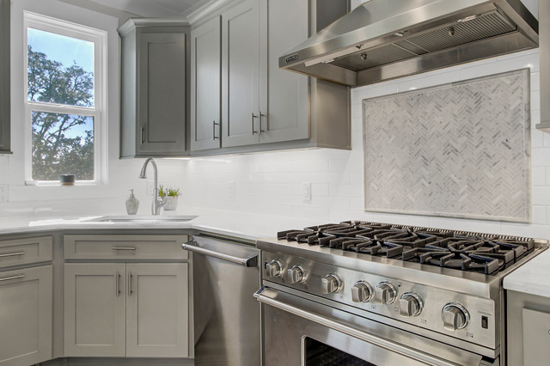
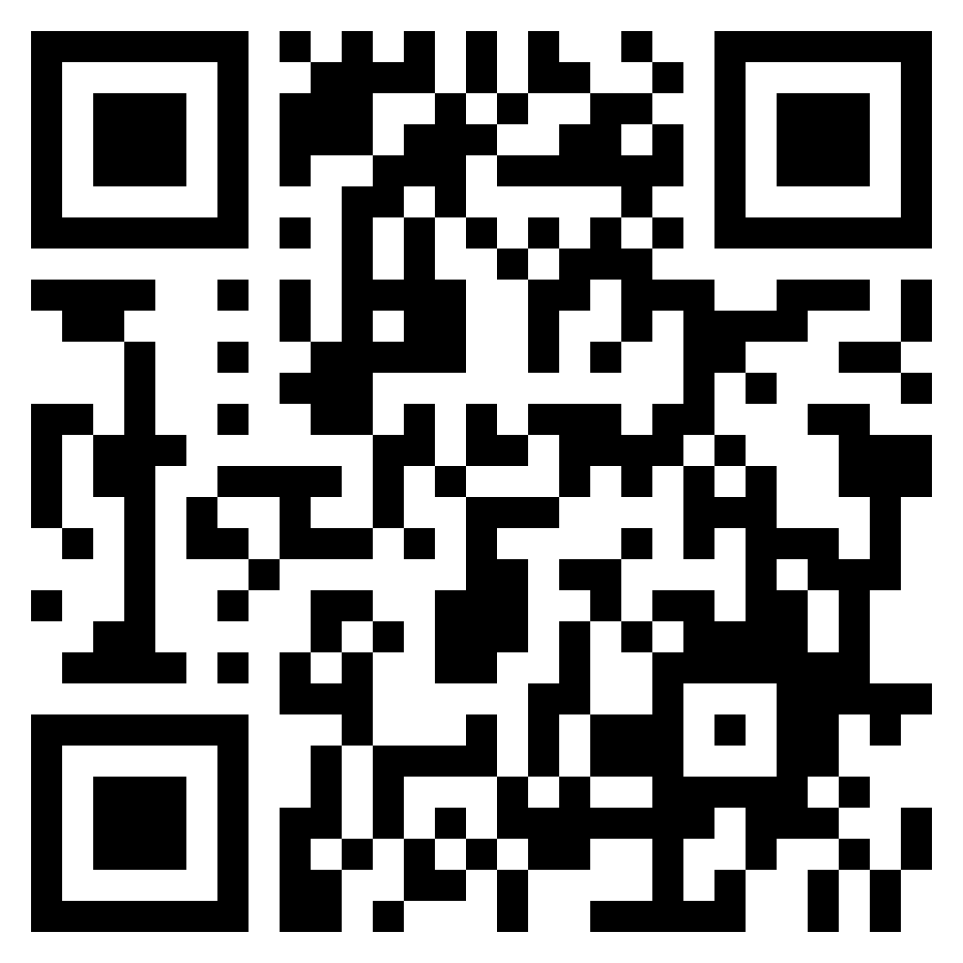


Improved Price At Your Client's Dream Home!
2157 Sol Legare Road
Charleston, SC 29412
MLS# 23011944
$1,585,000
Video Tour
Jaw dropping views are just one of the many hard to find features of this newly constructed custom elevated home with DOCK PERMIT. This beautiful home (with elevator) offers 4 bedroom suites, a sought after open-concept floor plan, and views from all the right places!
Viking appliances in the kitchen, custom wood work throughout the home, Cali Bamboo flooring… the list goes on and on. Bring your clients to see this gem before it is gone!
Schedule appointments through showing time and direct all questions to listing agent, Ellen O’Neil at 843-300-8530.
Take a video tour of the property!
Ellen O'Neil
Broker/Owner, ABR, e-PRO, CNE
Charleston Realtor of Distinction
(843) 300-8530
www.EllenONeilProperties.com

