Slide 1
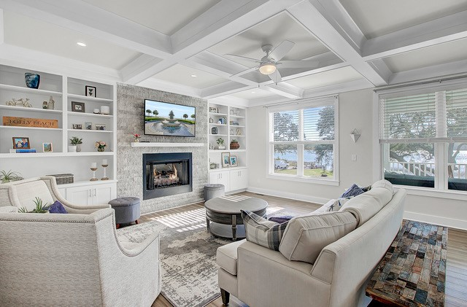
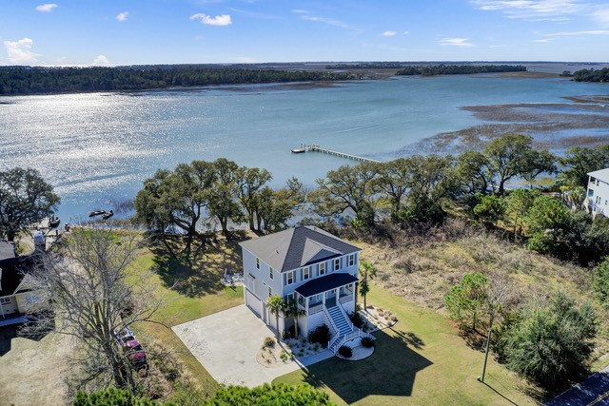
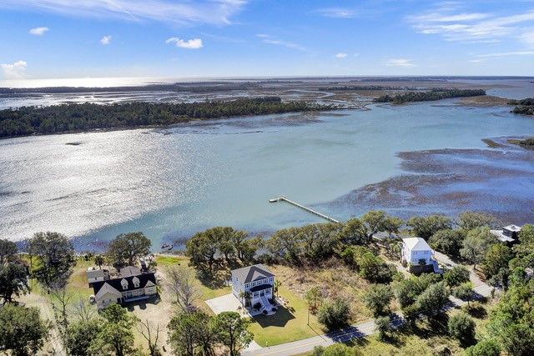
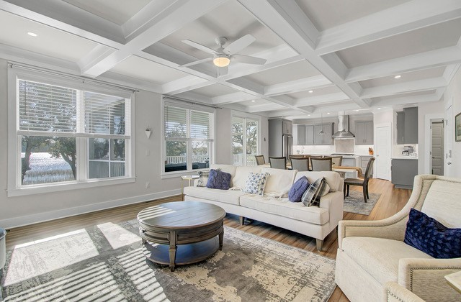
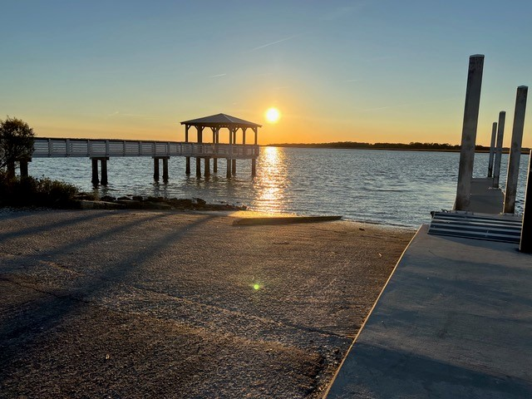
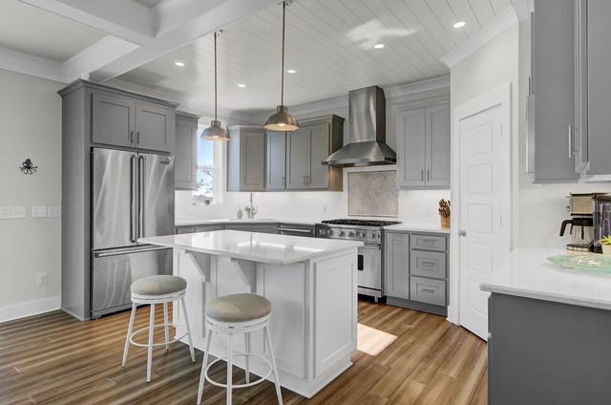
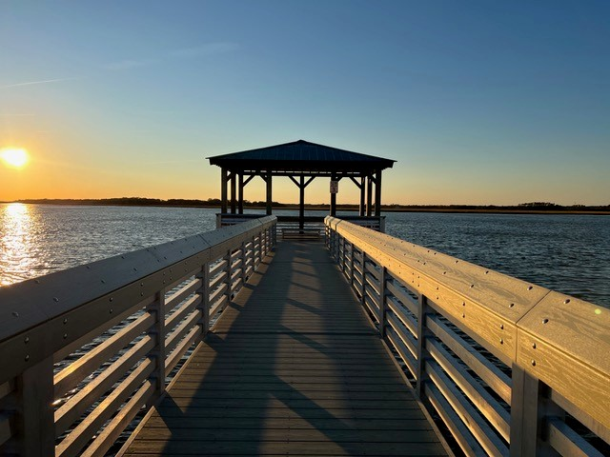


Custom Home with Stunning Views by Folly Beach
2157 Sol Legare Road
Charleston, SC 29412
MLS# 22030595
$1,650,000
Just in time for the holidays, this DREAM HOME will be sure to impress even the most discerning of buyers. A custom elevated home with water views located a mere 5 minutes from Folly Beach. Take in the sight of dolphins each day in your own back yard! This magnificent home has an elevator and sits on a large lot (over 1.7 acres) with marsh and river views. A BOATER’S DELIGHT ~ the Sol Legare Boat Launch and Fishing Pier are at the end of the road and you can keep your boat on your premises. Current owner has initiated the process for dock permit approval. Check out the many stunning features and finishes of this magnificent home where every bedroom is a suite with its own private bath. Coffered and Shiplap ceilings, Viking Appliances, quartz countertops throughout, Cali Bamboo floors… the list of beautiful finishes goes on and on. Time to schedule a tour of this GEM of a home while it is still available.
Click the link to see the property website including walk through video!
Property Website
Ellen O'Neil
Broker/Owner, ABR, e-PRO, CNE
Charleston Realtor of Distinction
(843) 300-8530
www.EllenONeilProperties.com

