Slide 1
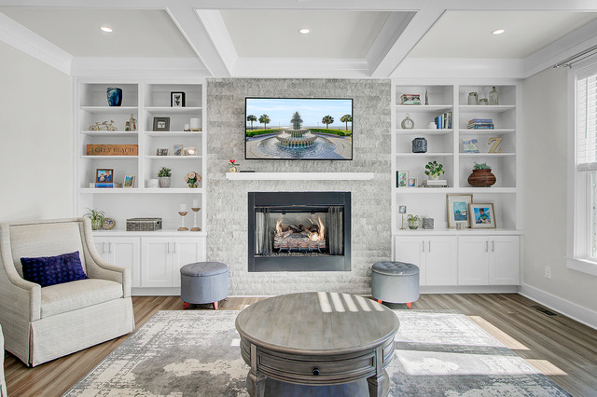
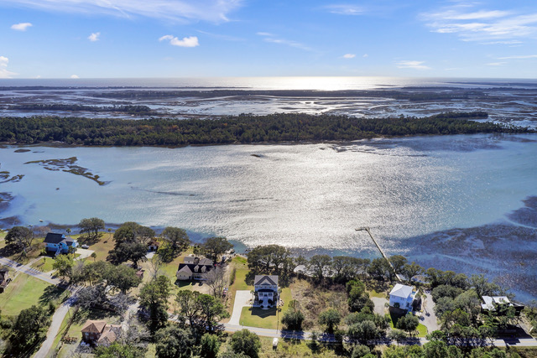
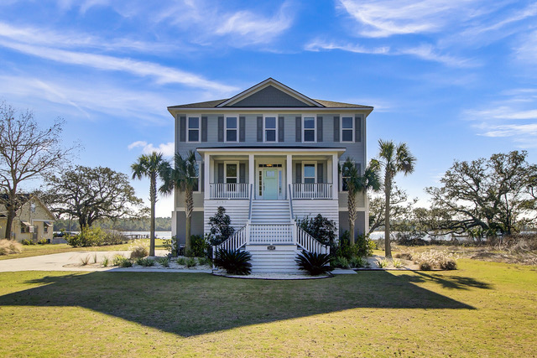
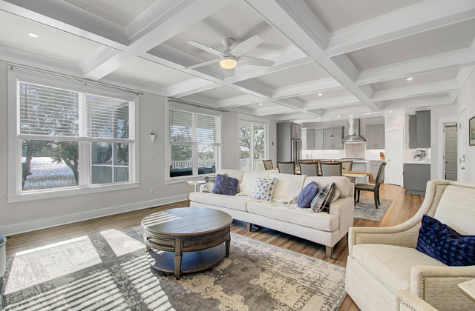
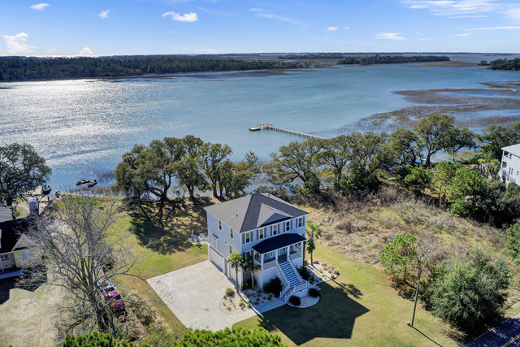
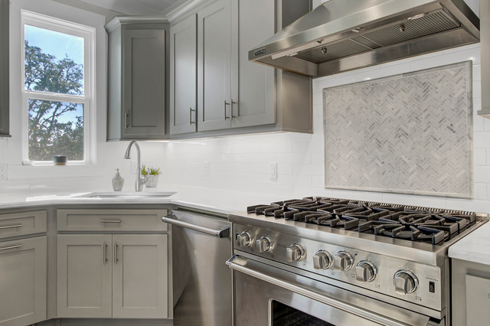



DREAM HOME with VIEWS GALORE
2157 Sol Legare Road
Charleston, SC 29412
MLS# 24002561
$1,585,000
Video Tour
OPEN HOUSE THIS SUNDAY!!!
Sunday, February 18 12:00 - 3:00 PM
Experience waterfront living in this elevated custom home near Folly Beach!
DOCK PERMIT IN HAND! This breathtaking property is poised to sell quickly. Immerse yourself in the meticulously designed floor plan where all 4 bedrooms are suites, each boasting its own private bath. Revel in unparalleled views and seize the opportunity to have your private boat dock with lift! Just 5 minutes to dip your toes in the sand at Folly Beach and a short ride to Historic Downtown Charleston.
Take a video tour of the property!
Ellen O'Neil
Broker/Owner, ABR, e-PRO, CNE
Charleston Realtor of Distinction
(843) 300-8530
www.EllenONeilProperties.com

