Slide 1
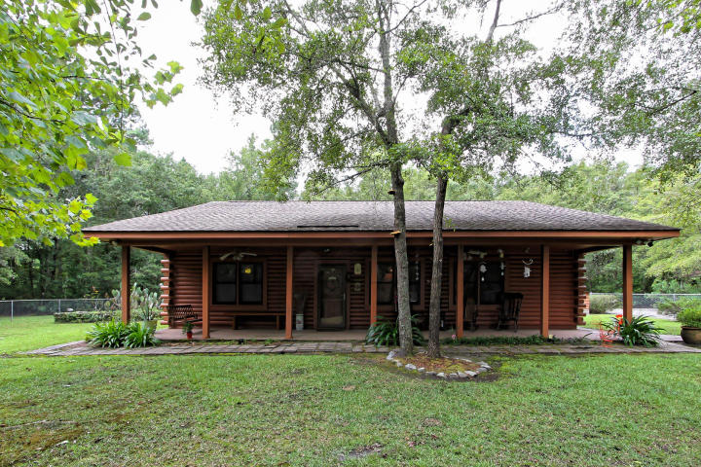
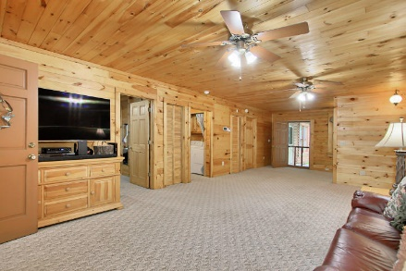
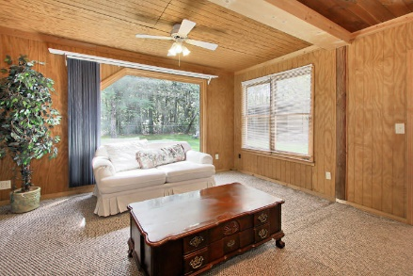
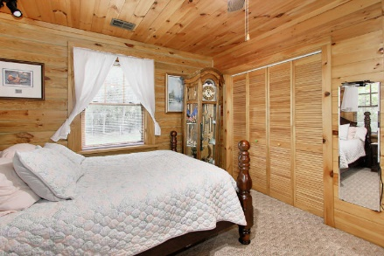
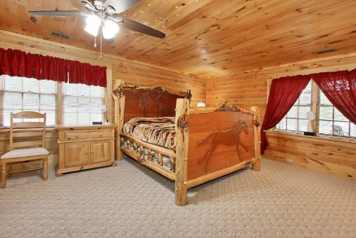
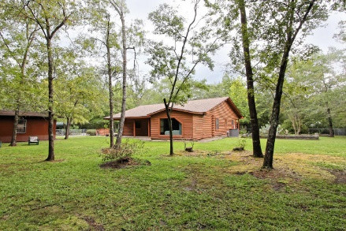
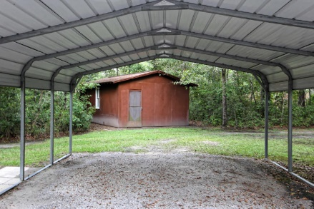



5.9 ACRES MINUTES FROM GOOGLE
215 New Oak Lane Berkeley Run | Moncks Corner, SC 29461
MLS# 18025289 | $425,000
Enjoy the private life on 5.9 acres. This custom built log home is located just off Cypress Gardens Rd minutes from Google. Perfect location for country living but close enough to city stores incase you forget the flour for you pie. The owner built this lovely home and has meticulously cared for it. The beautiful yellow pine walls and ceilings add rustic elegance to the log cabin life. The property has 2 barn like storage units and a green house, which all are completely fenced in. A brand new HVAC unit, all new duct work and tankless hot water heater boost energy efficiency. The home is on city water but there is a working well. The owners have had horses on property, there are an abundance of open spaces for riding.
Barb Burleson
(843) 425-4801
Barb@Southerngenerationsgroup.com
AGENTOWNED PREFERRED GROUP 824 JOHNNIE DODDS BLVD
MT PLEASANT, SC 29464
Marley Presswood
(843) 568-3212
Marley@SouthernGenerationsGroup.com
AgentOwned Preferred Group | 824 Johnnie Dodds Blvd | Mt Pleasant, SC 29464

