Slide 1
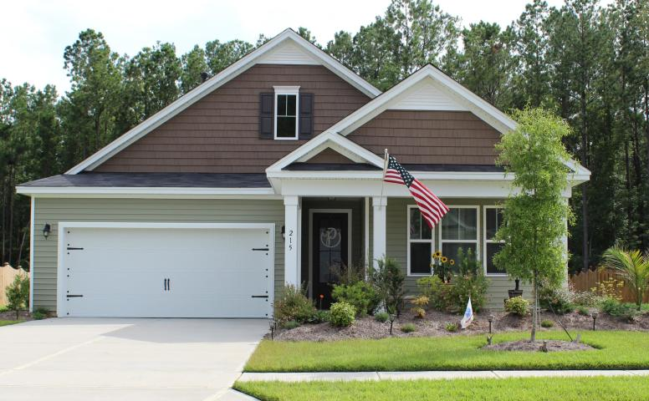
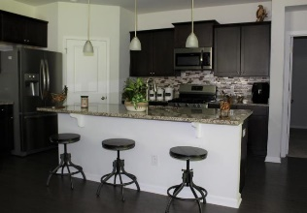
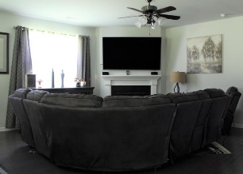
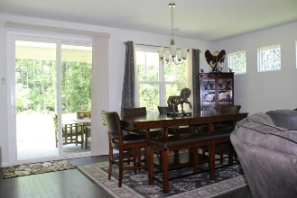
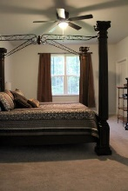
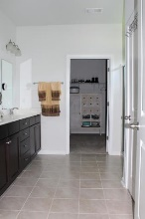
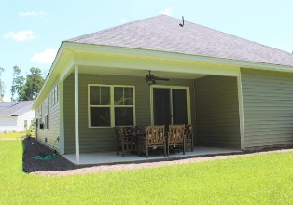
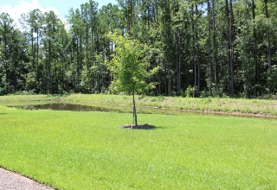
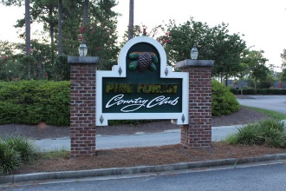
Motivated Seller Bring All Offers
215 Olympic Club Drive
Pine Forest Country Club
Summerville, SC 29483
MLS# 19020368
$298,500
You will fall in love with this move-in ready open concept single story home.
The wide foyer leads past 2 guest bedrooms and a full bath into the open living area and kitchen. The large granite kitchen island makes this home perfect for entertaining and has a lot of storage space. Master bedroom has two walk-in closets. Stainless steel appliances, granite countertops, gas range, and a tankless gas water heater are among a number of great included features in this home. Cozy up around the fireplace or relax on the large covered rear porch and enjoy the serenity of nature across the pond and into the densely wooded adjacent property. This home is within walking distance to Pine Forest Country Club's clubhouse, pool, pro shop and tennis courts.
Kevin Siko | (219) 808-6942 | kjsikohomes@gmail.com
Brand Name Real Estate | 4 Carriage Lane Suite 106 | Charleston, SC 29407

