Slide 1
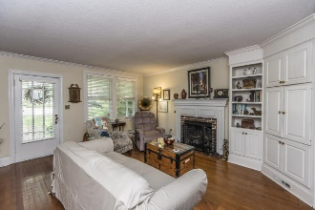
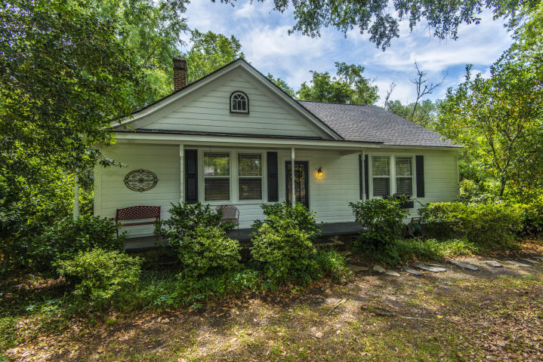
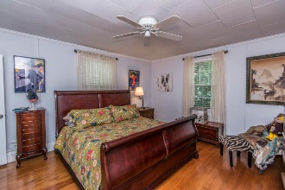
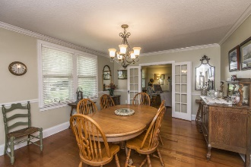
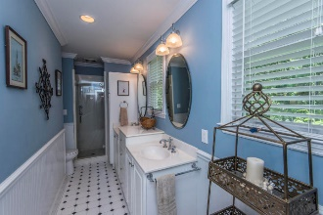
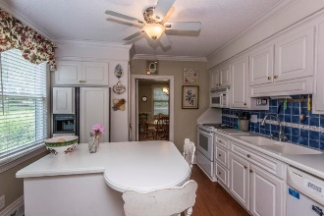
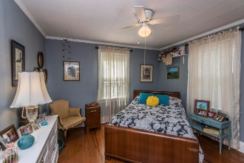
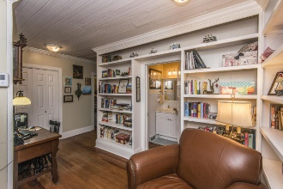
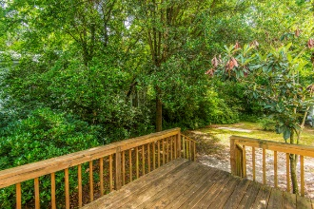
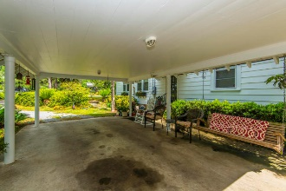
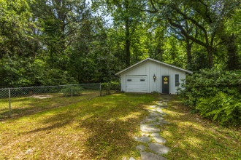
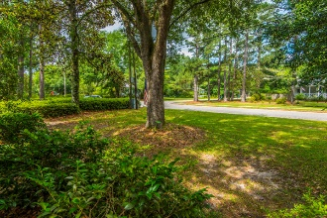


PRICE REDUCED IN HISTORIC SUMMERVILLE!
4 bed, 3.5 bath
Price Reduced In Historic Summerville!
Welcome home to 205 Magnolia Road, the best location in Charleston!
This 3 bedroom, 2 bath, 1636 sqft charming craftsman style cottage is footsteps from the most popular shops and restaurants of Avondale. Loaded with updates and upgrades, there is nothing you won't love about this home. Wonderful curb appeal and an adorable front porch with custom gate. Fresh paint throughout the entire downstairs. Gorgeous original hardwoods. Main floor master bedroom with oversized closet could almost double as an office! Brand new privacy fence captures one of the largest lots in the neighborhood. Kitchen loaded with updates and gas for cooking. Bathrooms have been updated / upgraded, bathtub re-glazed. Lighting has been updated with custom fixtures. Loads of storage. Oversized mudroom/laundry room. Huge storage shed with electrical provides endless options for use. All a few short minutes from downtown for work and play. This is the location and property in excellent condition that everyone's looking for. Come make this charming house your new home!
Offered for $470,000
215 S Gum Street
Historic District ~ Summerville, SC 29483
MLS# 18014038 ~ $339,900
DRASTIC PRICE REDUCTION ON THIS charming home in HISTORIC section of SUMMERVILLE, a 2 block walk from Hutchinson Square. On a quiet street of well-maintained homes, this 2BR, 2 bath home has hardwoods throughout except ceramic tile in the master bath. Set a spell on the full front porch shaded by huge trees. Enter the home to the living room complete with built-in TV niche/bookshelves and wood-burning fireplace. The French doors lead to the large dining room complete with chair rail. Push the door open into the cozy kitchen which has solid-surface countertops, an island at which to eat, fridge conveys and custom tile backsplash. The master bedroom is large and has a private bath that was added by the previous owner. The secondary bedroom is also large and has a ceiling fan.
The hall bathroom, original to the home, has slatted ceiling, tub/shower combo and updated vanity and fixtures. In the center of the home is an office space complete with closet, built-in bookshelves and a doggie door conveniently hidden in one of the shelves! Outside enjoy the deck which has chain link fencing for keeping the dogs and children safe. The carport is huge and the detached garage is home to laundry area and workshop. Enjoy all this on a lot that backs up to woods. Home under termite bond, security system which can transfer at no cost to buyer, and roof is less than 2 years old!
Don't let this historic gem slip away!
Barbara Daniels
(843) 532-4274
bdaniels@carolinaone.com
www.barbaradanielshomes.com
Carolina One Real Estate | 900 N Main St. | Summerville, SC 29483-6633

