Slide 1
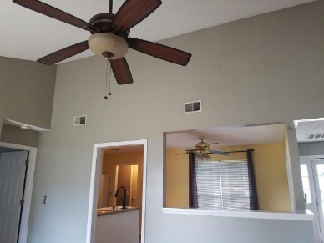
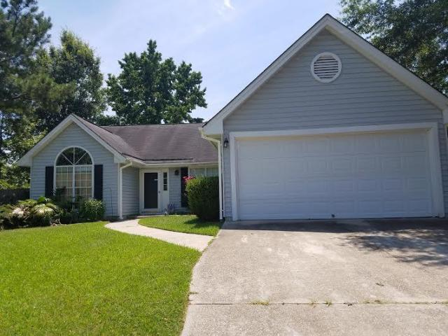
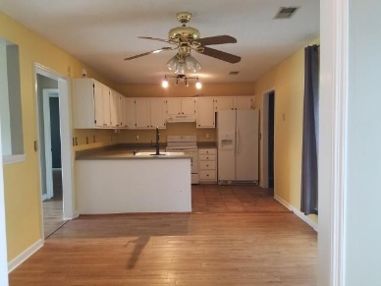
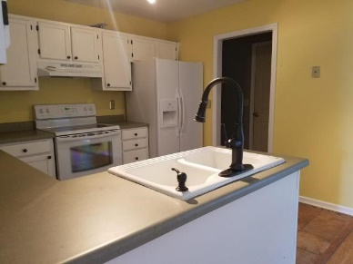
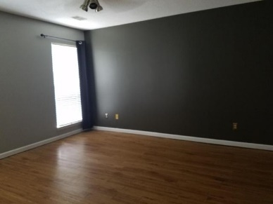
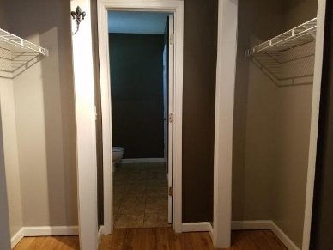
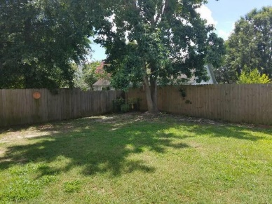
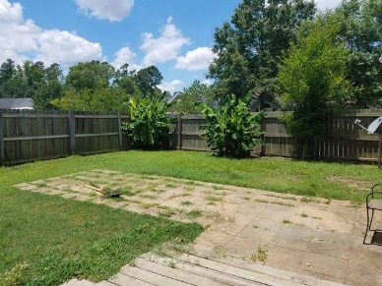


215 Woodland Lakes Road Woodland Lakes ~ Goose Creek, SC 29445 MLS# 16016432 ~ $165,000
Seller will pay portion of special assessment w/ full price offer
$500 Agent Bonus with ratified contract by 8/20/16
This attractive single story home with an open floor plan on a nice corner lot at the opening of a cul-de-sac is conveniently located near shopping, schools, and employment including bases. The roof was replaced in 2010 and the air handler is fairly new too. The large kitchen opens to the Family Room and family room has vaulted ceilings making the space feel spacious. The Master Bedroom is separate from other two bedrooms and there is a large patio off of the family room. New roof was installed in 2010 and the Air Handler was replaced in 2013 so large maintenance items have been taken care of for you. Home is close to soccer fields and recreation center
Cheryll Woods-Flowers
ABR, e-Certified, SHS
(843) 442-2219
www.woodsflowers.com

