Slide 1
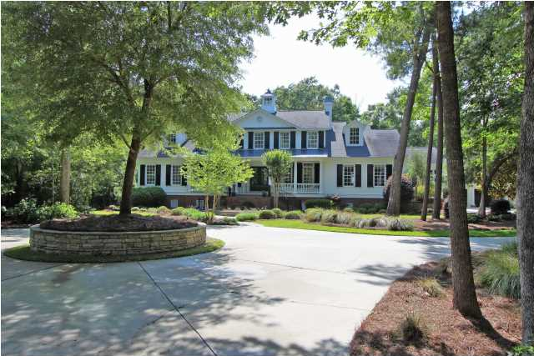
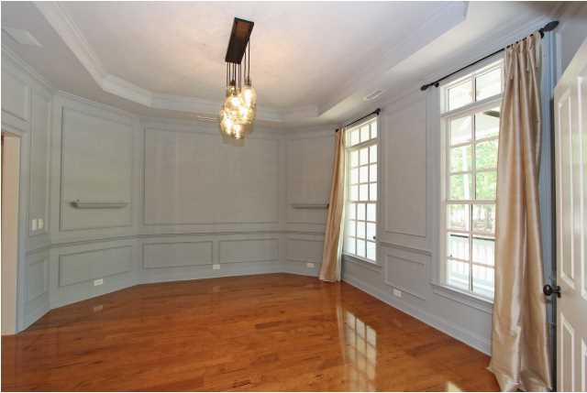
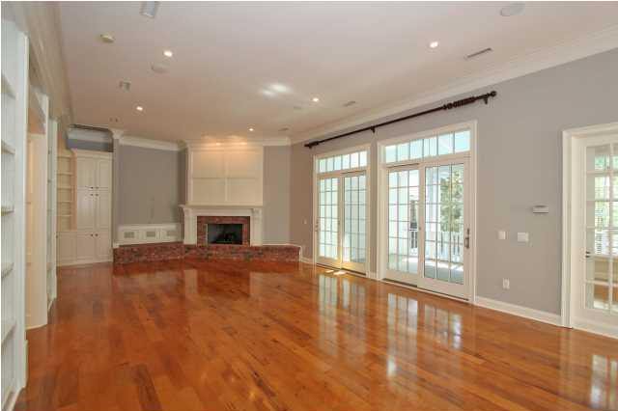
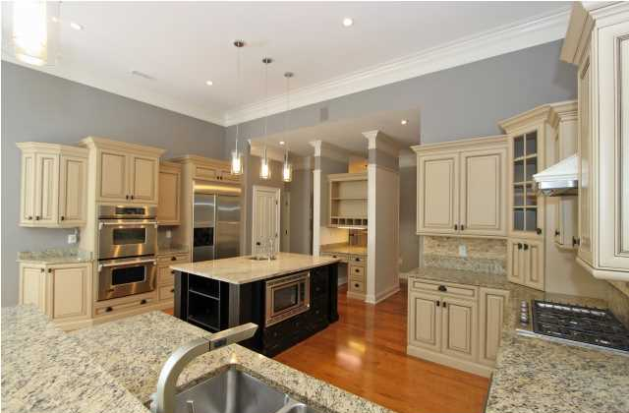
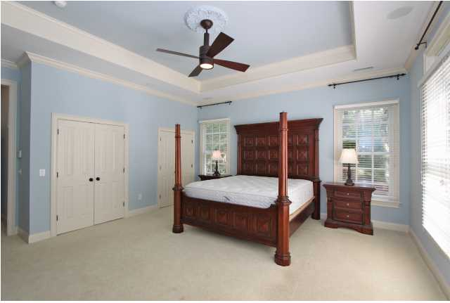
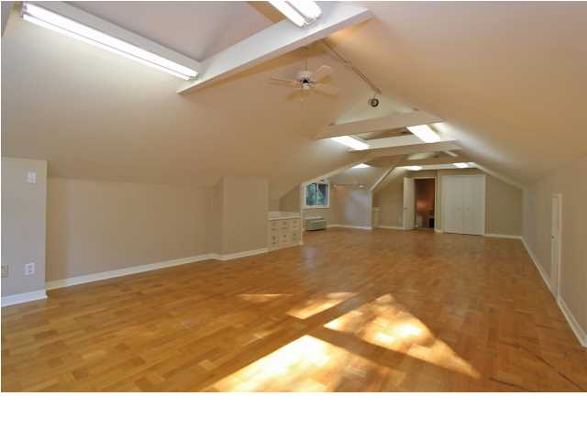
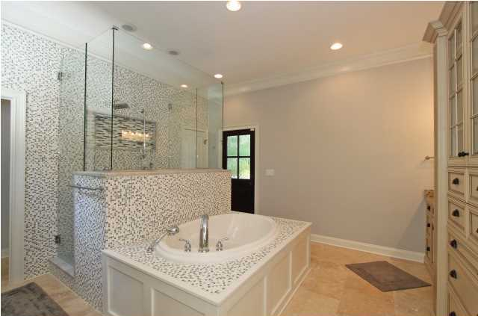
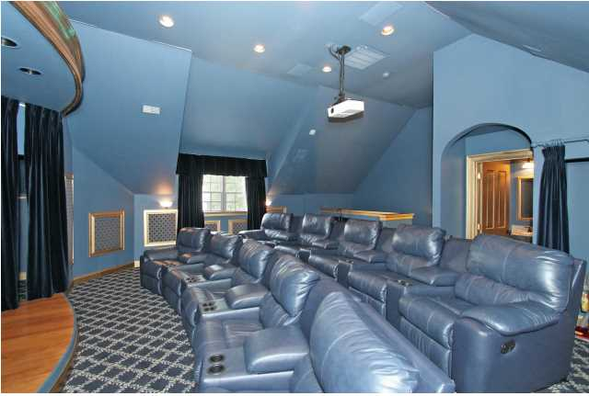
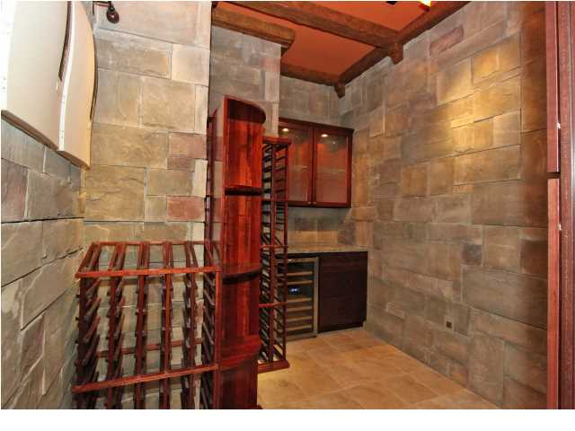
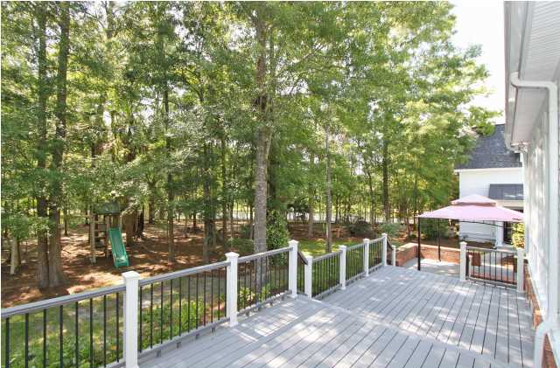


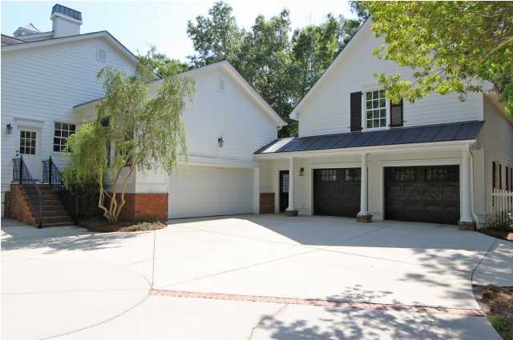
2161 Shell Ring Cir Dunes West MLS# 1412938 $1,195,000
See more at www.2161shellring.com
Looking for that special, forever family home? Look no further - you have arrived! Turn into the circular drive of the one and a half acre, landscaped, private corner homesite. Enter the stately plantation-style home via the welcoming front porch. To the left of the expansive foyer is a bedroom wing with a bedroom every little girl dreams of , two additional bedrooms, large master suite with huge walk-in closet, two additional closets, all with custom built ins , newly updated master bath with all the bells and whistles . Directly through the foyer, enter a magnificent great room with fireplace and entertainment area with all audio equipment in place. Chefs kitchen contains double ovens, two dishwashers , built in microwave in island, brand new gas cooktop, large pantry, work station, loads of counter space and cabinets. Sunroom off of kitchen with entertainment built ins ; powder room ;wine room with one hundred plus bottle wine racks and separate wine chiller; laundry room with room for two sets of washer/dryers, folding island , separate utility sink, and extra refrigerator completes first floor. Stairs leading to second floor comes with custom- painted mural on treads. Upstairs has two spacious bedrooms with shared bath , sitting area ,and plenty of extra storage. Fitness room with more storage and a unique children's hideaway . Outdoor areas include screened in porch with additional outdoor decking and gazebo area. Playground equipment included. Step into garage area that doubles as gym with basketball goal installed . Mud room connects to additional two car garage with a work station and a second floor theater room that will give your family years of fun and memories. Trey ceilings and wainscoting throughout; full irrigation and outdoor lighting. This is truly a home of classic elegance.
Clay Cunningham
Office - (843) 886-8110
Cell - (843) 345-4647
Fax - (843) 202-2921
clay@carolinaone.com
Carolina One Real Estate
1400-E Palm Boulevard
Isle of Palms, SC 29451

