Slide 1
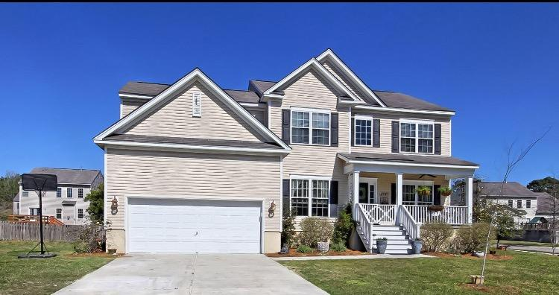
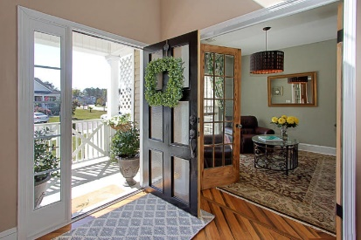
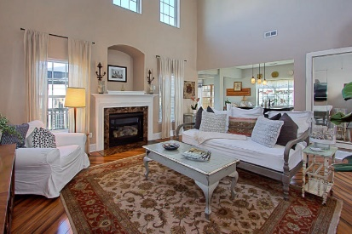
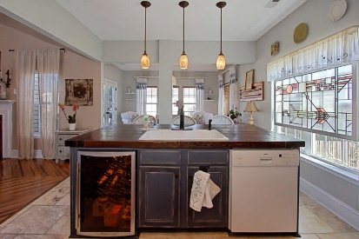
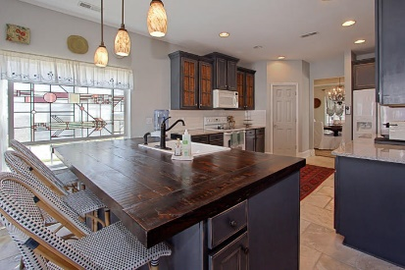
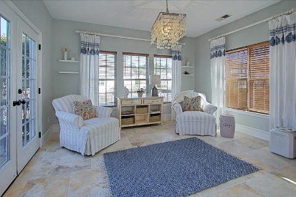
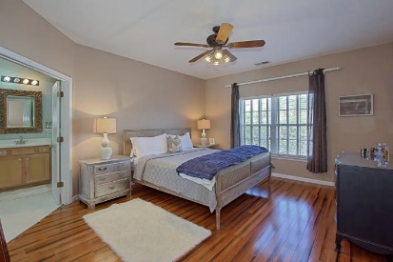
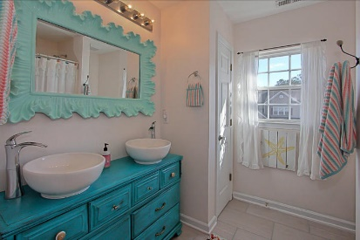
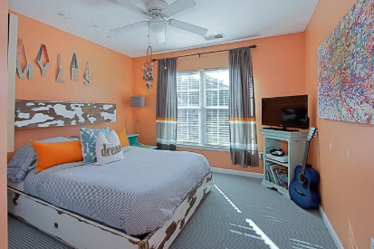
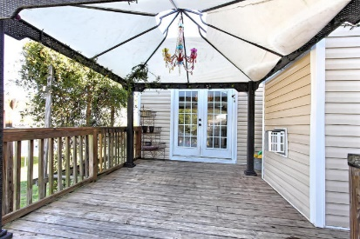
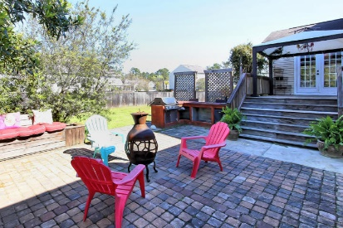


2161 Summerwood Drive
Planters Pointe ~ Mount Pleasant ~ MLS# 17017274 ~ $419,000
Motivated Sellers! Priced Well Below Appraisal!
From the moment you step in this home you recognize that the sellers have left no detail overlooked. From the herringbone bamboo floors to the large dark stained butcher block island complete with wine fridge, the home exudes unique character. Upon entering the home to your left there is a charming sitting are or office complete with beautiful French doors and to the right is a separate formal dining room. Directly adjacent to the dining area is the kitchen that features dark grey cabinets, open shelving, subway tile backsplash, and island with barstool seating. Behind the kitchen is another cozy sitting area that leads to the back deck/patio seating area, which are perfect for entertaining.
Mary Beth Bennett
(843) 367-1774
marybeth.bennett@agentownedrealty.com
www.chsarealiving.com
AgentOwned Preferred Group | 824 Johnnie Dodds Blvd | Mt Pleasant, SC 29464

