Slide 1
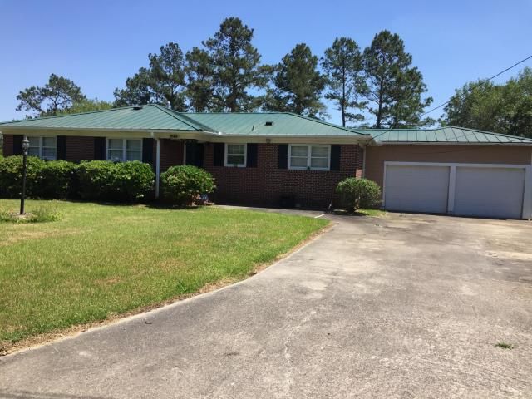
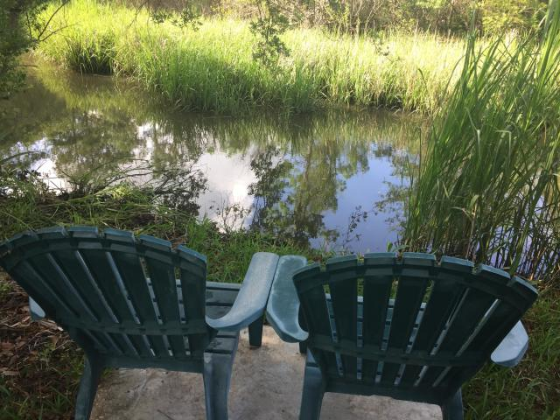
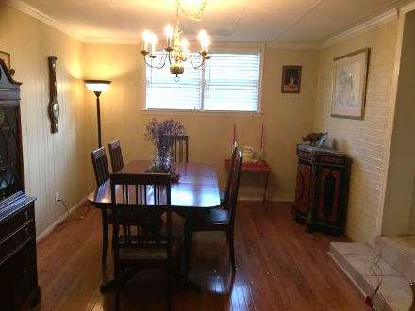
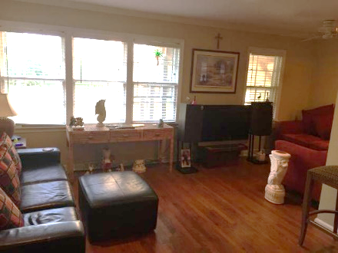
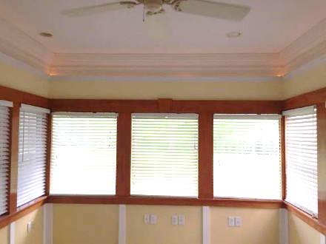
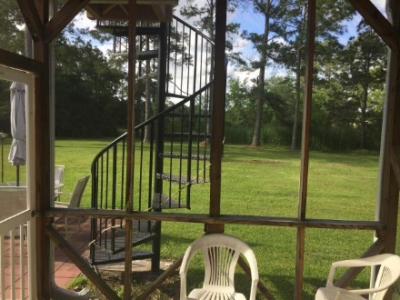
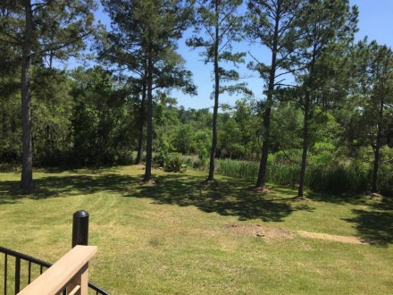
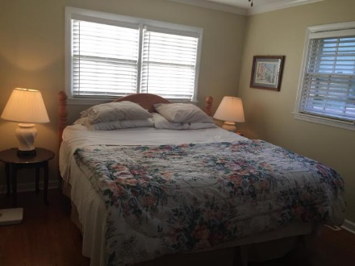
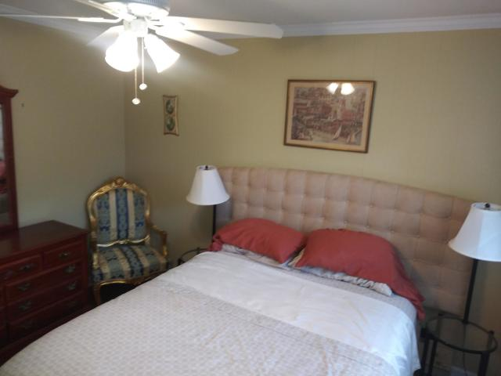
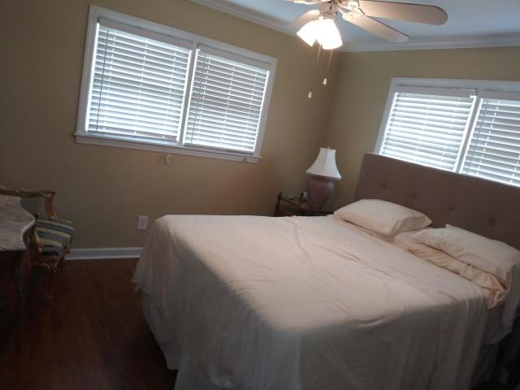


2168 Church Creek Drive
Springfield ~ Charleston, SC 29414
MLS# 19022811 ~ $348,000
West Ashley On Creek $348k!
Sunroom (approximately 225 square feet) is not included in square feet of home as it is slab on grade but it is air conditioned with picture windows and 2 stage crown molding.
Home is also on Church Creek with views across Church creek basin from Upper deck and Beautiful views of Church Creek from family room and sunroom.
Home also boasts a large screened porch and patio areas.
Gene Santos
(843) 729-2476
yoojeenw@yahoo.com
Brand Name Real Estate
4 Carriage Lane Suite 106
Charleston, SC 29407

