Slide 1
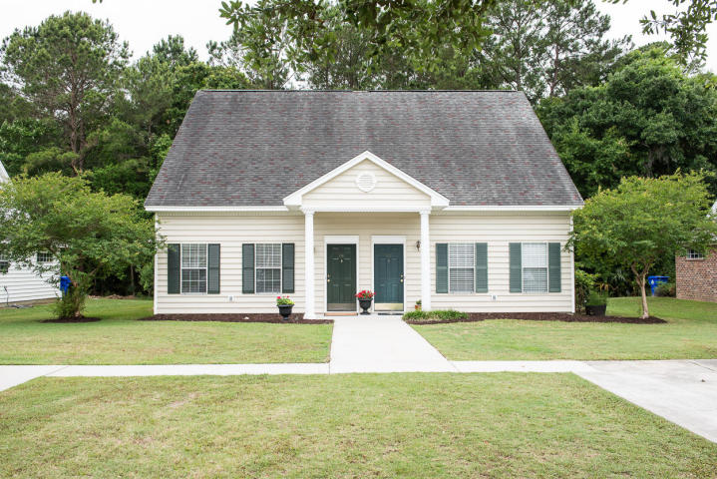
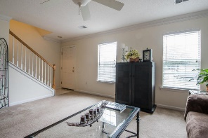
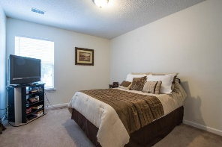
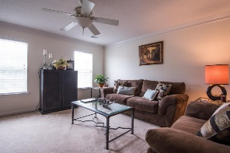
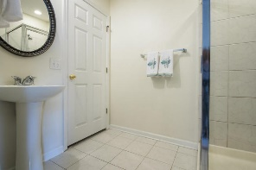
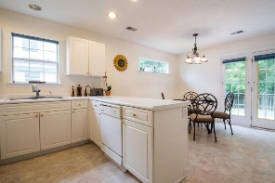
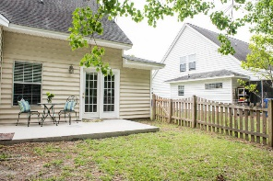
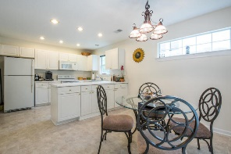
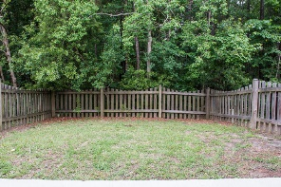


Just Reduced!
2168 Kings Gate Lane
Dunes West ~ Mount Pleasant MLS# 16013673 ~ $199,950
Now the coolest house on the block! Thanks to a brand new HVAC system. Beautiful and spacious one and a half story, 3 bedroom 2 bath townhome in desirable Dunes West. Once inside this light and bright duplex you will be greeted with a large living room decorated in neutral colors, ample in size to accommodate all your furnishings. You will also be delighted with the large eat-in kitchen with plenty of counter space, dual pantries, breakfast counter and breakfast nook with lots of light from the French door. All this overlooking a wonderful fenced in wooded backyard and private patio. The first floor bedroom can be used as a master or guest bedroom, with attached bathroom. The second floor boasts two more spacious bedrooms providing plenty of walk-in closet space. Other features include crown molding, and tile in the bathrooms. Located in one of the best school districts in the state! Close to dining, shopping and entertainment. It is also one of the best buys in all of Mt Pleasant!
John Nugent
(843) 304-2061
john.nugent@carolinaone.com
www.nugentknowsrealestate.com
Carolina One Real Estate | 628 Long Point Rd | Mt Pleasant, SC 29464

