Slide 1
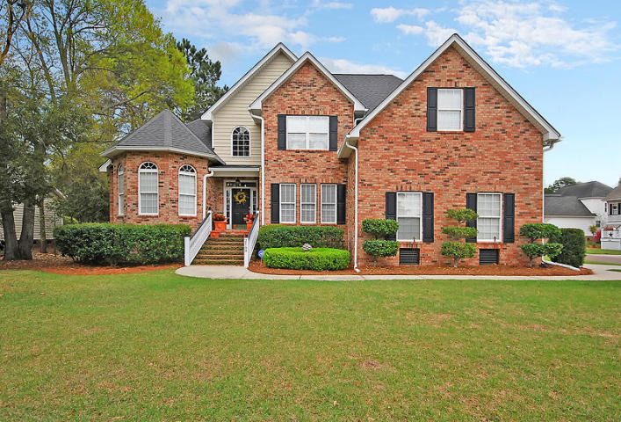
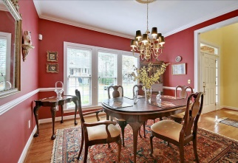
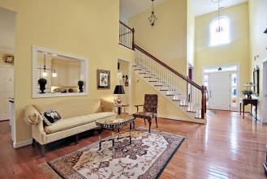
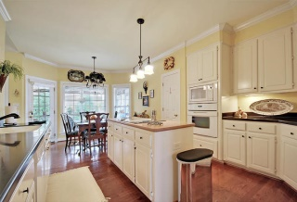
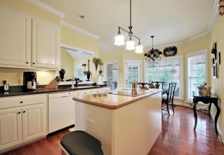
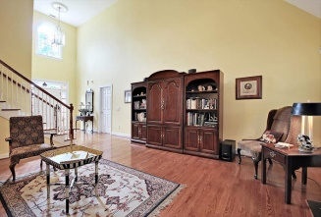
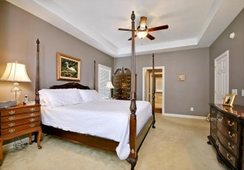
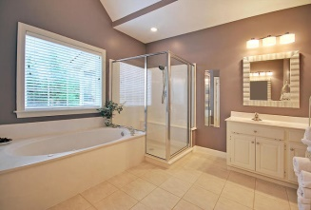
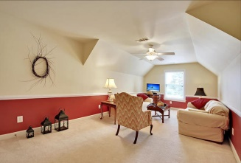
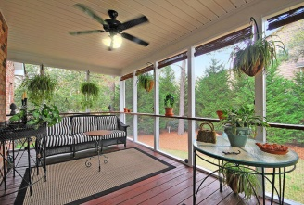
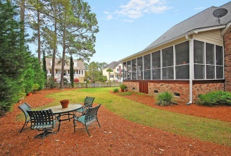

2168 Salt Wind Way Planters Pointe Mount Pleasant, SC MLS# 15007640 $448,000 4 Bedrooms | 3 Baths | 2,601 sf
Open House Lunch ~ Friday, Oct 3 from 11 - 1
Handyman Special… Bring your hard hats!
Stunning Home!
Absolutely, perfectly stunning brick home in Saltwood section of Planters Pointe. Conveniently located very near Park West, Park West schools, Dunes West and Rivertowne semi-private golf courses. Play golf at Dunes West or Rivertowne!
Great kitchens and baths! Home has lots of hardwood, site built custom cabinetry, huge screen porch with private feel. Open kitchen/breakfast/family rooms. Fireplace in family room w/gas logs & blower.
Master suite down and a another downstairs bedroom with walk-in closet and full bath - perfect for mother-in-law living needs. Huge bonus room over two car garage with plenty of work area. Extra storage with concrete floor under screen porch.
This is one of the prettiest brick homes in the area - a joy to show! Note - bonus room is fifth bedroom
Jill Marcacci
843-297-5590 jill@agentowned.com
www.agentownedrealty.com
AgentOwned Realty Co. Preferred Group, Inc. | 824 Johnnie Dodds Blvd | Mt Pleasant, SC 29464

