Slide 1
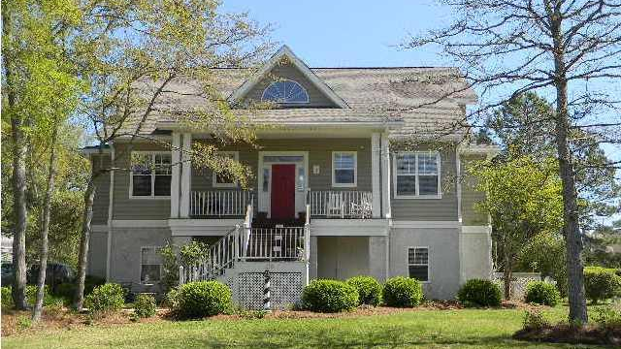
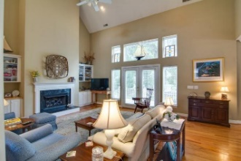
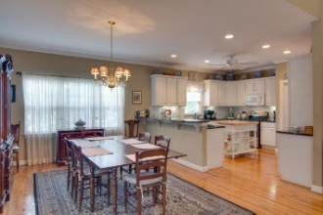
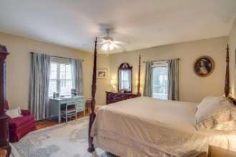

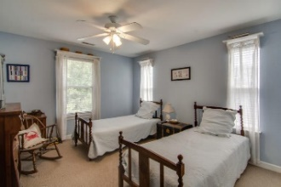
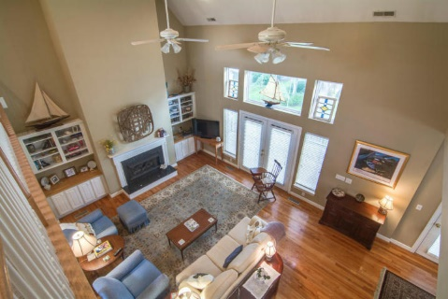
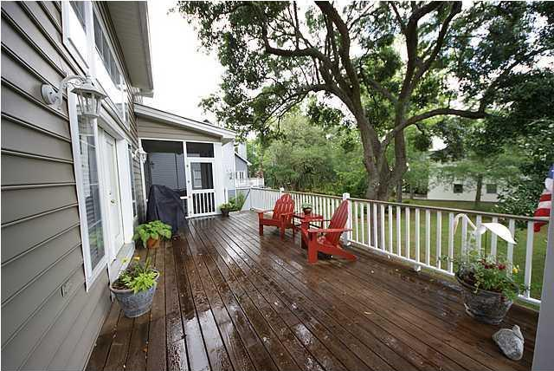
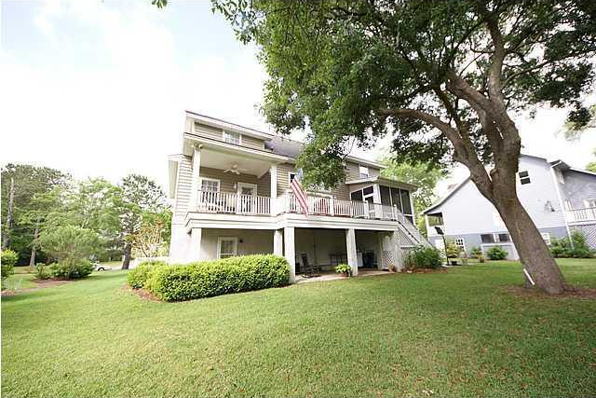


St Thomas Point Open House
Sunday, April 15th from 1-4
Custom built 4 bedroom/4.5 bath, well maintained home in the gated community of
St. Thomas Point on the Wando River.
There is an open floor plan with big Great Room, open to the Kitchen and Dining Area. Kitchen is large with Granite Counter Tops...New Stainless Steel Appliances, and lots of cabinet space. Hardwoods throughout the main level...Walk out onto the large deck and be greeted by a canapy of large private trees. Master Bedroom is on the first floor, with private screen porch...Then upstairs are two large bedrooms each with it's own private bath... Updated carpeting on this level. Walk down to the ground level and be greeted by another living space, with Bedroom and Full Bath. It has it's own private entry, perfect for Mother In Law Suite. New Philip Simmons HS, Opening this Fall.
216 Ashmont Drive
Wando, SC 29492 ~ MLS# 17018706 ~ $499,900
4 Bedrooms | 4½ Baths | 3,100sf
Frank Rutigliano
843-813-4961
frutigliano@kwchs.com

