Slide 1
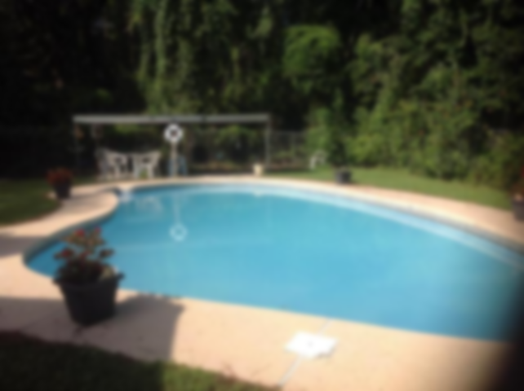
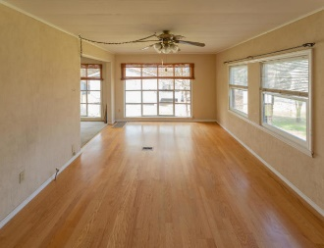
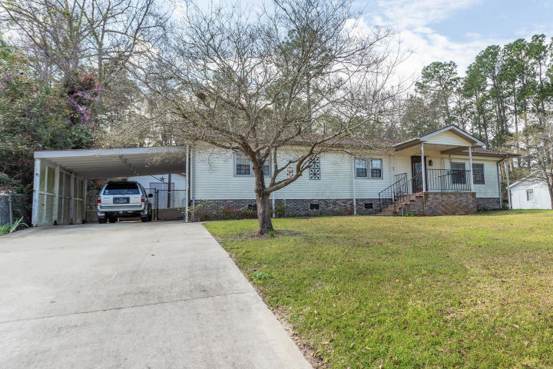
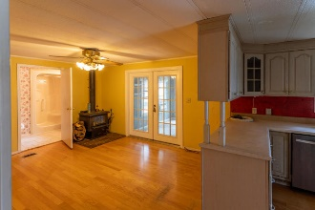
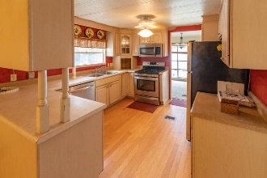
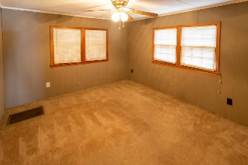
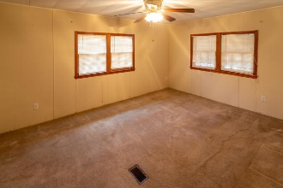
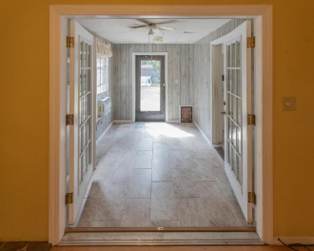
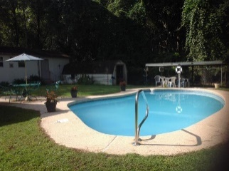

Awesome Property With A Lake View And In-Ground Swimming Pool! Minutes to Big Cathead!
216 Belvedere Drive
Eutawville, SC 29048 | MLS# 20007812 | $159,900
3 Beds | 2½ Baths | 1,548 Square Feet
This home is less than 2 miles of public lake access!!!
This 3 bedroom and 2.5 bath home has stainless steel appliances in the kitchen. The inside bathrooms have been updated with handicap access and granite countertops. There is a concrete inground pool that is 3-8 feet deep adjacent to a covered patio and outside half bathroom for changing clothes etc.. The yard is fenced and there is a workshop with electricity as well as separate large storage area. There is also another storage building for pool and yard supplies and equipment. The home has vinyl siding and gutter for easy clean up.
Carla C Davis
Mobile - (843) 437-4873
gaweber@tds.net
AgentOwned Premiere Group
141 A N. Main Street
Summerville, SC 29483

