Slide 1
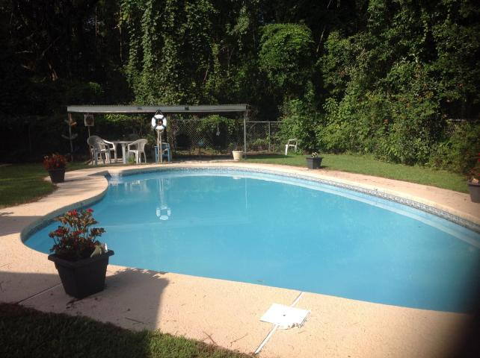
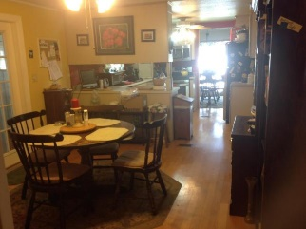
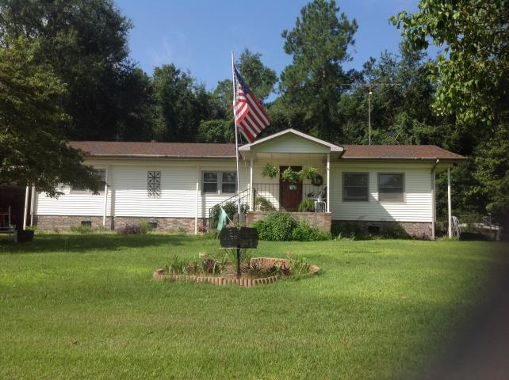
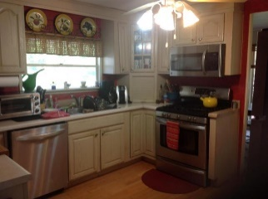
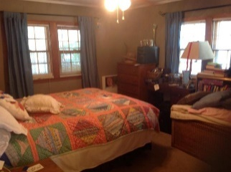
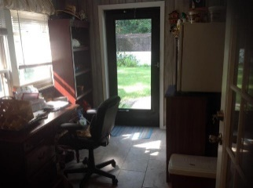
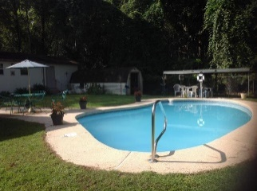
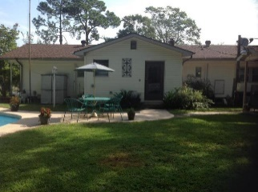
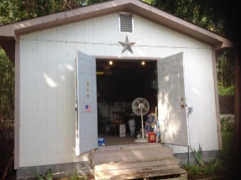

Awesome property with a Lake view and in ground swimming pool! Minutes to Big Cathead!
216 Belvedere Drive
Eutawville, SC 29048 | MLS# 17022175 | $159,900
3 Beds | 2½ Baths | 1,548 Square Feet
This property is within 2 miles of public lake access! Also has a fenced in yard, covered patio, workshop with electricity, separate shed for outdoor equipment, outside half bathroom for pool use, gutters and vinyl siding, stainless steel appliances, brick underpinning, washer and dryer (gas) that stay, and a wood stove. This 3 bedroom, 2.5 bathroom home also has a concrete in-ground swimming pool that is 3-8 feet deep, a one car carport, granite counters, and updated bathrooms that are handicapped accessible.
Carla C Davis
Mobile - (843) 437-4873
gaweber@tds.net
AgentOwned Premiere Group
141 A N. Main Street
Summerville, SC 29483

