Slide 1
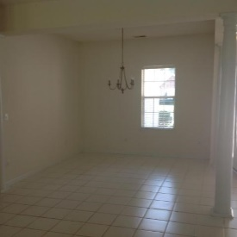
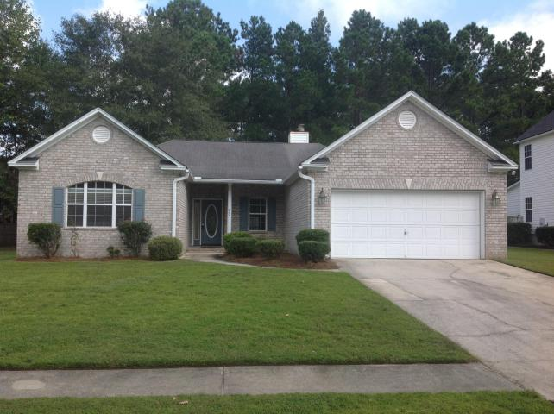
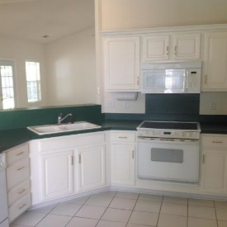
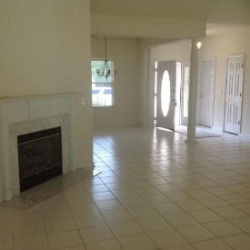
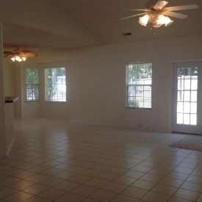
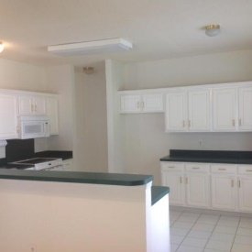
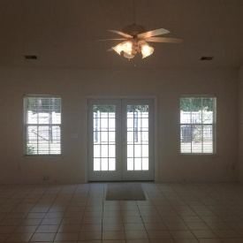
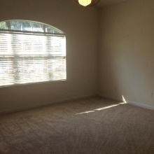
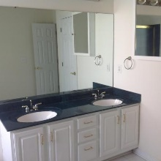
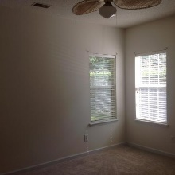
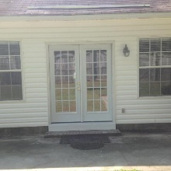
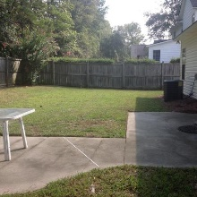
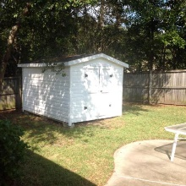
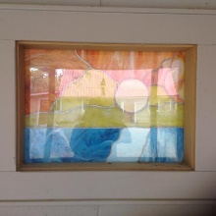

RECENTLY REDUCED!
216 N Pembroke Drive
Crowfield Plantation | Goose Creek | MLS# 17026024 | $232,500
If you are looking for a home with an open floor plan this is the home for you! This beautiful 3 bedroom and 2 bath brick home has all new carpet through out as well as new interior paint and New French doors. This property is on a quiet cul de sac and is close to schools and shopping. Property backs up to the path, has a 8ft x 12ft shed, Large tiled Gas fireplace in living room, and New side door in garage. Property also has insulated storage over the garage with a brand new set of stairs!
Carla C Davis
Mobile - (843) 437-4873
gaweber@tds.net
AgentOwned Premiere Group
141 A N. Main Street
Summerville, SC 29483

