Slide 1

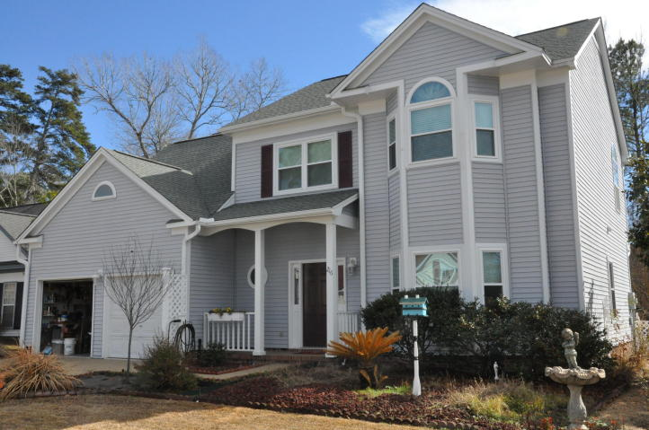
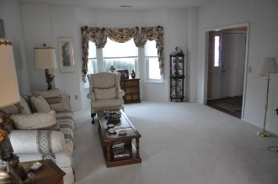
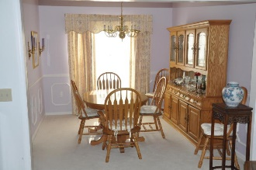
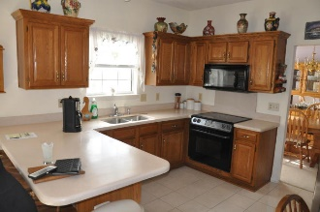
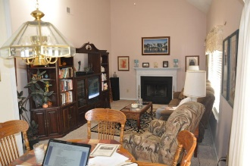
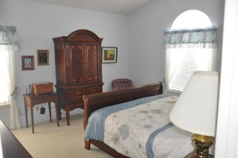
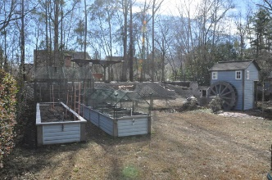
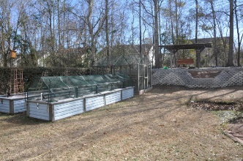
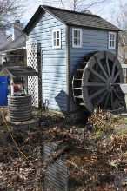
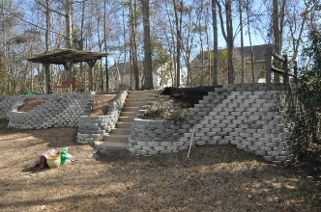
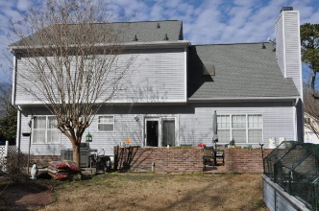


216 Smithfield Avenue
Brandymill · Summerville · MLS# 18002886 · $280,000
New Listing in Brandymill
New Listing in sought after Brandymill!! Meticulously maintained 3BR + Loft (4th BR) 2.5BA in a great neighborhood; Large eat in kitchen with formal dining room; Some notable improvements include solid surface countertop and ceramic tile floor in kitchen; all piping changed to CPVC; The 30 year shingle roof is less than 10 yrs old; Home comes with dual thermostats for comfort and energy efficiency with metal ducting installed in attic; Two car garage is a workman’s dream with insulated garage doors and 8’ work bench complete with sink! The backyard is something to see! Custom flagstone walkways to Pond w/Creekbed, Waterfall and Waterwheel attached to 4’ x 8’ shed (w/power); the yard has TWO 4’ x 22’ Raised Beds and vertical strawberry planter for growing your favorite fruit vegetables AND 10' x 10' Screen House WITH asparagus bed! newcomes with six station sprinkler system!; 10' x 28' custom patio with brick planters; has custom stone retaining wall with staircase to berm. Home comes with Security System.
David Salzinger
(843) 580-4185
charlestonsells@gmail.com
AgentOwned Premiere Group | 1800 Trolley Rd | Summerville, SC 29485

