Slide 1
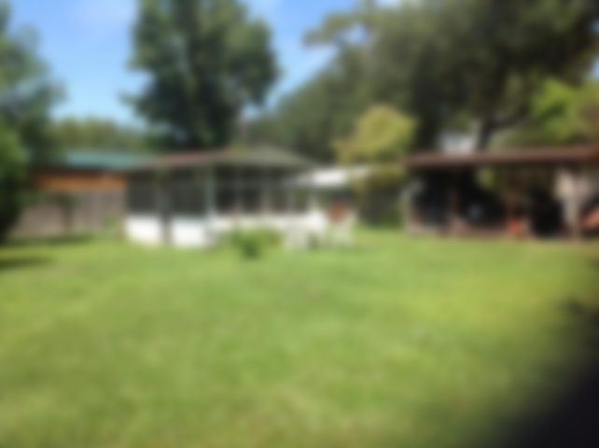
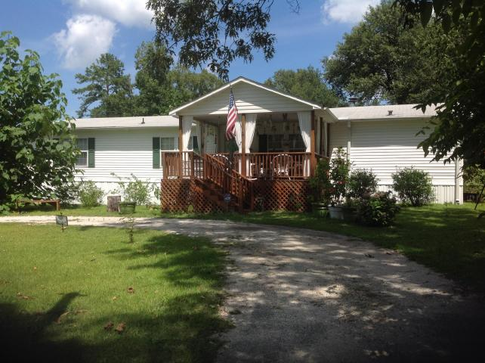
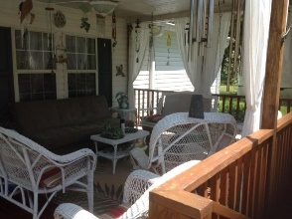
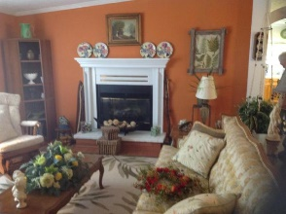
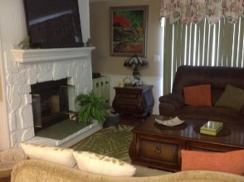
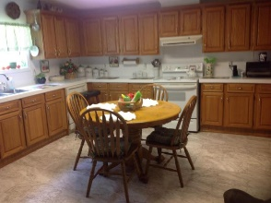
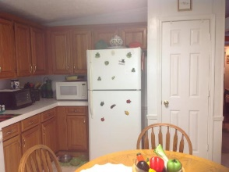
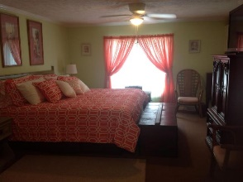
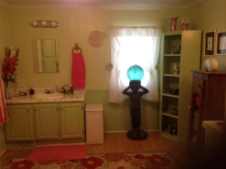
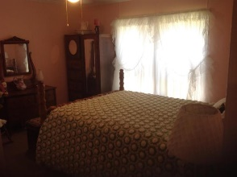
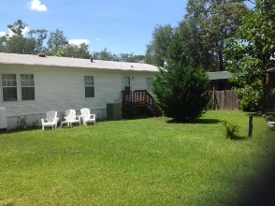
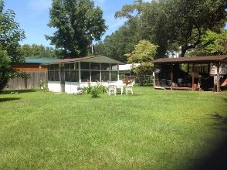
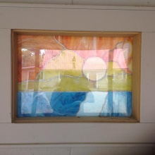

Immaculate Home Within Minutes Of Lake Marion!
216 St John Street
Eutawville, SC 29048 | MLS# 17019976 | $119,900
3 Beds | 2 Baths | 1,904 Square Feet
IMMACULATE!!!! MUST SEE. THIS PROPERTY IS JUST ACROSS ROOSEVELT FROM LITTLE CATHEAD. LARGE KITCHEN WITH CABINETS GALORE. DUAL FIREPLACES FROM DEN TO LIVING ROOM. MOVE IN READY FOR FULL TIME RESIDENT OR GREAT GETAWAY PLACE. LARGE SHED CONVEYS FOR YOUR LIFE JACKETS, FISHING TACKLE OR STORAGE IN GENERAL. CLOSE TO BIG CATHEAD AS WELL.
Carla C Davis
Mobile - (843) 437-4873
gaweber@tds.net
AgentOwned Premiere Group
141 A N. Main Street
Summerville, SC 29483

