Slide 1
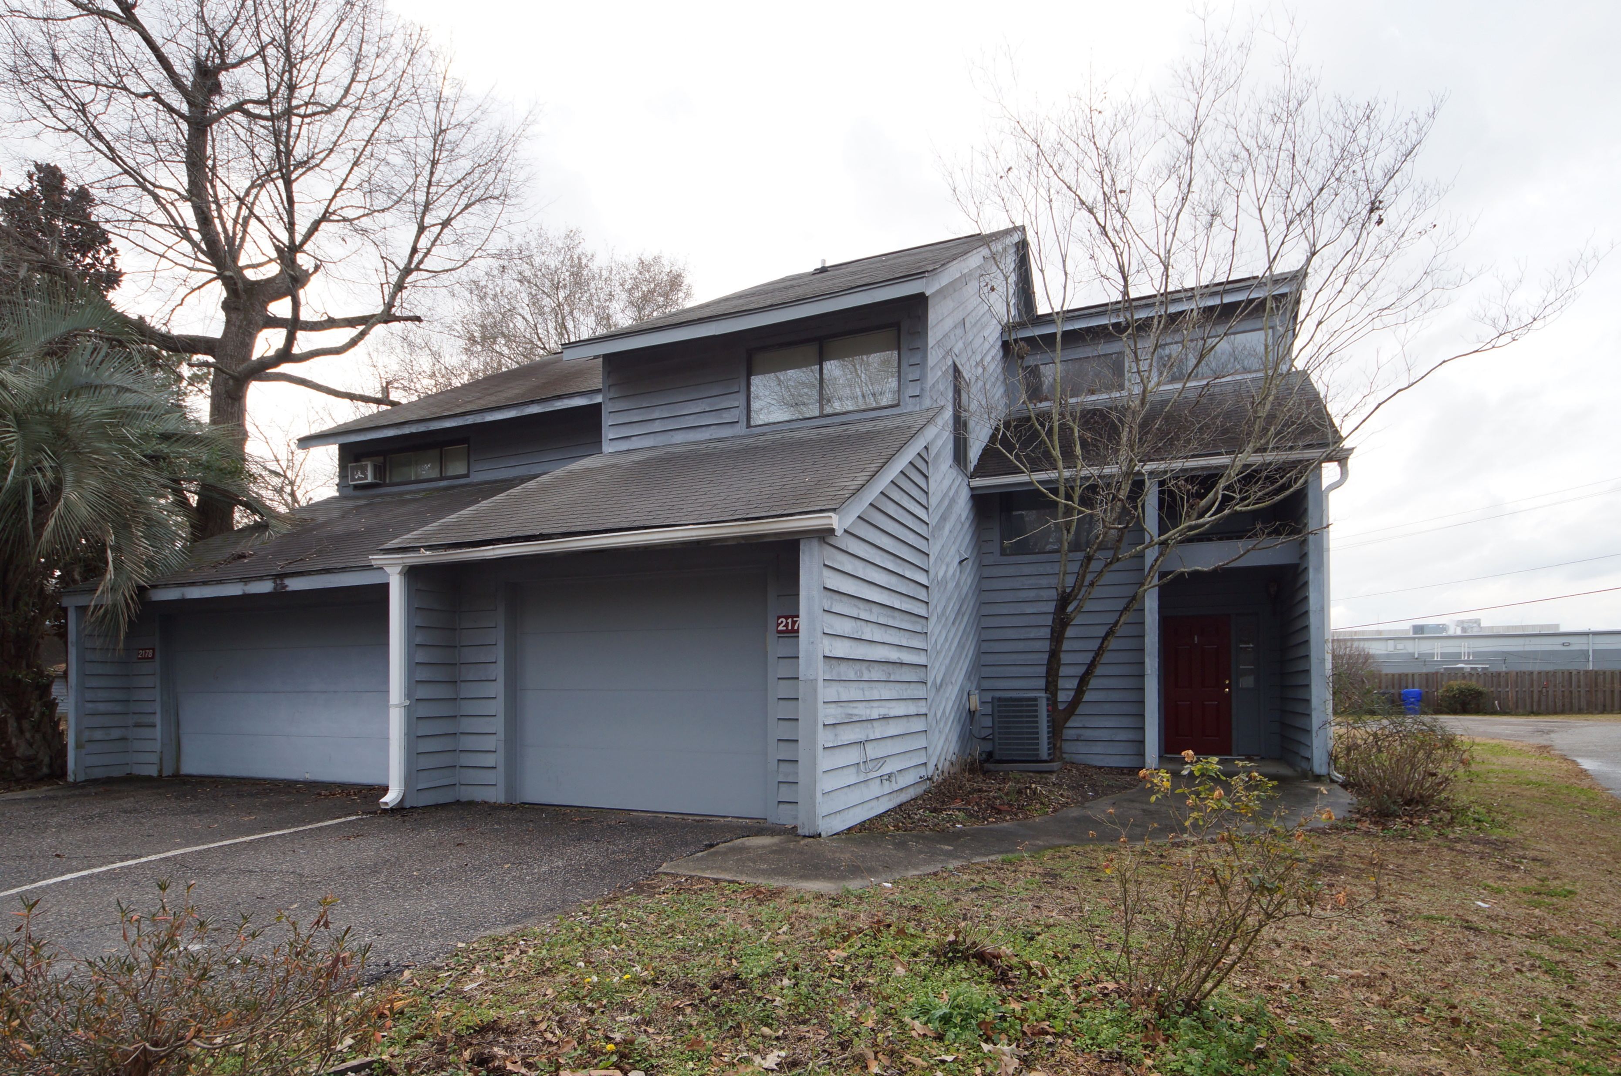
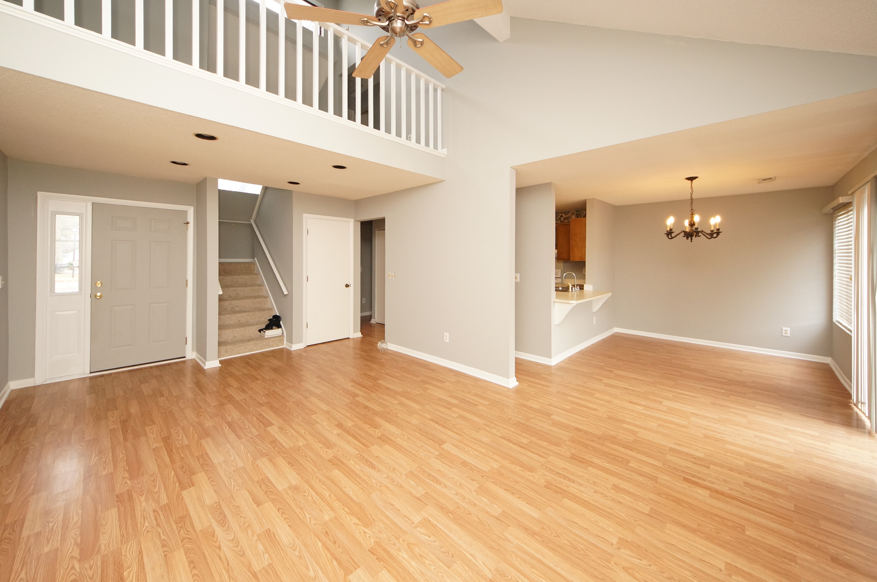
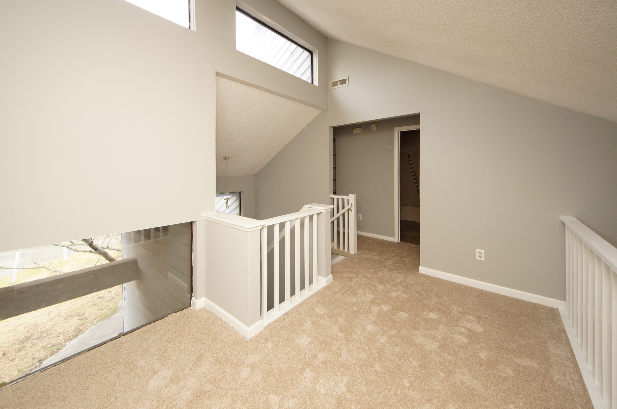
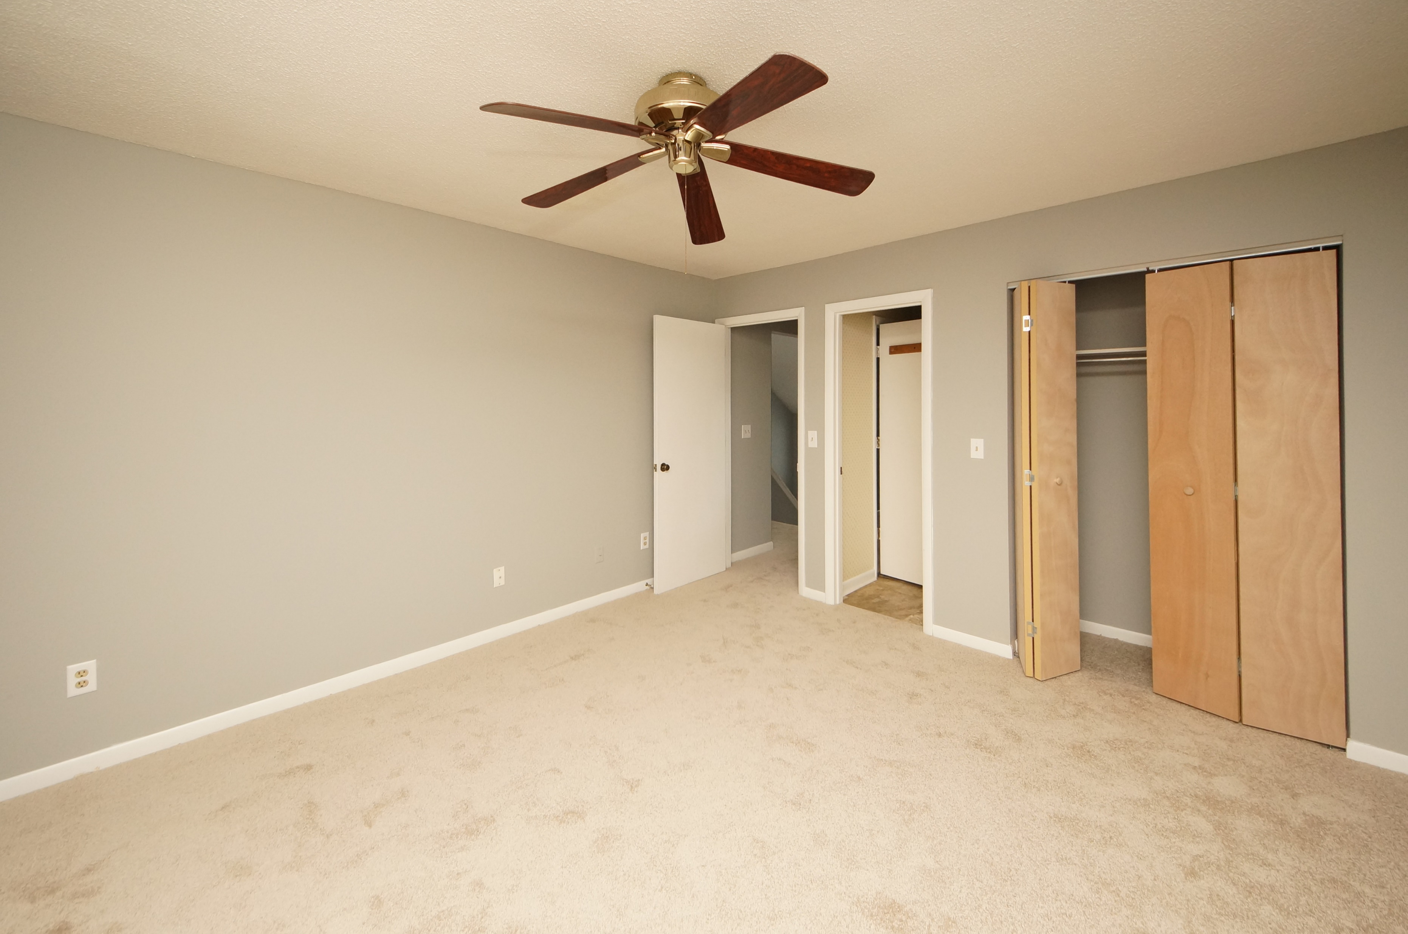


2176 Spoleto Lane Otranto Club Villas III :: N Charleston, SC 29406 MLS# 18001748 :: $110,000 2 Bed / 1½ Bath
New Paint and New Carpet!
Just Reduced
Spacious 2 bedroom 2.5 bath home with eat in kitchen, living room, fire place, and upstairs loft.
Per seller monthly regime covers insurance on the exterior of the condo, roof and termite bond.
Opportunity to own a nice home in a convenient location!
Neighborhood pool!!!
Connie White, Broker
843-532-3356
conniesyouragent@gmail.com
Charleston Homes · 597 Old Mt. Holly Road · Suite 301 · Goose Creek, SC 29445

