Slide 1
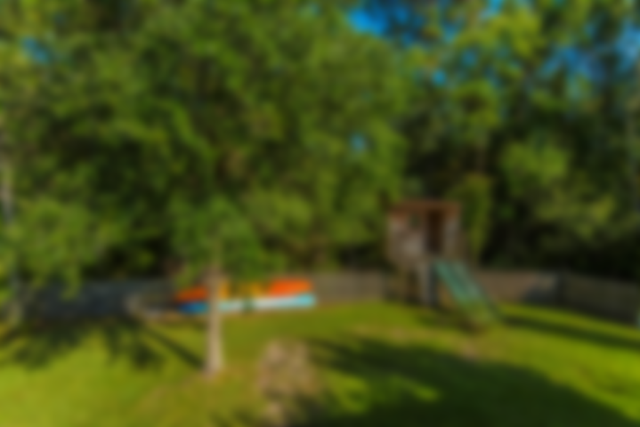
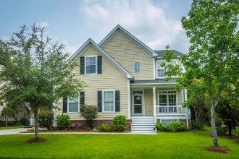
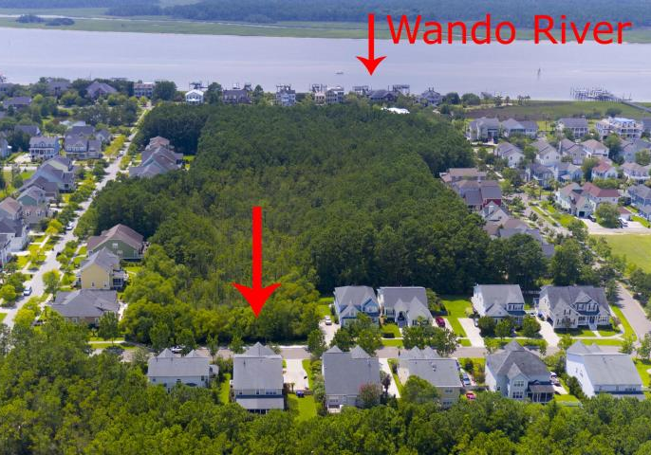
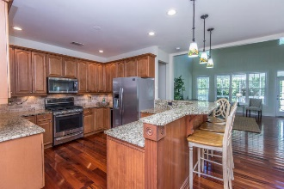
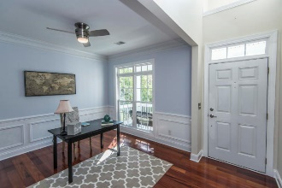
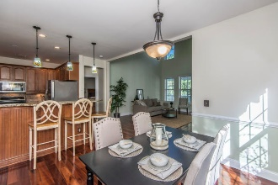
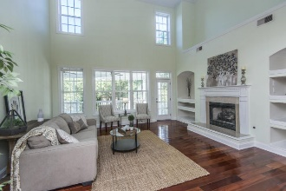
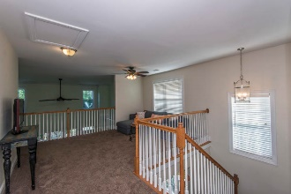
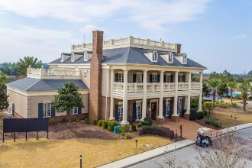
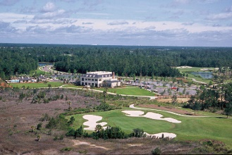
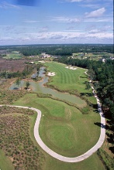
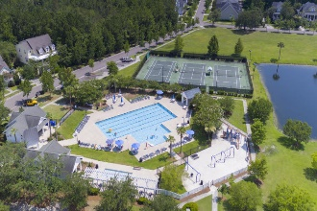
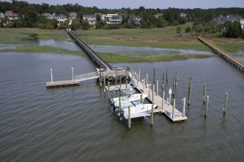


2177 Sandy Point Lane Mount Pleasant, SC 29466 | MLS# 18020096 | $551,000
New Price! Best Value in Rivertowne!
Charming southern cottage located in one of Mount Pleasant's most sought after neighborhood of Rivertowne on the Wando. Stepping into the home you'll be greeted by gleaming hardwood floors and a formal dining room with custom treatments such as wainscotting, crown moulding and tray ceiling. Currently being used as a home office, this flexible space can transform into any use that suits your family's needs! Just beyond, the stunning two story family room provides the 'wow factor' everyone is searching for!
Additional features and updates include dual zone HVAC with Ecobee4 Smart WiFi thermostats for both units, all new 10year hardwired with battery back smoke and carbon dioxide detectors throughout and all toilets and seals recently replaced. All of this and located in the prestigious Rivertowne on the Wando Neighborhood with three community docks for fishing, boating or just to relax and watch the amazing Wando River sunsets. Enjoy golf at Rivertowne Country Club's Arnold Palmer Signature Course then meet friends at the club for dinner. Additional amenities include neighborhood pool, tennis courts, walking trails and play park all conveniently located to beaches and the world class dining and shopping of historic downtown Charleston
Asking $1,200,000
MLS# 17023051
3,692 SqFt
4 Bed/3½ Baths
Short Drive to Historic Downtown Charleston & Beaches
Don Dawson 843-514-0452 ddawson@carolinaone.com Carolina One Real Estate • 2713 Highway 17 North • Mount Pleasant, SC 29466
www.TeamDawsonSC.com

