Slide 1

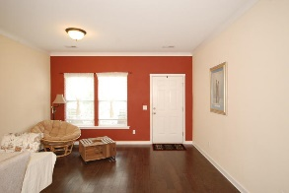
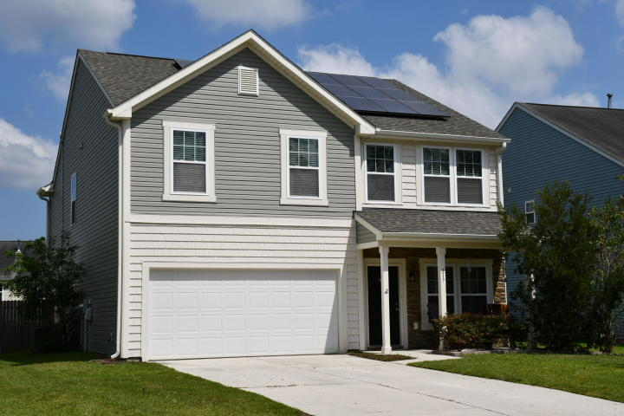
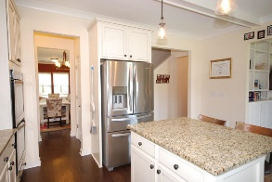
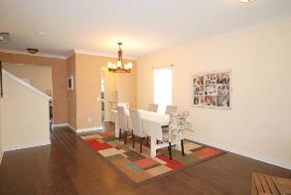
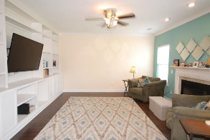
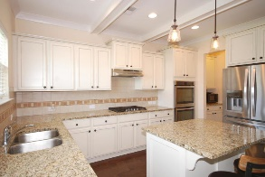
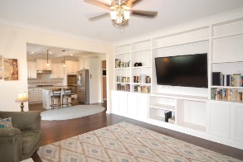
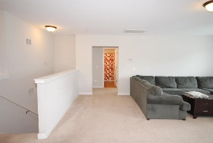
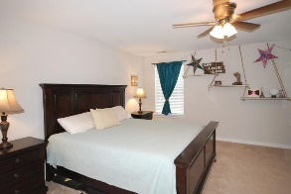
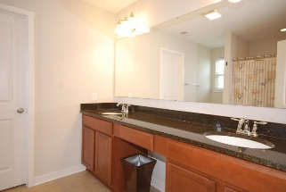
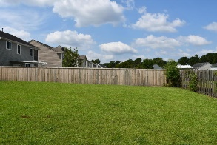
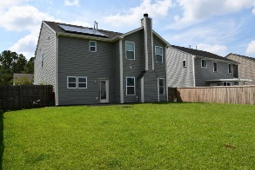
Debbie Cromer
ABR, RSPS, REALTOR, CRS
(843) 437-6342
debbie@debbiecromer.com
www.mylowcountryhomes.com
Offering $1,500 Agent Bonus
through October 31!
217 Balsam Circle
Madison Ridge | Summerville, SC 29485 | MLS# 19025927 | $269,500
Beautifully maintained home with Solar Panels.
You enter the home into the spacious formal living and dining space with plenty of room for a holiday meal. The butler's pantry connects it to the gourmet kitchen with a beamed ceiling, double wall ovens, gas cook top, granite countertops and stainless steel appliances, flowing into the family room with both a fireplace and beautiful built ins. There is also a cute drop zone, half bath and two car garage. Hardwood floors throughout the downstairs and whole house central vac. Upstairs you find a large loft, generous master bedroom with en suite bath and large walk in closet, real laundry room, two additional bedrooms and a full hall bath. The backyard is large and fully fenced. Don't forget the solar panels. July '19 power bill was $26
Century 21 Properties Plus | 1090 Park West Blvd; Ste 3 | Mount Pleasant, SC 29466

