Slide 1
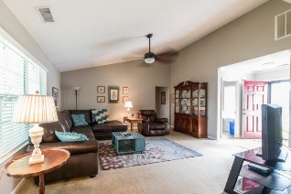
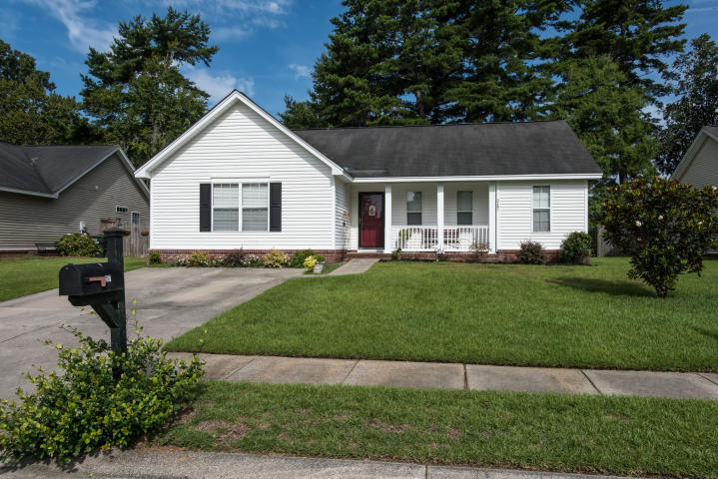
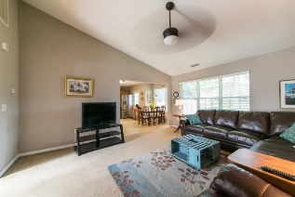
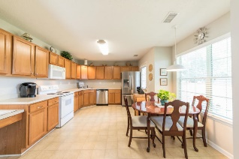
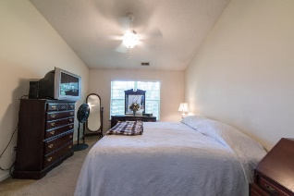
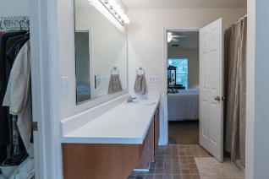
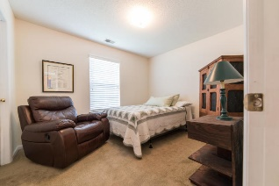
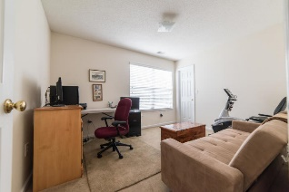
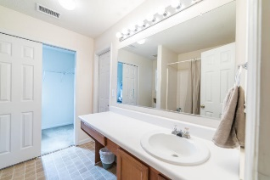
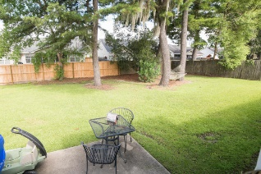


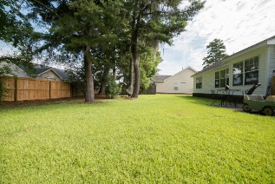
217 Mallory Drive
Grand Oaks Plantation ~ Charleston, SC 29414
MLS# 19021927 ~ $228,000
Easy living at its finest
This cute cottage has everything you need. A cute front porch graces the front of this home. As you enter there is a small foyer with a large laundry room. The family room is spacious and opens up into the breakfast area and large kitchen. Tons of counter space graces this beautiful and very efficient kitchen. Tons of cabinets and lots of natural light. There are two generously sized guest bedrooms with a full bath that services both rooms. Then on the other side of the home there is a large master bedroom with an en suite bath and a huge walk in closet. Don't miss this opportunity! Priced to sell y'all so come see this home today!
Carey Nikonchuk
(843) 276-1701 M
cnikonchuk@gmail.com
www.palmettoproperty.net

