Slide 1
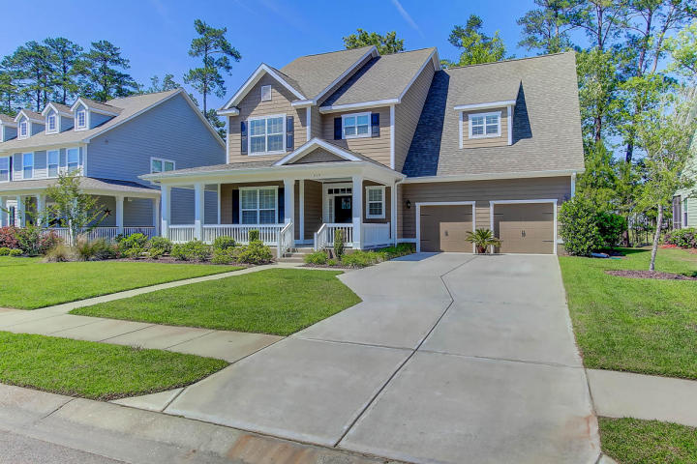
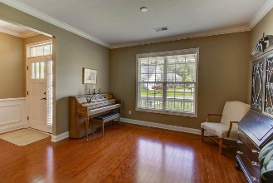
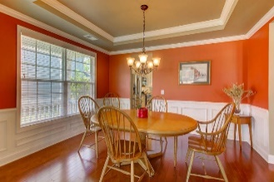
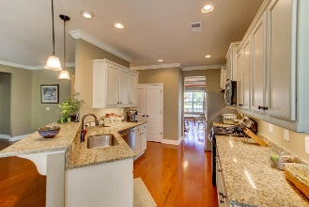
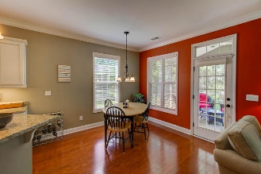
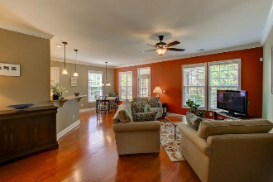
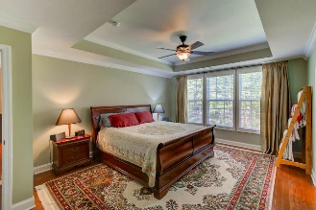
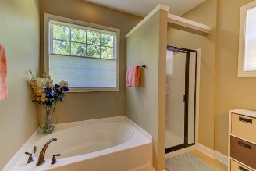
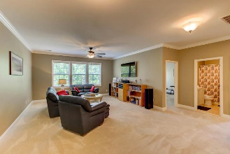
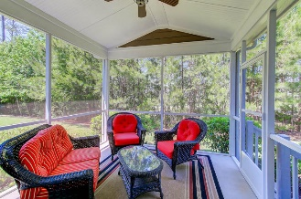
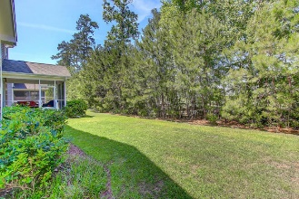


217 Silver Cypress Circle Legend Oaks Plantation ~ Summerville ~ MLS# 17032506 ~ $375,000
Recent Price Adjustment
SELLER SAYS BRING OFFER!
Jaw dropping value and price per square foot behind the Gate! Immaculate home with all the bells and whistles including a wrap around front porch! Beautiful hardwood flooring welcomes you thru out the entire first floor (including the stairs)! Take note of the 1st floor master suite w/huge walk in closet with custom shelving. The upscale kitchen with flat panel cabinets and granite ctr tops will instantly catch your attention. Stainless appliances include gas range with 5 burners and refrigerator that conveys! Access the spacious screen porch from the eat in kitchen area. Dining room w/tray ceiling is tastefully trimmed out with crown molding, wainscoting and chair rail. $2100 Credit available toward buyer's closing costs and prepaids w/use of preferred lender. Upstairs you'll find a 'to die for' space that all active family lives covet! Whether you have need for a media room or a teen gathering space - this is it! And surrounding it you'll find four spacious guestrooms w/large closets for ample storage. Two of these rooms are furnished for a fitness room and office. This home has it all - including a tankless water heater! Security system, gutters and full irrigation system in place. Termite bond transferable. Do NOT miss out on viewing this home - there can only be one lucky new homeowner!
Libby & Steve Smith
843-814-7515 | 843-819-7600 lsmith@carolinaone.com | ssmith@carolinaone.com
www.libbyandstevesmith.com
Carolina One Real Estate
628 Long Point Rd.
Mt Pleasant, SC 29464

