Slide 1

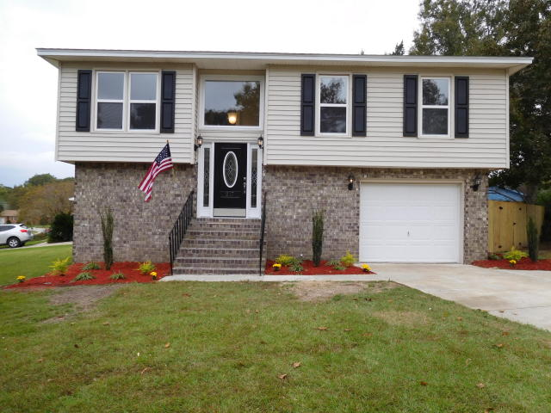
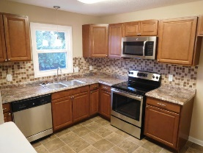
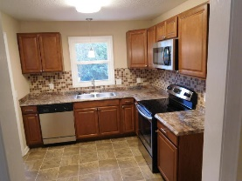
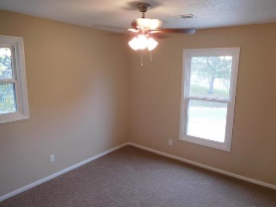
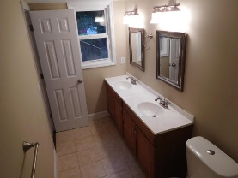
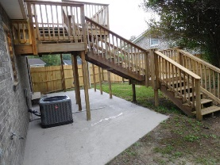
Don C Mason
(843) 364-9090
nibsc@aol.com
Better than new construction!
217 Trinity Place
College Park | Ladson, SC 29456 | MLS# 15027412 | $159,000
WOW FACTOR!!
Like new renovation. Better than new construction. New 30 yr. architectural shingled roof. New double hung vinyl windows. New A/C. Brand new kitchen with cherry cabinets, new counter tops. All new Stainless appliances . Modern Tiled backsplash. All new 6 panel doors and hardware. All new lights & ceiling fans. All new toilets, faucets, & mirrors. Brand new his & hers vanities in the master bath with ceramic tiled floors. This is 3 beds up & the master down. Master has a private door to go out to a private patio. Off of the dining room is a huge nice wooden deck for grilling & entertaining. Nice backyard with a storage building. Huge corner lot with a crosswalk to cross the street to both schools in this subdivision. Topped off with professional landscaping.
Real Estate Advocates
Palm Beach Gardens, FL 33418
www.realestateadvocates.com

