Slide 1
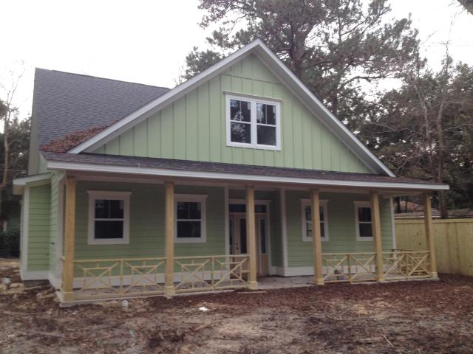

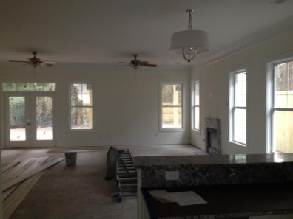
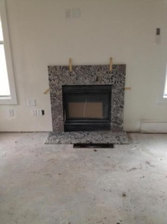
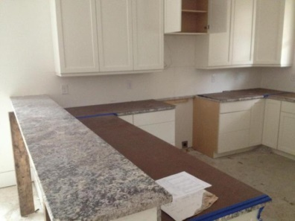
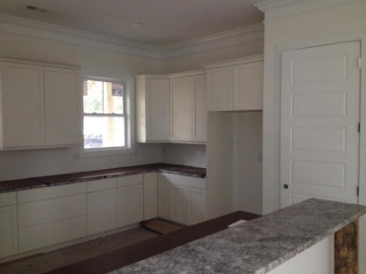
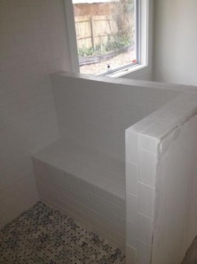
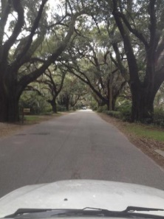



Low Country Livin' Under the Oaks!
2183 Coker Avenue
Riverland Terrace
Charleston, SC 29412
MLS# 1418521
$532,350
2,535 SF
4 Bedrooms :: 3/1 Baths
HIGHLIGHTED FEATURES:
CUSTOM cabinets with NO SLAM drawers (kitchen)
Can lighting
Hardi Plank exterior
TANKLESS water heater
Outside gas hookups for your gas grill (say goodbye to switching out tanks)
HUGE hidden STORAGE area
Powder room
Large back yard
Walk to the Neighborhood park in less than 3 minutes
Zoned for Stiles Point Elem.
Easy access to the new Harris Teeter grocery store. Drive to downtown with NO STOPLIGHTS!!!!
Great Value for NEW Construction in Stiles Point. Be sure to check the comps!
Fantastic new home offered by Riverland Terraces premier builder Port City Homes. This new home boasts over 2500 sq feet with 4 bedrooms and 3.5 baths. Hardwood floors downstairs. Large open kitchen with granite countertops. Generous master bedroom has 9ft tall ceilings and well appointed master bath with garden tub and separate tiled shower and 10x10 walk-in closet.
Oversized family room with a fireplace flows beautifully from the open kitchen to the back of the house with access to the 320 sq ft rear porch. Upstairs there are 2 mirrored bedrooms that share a full bath. The fourth bedroom can easily be used as media room.
Hardi plank exterior. 30 year architectural shingles. Tankless water heater. Free ''2-10 builder warranty'' will be provided to the buyer. There are 2 large magnolia trees and one grand Pecan tree that provide beautiful setting under the canopy.
Bring your offer soon and you can make the finishing selections. Save thousands of dollars on flood insurance!!! X flood zone...meaning flood insurance is NOT required! An added bonus is a neighborhood boat ramp on the Wappoo Cut that offers access to Charleston harbor or the Stono River.
If you are looking for a new home with all of the amenities you expect in new construction but in a beautiful established neighborhood, this is the house for you. Rendering is not exact.
Lizzie H Ray
(843) 452-9298
lizzieray1122@gmail.com
Eric Draper
(843) 442-7118
eric.draper@gmail.com
www.charlestonrealestategroup.com
Charleston Real Estate Partners. LLC | 792 Folly Rd. C1 | Charleston, SC 29412

