Slide 1
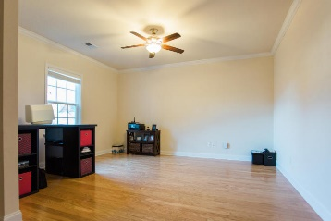
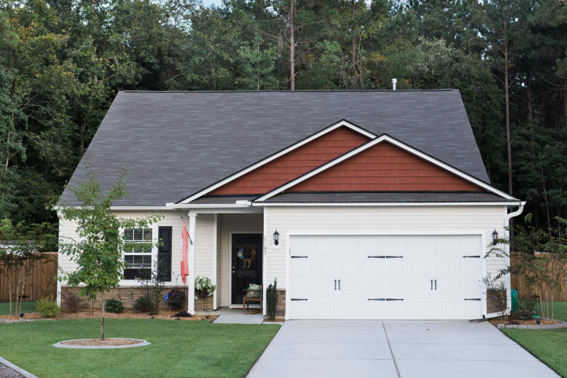
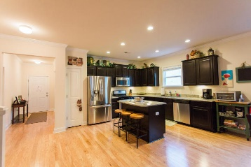
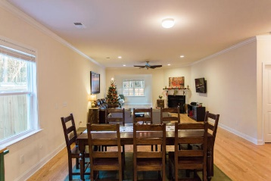
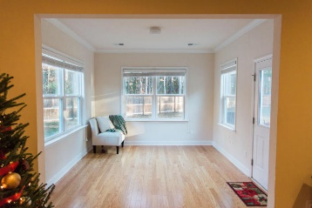
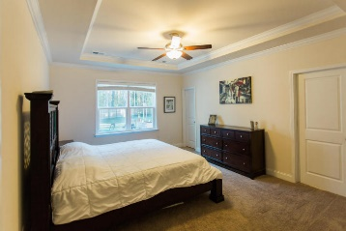
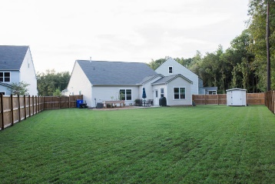
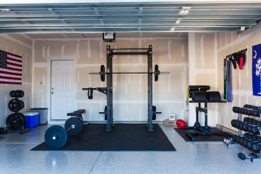


Beautiful One Story on Large Lot!
Price Reduced!
2183 Gammon Street
Carolina Bay
Charleston, SC 29414
MLS# 15030865 ~ $315,000
Beautiful one story in coveted Carolina Bay! With hardwoods in the living area, supersized lot that backs up to a 68 acre preserve that will never be developed on a private cul de sac!
Great light, open floor plan, immaculately clean. Separate study or formal dining room as you walk into a large kitchen family room with a fireplace; then walk out into the sunroom after you grab a glass of tea to drink while you are enjoying the private patio and raised garden bed. Grab some lettuce to add to that burger.
When you're tired, saunter into the master for a nice hot shower in your walk-in shower. Great separate two bedrooms with their own hall and bath so your guests, kids or grandkids will have privacy as well. Shed in the backyard, gas fireplace, HEPA air filter. Clean and serene!
Susan Woodworth Kraber
Mobile - (843) 779-9655
susankraber1@gmail.com
ERA Wilder Realty, 125-F Wappoo Creek Dr, Charleston, SC 29412

